Slide 1
Tolerance & imūnsupresīvās šūnas
Imūnpriviliģētie orgāni
Dr.biol. Zane Kalniņa
LU BF Imunoloģijas kurss maģistrantiem
24.10.2014

Slide 2
Lekcijas izklāsts – 1.daļa
Centrālās un perifērās tolerances pamatprincipi
B. Imūnsupresīvās (= regulatorās, modulējošās) šūnas
  Regulatorās T šūnas
  Regulatorās B šūnas
  Mieloīdās izcelsmes supresorās šūnas
  Cilmes šūnu imūnsupresīvās īpašības
  Tolerogēnās dendrītiskās šūnas
Notes:
Peripheral tolerance is immunological tolerance developed after T and B cells mature and enter the periphery. These include the suppression of autoreactive cells by 'regulatory' T cells (Tregs) and the generation of hyporesponsiveness (anergy) in lymphocytes which encounter antigen in the absence of the co-stimulatory signals that accompany inflammation, or in the presence of co-inhibitory signals.

Slide 3

Aktuālais jautājums…
  Kā imūnsistēma nodrošina augsta specifiskuma imūno atbildi pret lielu klāstu svešu antigēnu, neuzbrūkot sava organisma molekulām?

Slide 4

Imūnā jeb imunoloģiskā tolerance
  Imūnās sistēmas aktivācijas trūkums pret antigēnu (vielu, audiem), kas normāli spēj izraisīt imūno atbildi
  Normālā fizioloģiskā situācijā indivīdi ir toleranti pret saviem (self) antigēniem

Slide 5
Tolerances veidi
  Iedala atkarībā no vietas, kur tolerance tiek ierosināta:
  CENTRĀLĀ - tīmusā (T šūnām) vai kaulu smadzenēs (B šūnām) = dabīgā/naturālā
  !!! svarīga, lai atšķirtu savu no sveša (self/non-self)
  PERIFĒRĀ – darbojas pēc T un B šūnu nobriešanas, perifērijā = inducētā/iegūtā
  !!! nozīmīga, lai pasargātu organismu no pārmērīgas reakcijas uz dažādiem vides faktoriem (alergēniem, zarnu mikrofloras utt.)
  Mehānismi, kā šie tolerances veidi tiek ierosināti, ir atšķirīgi, bet rezultāts ir līdzīgs – imunoloģiskā atbilde nenotiek

Slide 6
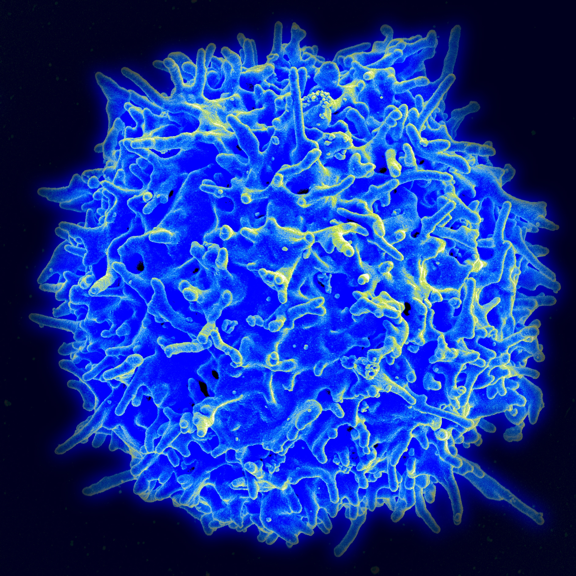
T šūnu tolerance

Slide 7
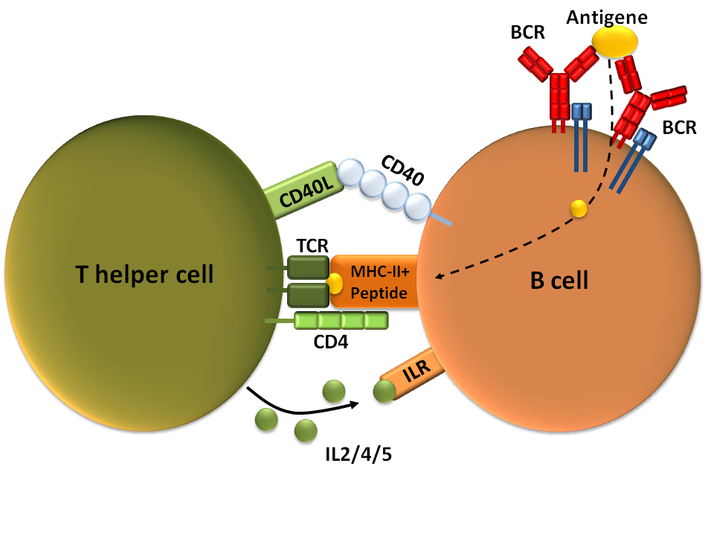
Centrālā T šūnu tolerance – kur, kad?
T šūnu tolerance sākas tīmusā, tiklīdz uz T šūnu priekšteča virsmas tiek ekspresēts TCR (DP timocītu stadijā)
!!!!
T limfocītu tolerance ir īpaši svarīga, jo tā ietekmē arī B šūnu toleranci
(NB! Tikai runājot par T-šūnu atkarīgajiem Ag)
Notes:
Neatdalāms process no T šūnu nobriešanas

Slide 8
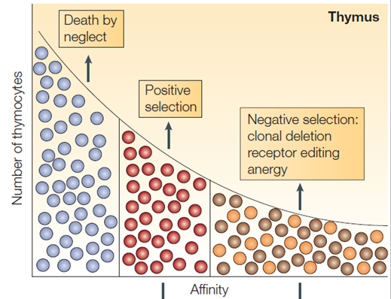
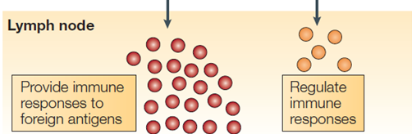

Centrālā tolerance
T šūnām ar augstu TCR:MHC-self peptīda afinitāti var būt vairāki likteņi:
A. Negatīvā selekcija:
Klonālā delēcija (lielākoties)
Receptoru editēšana (otrreizēja gēnu rekombinācija)
Anerģija (vairāk darbojas perifērajā tolerancē)
B. Klonālā diversifikācija (novirzīšana) – regulatoro T šūnu (T_{reg}) veidošanās
Affinity to self Ag-MHC complex
Naturālās T_{reg} šūnas (diferenciācija uz CD4+ CD25+ FoxP3+ fenotipu)
Notes:
The affinity of the T-cell receptor (TCR) for self-peptide–MHC ligands is the crucial parameter that drives developmental outcome in the thymus. Progenitors that have no affinity or very low affinity die by neglect. This is thought to be the fate of most thymocytes. If the TCR has a low affinity for self-peptide–MHC, then the progenitor survives and differentiates, a process that is known as positive selection. If the progenitor has a high affinity for self-peptide–MHC, then several outcomes are possible. First, the progenitor can be selected against, a process that is known as negative selection. The main mechanism of negative selection is clonal deletion, but receptor editing and anergy have also been described. Second, there seem to be mechanisms that select for high-affinity self-reactive cells and result in differentiation into a 'regulatory'-cell phenotype. It is not known what determines whether a T cell is tolerized by negative selection or is selected to become a regulatory T cell⁹. IEL, intestinal epithelial lymphocyte; NKT cell, natural killer T cell; T_{Reg} cell, CD4⁺CD25⁺ regulatory T cell.
Recognition of self antigens by immature T cells in the thymus may lead to death of the cells (negative selection, or deletion) or the development of regulatory T cells that enter peripheral tissues.
DP thymocites

Slide 9
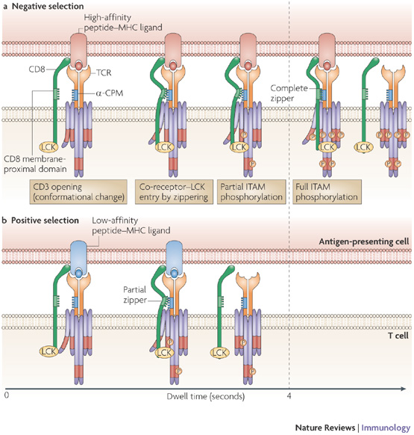
«Rāvējslēdzēja» modelis
(poz. vs neg. selekcijai)
Zemas un augstas afinitātes mijiedarbības ierosina kvalitatīvi atšķirīgas atbildes T šūnās (sigālu transdukcijā), tādējādi nosakot selekcijas virzienu
>4 s
<4 s
Notes:
a | A high-affinity peptide–MHC ligand that interacts with a T-cell receptor (TCR)–co-receptor pair with a dwell time of more than 4 seconds induces full, stable 'zippering' between the membrane-proximal domain of CD8 and the connecting peptide motif in the -chain of the TCR (-CPM). This allows stable association of LCK with the CD3 complex and results in complete phosphorylation of the CD3 immunoreceptor tyrosine-based activation motifs (ITAMs), thereby inducing negative selection. b | A low-affinity peptide–MHC ligand that interacts with a TCR–co-receptor pair with a dwell time of less than 4 seconds induces incomplete zippering and therefore allows only transient LCK association and partial CD3 ITAM phosphorylation, consequently triggering positive selection. In the absence of the -CPM or the membrane proximal region of CD8, the TCR–co-receptor zippering capacity is lost and co-receptor stabilization of the open CD3 conformation does not occur (not shown).

Slide 10
Kādēļ ar centrālo toleranci nav pietiekami?
  Ne visi antigēni, pret kuriem būtu jānodrošina T šūnu tolerance, ir ekspresēti tīmusā laikā, kad notiek TRC repertuāra atlase
  Pssst….
  Lielākā daļa antigēnu tomēr tiek ekspresēti tīmusā, un pret tiem veidojas centrālā tolerance

Slide 11
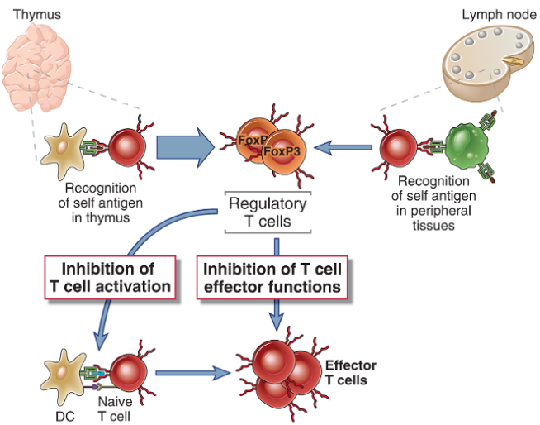
Centrālā un perifērā T šūnu tolerance
Inducētās jeb adaptīvās T_{reg} šūnas
Perifērā tolerance – imunoloģiskā tolerance, kas izveidojas pēc tam, kad T un B šūnas nobriest un nokļūst perifērijā
Abbas, Abul K., CELLULAR AND MOLECULAR IMMUNOLOGY, 7th edition, Elsvier Sounders
Notes:
During maturation in the thymus, most T cells with high avidity for self-peptide-MHC complexes are eliminated
However, because not all self-Ags are expressed in the thymus under conditions required to induce such deletion,
additional mechanisms exist to ensure T cell tolerance in the periphery, including clonal deletion, anergy, and immunoregulation.
Regulatory T cells are generated by self antigen recognition in the thymus (sometimes called natural regulatory cells) and (probably to a lesser extent) by antigen recognition in peripheral lymphoid organs (called inducible or adaptive regulatory cells). The development and survival of these regulatory T cells require IL-2 and the transcription factor FoxP3. In peripheral tissues, regulatory T cells suppress the activation and effector functions of other, self-reactive and potentially pathogenic lymphocytes.

Slide 12
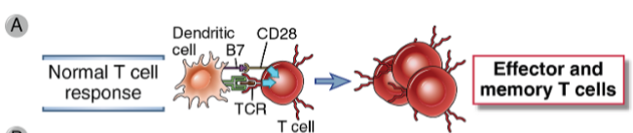
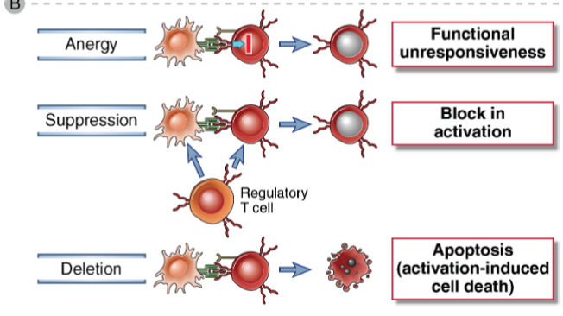
Perifērās T šūnu tolerances mehānismi
Low-dose Ag
Notes:
The signals involved in a normal immune response (A) and the three major mechanisms of peripheral T cell tolerance (B) are illustrated.
Activation of naive T cells by quiescent APCs results in tolerance through deletion and anergy.
High dose
Ag rendered the remaining cells anergic to further stimulation,
thereby sparing them from further activation and deletion. In contrast,
treatment with lower doses of Ag did not induce anergy and
the residual cells remained susceptible to further activation, which
ultimately led to their complete clonal deletion. This disparity in
susceptibility to deletion was associated with changes in the regulation
of TCR-mediated signaling molecules.

Slide 13
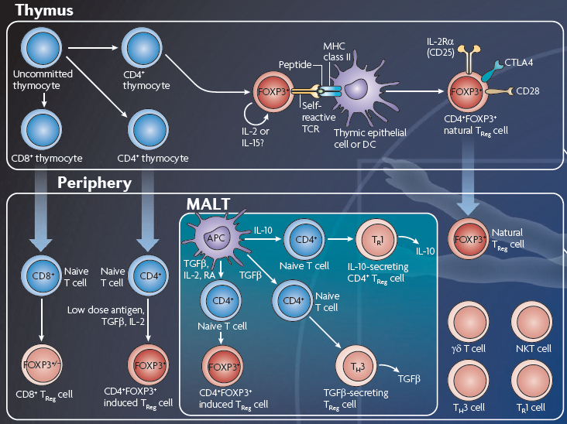
Dažādi T_{reg} šūnu subtipi un to izveide
Notes:
http://www.nature.com/nri/posters/tregcells/index.html
Abbreviations for poster entitled Regulatory T cells by Ethan Shevach and Todd Davidson
A2AR, adenosine receptor 2A; CCL, CC-chemokine ligand; CCR, CC-chemokine receptor; CTL, cytotoxic T lymphocyte;
CTLA4, cytotoxic T lymphocyte antigen 4; GARP, glycoprotein A repetitions predominant (also known as LRRC32);
GITR, glucocorticoid-induced TNF-receptor-related protein; IDO, indoleamine 2,3-dioxygenase; IEC, intestinal
epithelial cell; IRF4, interferon-regulatory factor 4; LAG3, lymphocyte activation gene 3; M cell, microfold cell; PBMC,
peripheral blood mononuclear cell; R, receptor; RA, retinoic acid; TCR; T cell receptor; TFH cell, T follicular helper cell;
TGFβ, transforming growth factor-β; TLR, Toll-like receptor; TR1 cell, inducible regulatory type 1 T cell.
Many T cell types have immune regulatory function, but the two most important TReg cell subsets express the transcription
factor FOXP3 and develop in the thymus or can be induced in peripheral sites including the mucosa-associated lymphoid
tissue (MALT). Although expression of FOXP3 is considered a useful marker for these cell subpopulations in mice, FOXP3
expression may also be induced in human T cells that lack TReg cell function. However, functional activated human FOXP3+
TReg cells express a unique pattern of cell surface markers that can facilitate their isolation. A third important type of TReg cell
secretes the immunosuppressive cytokine interleukin-10 (IL-10) and may develop from conventional CD4+ T cells by activation in
the presence of IL-10 or may develop from T helper 1 (TH1) or TH2 cell subsets. Other T cell subpopulations including natural killer T
(NKT) cells, γδ T cells and CD8+ T cells can also exert potent suppressor functions in certain settings. Although both human
and mouse CD8+ T cells can be induced to express FOXP3, a suppressive function for these cells in vivo has yet to be clarified.

Slide 14
T_{reg} šūnu funkcijas – lomas dažādos kontekstos
T_{reg} šūnas modulē daudzus dažādus fizioloģiskas un patoloģiskas imūnās atbildes reakcijas:
  Autoimunitāte
  Alerģija
  Bakteriāla infekcija
  Audzēja imunoloģija
  Orgānu transplantācija
  Grūtniecības tolerance
  Aptaukošanās
Uztur imūno homeostāzi dažādos organisma audos, modulējot imūno atbildi, lai novērstu autoimunitāti, un laikā nomāktu iekaisuma reakcijas, tādējādi novēršot potenciāli letālas, pārmērīgas imūnās atbildes pret infekcijām.
Notes:
Regulatory T cells (Tregs), either natural or induced, suppress a variety of physiological and pathological immune responses
Defects in TReg cell function may be an important factor in the development of autoimmunity or in the failure to control immunopathology, whereas overactive TReg cell function may contribute to the suppression of tumour immunity.
Function of FOXP3+ regulatory T cells
FOXP3+ TReg cells have been shown to influence the outcome of immune responses in several tissues. For example, in the
intestine TReg cells have a key role in maintaining tissue homeostasis by inhibiting the overactivation of dendritic cells (DCs) and
effector T cells. In the case of autoimmunity, such as that depicted in the central nervous system (CNS), TReg cells can have a beneficial
effect by short circuiting the inflammatory loop of T cells and antigen-presenting cells (APCs). This same general mechanism can
have negative consequences in the setting of a tumour, in which TReg cells can inhibit the antitumour immune response, thereby
preventing tumour clearance. During infection TReg cells carry out a delicate balancing act; preventing immunity would lead to the
inability to clear the pathogen, whereas unrestrained immunity would lead to unwanted immune-mediated tissue destruction.
In each of the examples shown, we focus on the role of FOXP3+ TReg cells, although interactions between multiple immune
cell types and indeed different types of regulatory T cell are also likely to be important in the regulation of immune responses.

Slide 15
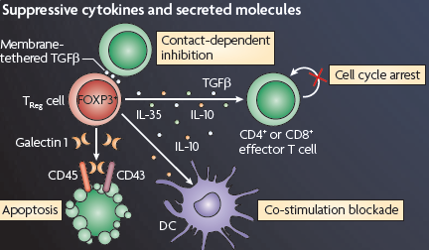
FoxP3+ Treg šūnu darbības mehānismi (1)
http://www.nature.com/nri/posters/tregcells/index.html

Slide 16
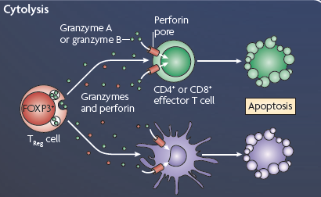
FoxP3+ Treg šūnu darbības mehānismi (2)
http://www.nature.com/nri/posters/tregcells/index.html

Slide 17
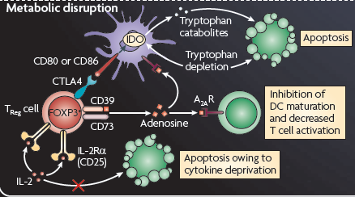
FoxP3+ Treg šūnu darbības mehānismi (3)
http://www.nature.com/nri/posters/tregcells/index.html
Notes:
Concerning modification of APC function, activated Tregs may hamper the up-regulation or down-modulate the expression of CD80 and CD86 on APCs, as well as stimulate dendritic cells (DCs) to express the enzyme indoleamine 2,3-dioxygenase (IDO) IDO catabolizes conversion of the essential amino acid tryptophan to kynurenine, which is toxic to T cells neighbouring the DCs
Following cell contact, Tregs may deliver a negative signal to responder T cells via
up-regulating intracellular cyclic AMP, which leads to inhibition of T cell proliferation and IL-2 formation;
generating pericellular adenosine catalyzed by CD39 (ectonucleoside triphosphate diphosphohydrolase 1) and CD73 (ecto-5#-nucleotidase) expressed by Tregs

Slide 18
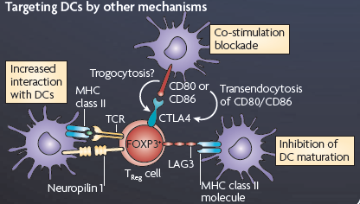
FoxP3+ Treg šūnu darbības mehānismi (4)
http://www.nature.com/nri/posters/tregcells/index.html

Slide 19
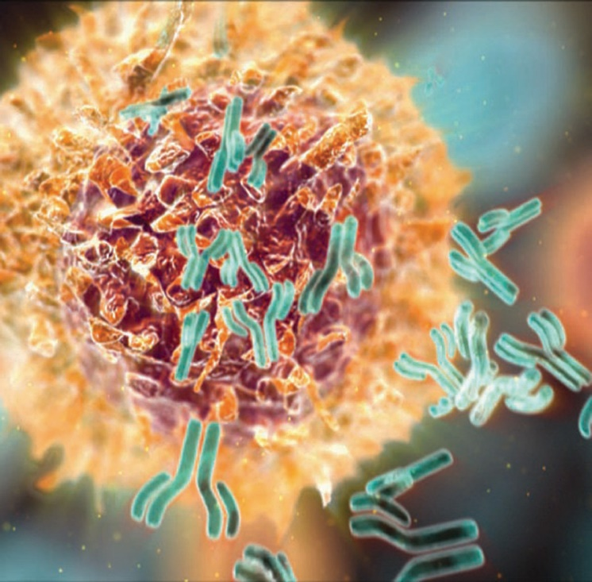
B šūnu tolerance
T šūnu tolerance
B šūnu tolerance
>

Slide 20
Kritiskais raksturlielums B šūnu tolerances veidošanās procesā:
antigēna aviditāte = afinitāte + blīvums
+
BCR aktivēšanas slieksnis
B šūnu selekcija norit daudzos B šūnu nobriešanas etapos, centrāli – kaulu smadzenēs (vai embrijam/auglim aknās), perifēri – SLO

Slide 21
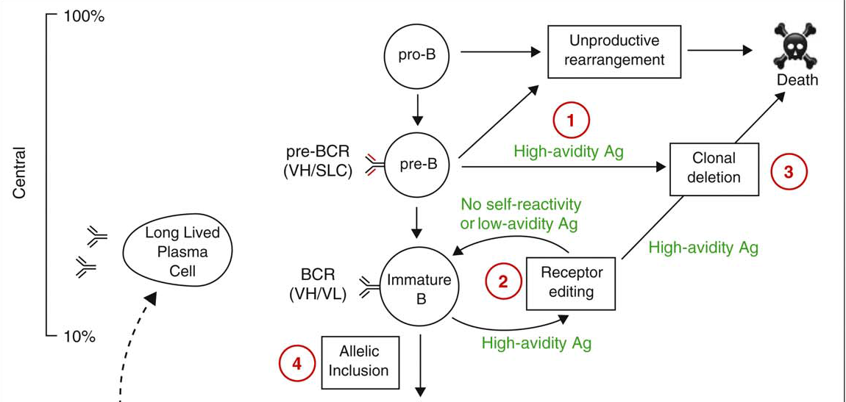
Patstāvīgais darbs
1. attēls ar paskaidrojumiem – izdales materiālos (pilnā raksta versija pieejama online)
http://www.sciencedirect.com/science/article/pii/S095279151000110X - brīvpieejas raksts

Slide 22
Regulatorās B šūnas (B_{regs} /B10 šūnas)
  Atklātas nesen, daudz mazāk pētītas
  Iesaistās imūnās atbildes nomākšanā, pateicoties imūnmodulējošu citokīnu sekrēcijai
  Daudzveidīgs fenotips, vispētītākās - IL10 sekretējošās B šūnas (B10)
  B10 šūnas funkcionāls B šūnu fenotips, jo tās sastopamas dažādu B šūnu subtipu vidū - B-1 B šūnās, marginālās zonas, tranzicionālajās un atmiņas B šūnās
  IL10 nomāc iekaisumu veicinošo citokīnu IL2, IL3, IFN-γ un TNF-α veidošanos, kā arī Th1 un DC atbildes (caur DC arī CTL atbildes)
  Agrīnāka, bet īslaicīgāka regulatorā loma kā Treg šūnām
  Pelēs anatomiski atrodamas pieaugušu indivīdu asinīs, limfmezglos un vēdera dobumā, kā arī jaundzimošo liesā
Notes:
Recently, the ability of B cells to negatively regulate cellular immune responses and inflammation has been described and the concept of regulatory B cells has emerged. A variety of cytokines produced by regulatory B cell subsets have been reported, with IL-10 being the most studied. In this review, this specific IL-10-producing subset of regulatory B cells has been labeled B10 cells to highlight that the regulatory function of these rare B cells is mediated by IL-10, and to distinguish them from other B cell subsets that regulate immune responses through different mechanisms. B10 cells are a functionally defined subset currently identified only by their competency to produce and secrete IL-10 following appropriate stimulation. Although B10 cells share surface markers with other previously defined B cell subsets, currently there is no cell surface or intracellular phenotypic marker or set of markers unique to B10 cells. The recent discovery of an effective way to expand B10 cells ex vivo opens new horizons in the potential therapeutic applications of this rare B cell subset.
B10 cells share surface markers with other
previously defi ned B cell subsets both in mice and
humans, such as marginal zone B cells, transitional
B cells, B1a B cells, and memory B cells

Slide 23
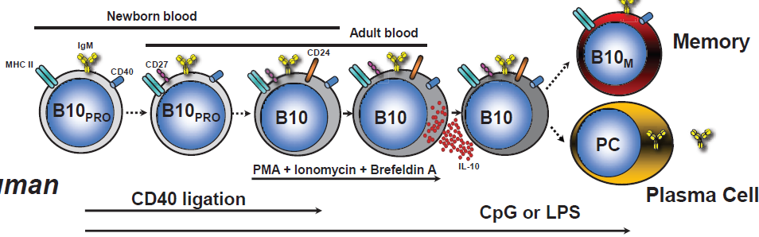
B10 šūnu lineārās diferenciācijas modelis cilvēkos
Priekšteču populācija
IL-10 ekspresijas kompetence
IL-10 ekspresija un sekrēcija
Cilvēkiem B10+B10PRO šūnas pieaugušo asinīs ekspresē CD27 un CD24
Notes:
Figure 1. Linear diff erentiation model of B10 cell development in vivo in mice and humans. B10 cells originate from a progenitor
population (B10PRO). In mice, B10PRO cells are found in the CD1d−CD5− adult blood and lymph node B cell subsets and within the CD1d−CD5+
neonatal spleen and adult peritoneal cavity B cell subsets. CD40 stimulation induces B10PRO cells to become competent for IL-10 expression,
while lipopolysaccharide (LPS) induces B10PRO cells to become competent for IL-10 expression and induces B10 cells to produce and secrete
IL-10. CD1dhiCD5+ IL-10-competent B10 cells in the adult spleen are induced to express IL-10 following stimulation with phorbol esters (phorbol-12-myristate-13-acetate (PMA)) and ionomycin or LPS plus PMA and ionomycin for 5 hours. Following a transient period of IL-10 expression, a small subset of B10 cells can diff erentiate into antibody-secreting plasma cells (PC). B10 cells also possibly diff erentiate into memory B10 cells (B10M). B10 cell development in humans appears to follow the diff erentiation scheme observed in mice. B10 cells and B10PRO cells have been identifi ed in human newborn and adult blood. B10+B10PRO cells in adult human blood express CD27 and CD24. Whether human B10 cells further differentiate into PCs or B10M remains to be determined. Solid arrows, known associations; dashed arrows, speculated associations. MHC-II, major histocompatibility complex class II.
Human B10 cell development
B10PRO cells and B10 cells have been recently identifi ed in
humans [48] and their responses to LPS, CpG and CD40
ligation appear to follow the general scheme of mouse
B10 cell development (Figure 1). One notable diff erence
in mouse versus human B10 cell development is the lack
of response of mouse B10PRO cells to CpG compared with
their human counterparts. Human B10PRO cells can be
driven to develop ex vivo into B10 cells with LPS or CpG
stimulation, or CD40 ligation. Interestingly, BCR ligation
augmented human B cell IL-10 responses to CpG in one
study [49]. Th is fi nding is in discordance with our fi ndings
in both humans [48] and mice [37], where BCRgenerated
signals inhibit the abilities of LPS or CpG and
CD40 ligation to induce cytoplasmic IL-10 production.
Whether human B10 cells develop into antibodysecreting
cells or enter the memory pool (memory B10
cells, B10M) remains to be determined.

Slide 24
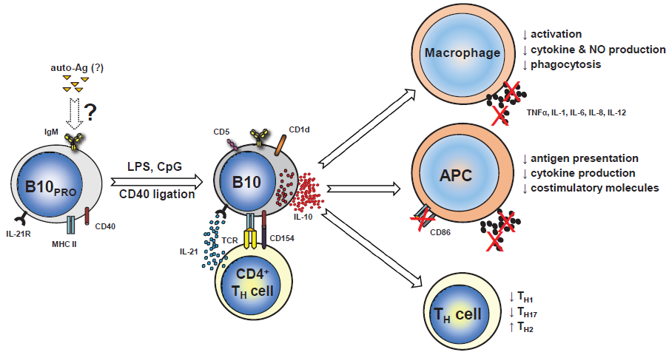
B10 regulatorie efekti (AI slimības modelis)
TLR ligandi
Ag-specifiskā nomākšana
Notes:
Figure 2. B10 cell regulatory eff ects in autoimmune disease. In this model, unidentifi ed autoantigens (auto-Ags) drive early development of
B10PRO cells. Following exposure to CD40 ligation and/or Toll-like receptor (TLR) ligands (lipopolysaccharide (LPS), CpG), B10PRO cells mature into B10
cells that can actively secrete IL-10 and regulate both innate and adaptive immune responses. IL-21R signaling along with major histocompatibility
complex class II (MHC-II) and CD40 cognate interactions with CD4+ T cells, although not needed for B10 cell development, are necessary for B10 cell
eff ector functions and result in antigen-specifi c responses. B10 cells regulate macrophage function by decreasing their activation, phagocytosis and
cytokine and nitric oxide (NO) production. In antigen-presenting cells (APCs), B10-cell-negative regulation of antigen presentation, expression of
co-stimulatory molecules (such as CD86) and proinfl ammatory cytokine production limits T cell activation. In CD4+ T helper (TH) cells, B10 cells skew
responses towards a TH2 phenotype and away from TH1 and TH17 responses. The negative regulatory eff ects of B10 cells thereby limit infl ammatory
responses and subsequent tissue damage. Arrows with solid outline, known associations; arrows with dashed outline, speculated associations.

Slide 25
Citas imūnsupresīvās šūnas
Mieloīdās izcelsmes supresorās šūnas
MDSC – myeloid-derived suppressor cells

Slide 26
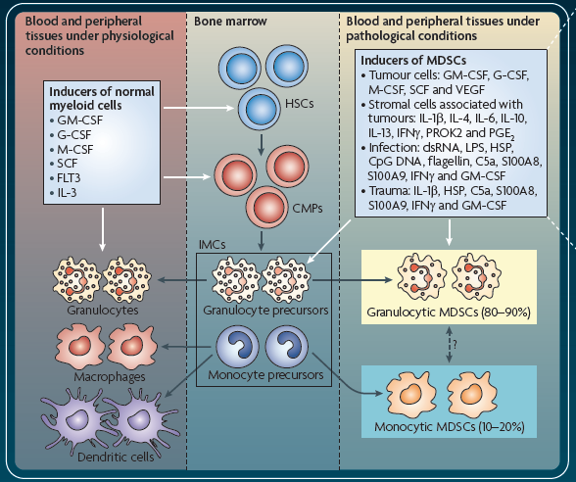
MDSC veidošanās un akumulācija
www.nature.com/nri/posters/mdscs
Notes:
www.nature.com/nri/posters/mdscs
Generation and accumulation
MDSCs are an intrinsic part of the myeloid cell lineage and are a heterogeneous population comprised of myeloid cell progenitors and precursors of granulocytes, macrophages and dendritic cells.
In healthy individuals, IMCs generated in the bone marrow differentiate into mature granulocytes, macrophages or dendritic cells.
Various cytokines and soluble factors released during pathological conditions, such as cancer, infection, trauma and autoimmunity (and after bone marrow transplantation), cause the proliferation of IMCs and a partial block of their differentiation. This results in the accumulation of MDSCs, which then migrate to secondary lymphoid organs and tissues (such as the tumour site), where they exert their effects on other cell populations.

Slide 27
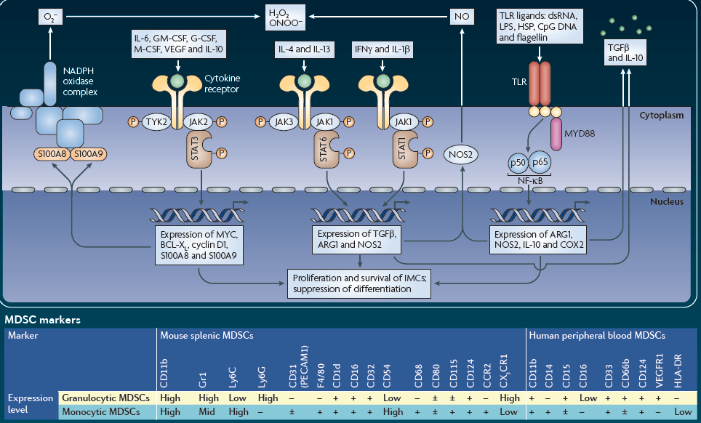
MDSC aktivēšana un proliferācija
www.nature.com/nri/posters/mdscs
Notes:
www.nature.com/nri/posters/mdscs
The proliferation of MDSCs is associated with activation of these cells in a pathological context. Activation is mediated through
several transcription factors and results in the upregulation of expression of immunosuppressive factors, such as ARG1 and NOS2,
upregulation of activity of the NADPH oxidase complex and an increase in the production of NO, ROS, RNS (reactive nitrogen species) and cytokines.

Slide 28
MDSC supresijas mehānismi
  Antigēnu nespecifiski
  Daudzas no MDSC sekretētajām molekulām ietekmē iekššūnas signālceļus, kas nosaka T šūnu proliferāciju pēc antigēna stimulācijas
  MDSC nereti tiek asociētas ar Treg šūnu populācijas ekspansiju
  Sekundārajos limfoīdajos orgānos MDSC var iesaistīties antigēnu prezentēšanā T šūnām, vienlaicīgi nododot tām supresīvus signālus
  Audzēju mikrovidē bieži ir signāli, kas konstitutīvi aktivē imunosupresīvo programmu MDSC, kas ietekmē blakusesošās T šūnas antigēna-nespecifiskā veidā
Notes:
www.nature.com/nri/posters/mdscs
T cell suppression
MDSCs can suppress T cell effector functions in various ways. Several factors can modulate the expression levels of ARG, NADPH oxidase and NOS in MDSC subsets, with the final effect on the microenvironment including depletion of l-arginine, release of RNS and ROS (with ONOO–and H2O2 being the most prevalent molecules, respectively) or unopposed production of high NO levels. Moreover, l-cysteine can be sequestered by MDSCs. All of these molecules influence the intracellular signalling pathways that control T cell
proliferation after antigen stimulation. MDSC-mediated immune suppression can also be associated with the expansion of TReg cell populations. In secondary lymphoid organs, MDSC-mediated suppression requires the direct presentation of antigens by MDSCs to T cells. The activity of MDSCs can also be enhanced by activated T cells in this way. At tumour sites, microenvironmental signals support constitutive activation of the immunosuppressive programme in MDSCs, which affects nearby T cells in an antigen-nonspecific manner.

Slide 29
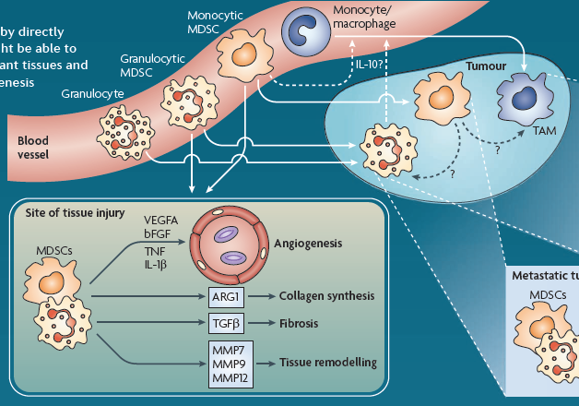
MDSC kanceroģenēzē un audu bojājumu vietās
Audzēju mikrovidē MDSC veicina angioģenēzi un limfangioģenēzi, kā arī diferencējas par TAM (tumoru asociētajiem makrofāgiem), kam līdzīgas funkcijas. Iespējams, piedalās arī pre-metastātiskās nišas sagatavošanā. Sekretētās MMP veicina invāziju.
www.nature.com/nri/posters/mdscs
Notes:
www.nature.com/nri/posters/mdscs
Tumorigenesis and tissue repair
MDSCs in the tumour environment produce factors that support tumour growth by directly
promoting tumour angiogenesis and lymphangiogenesis. In addition, MDSCs might be able to
differentiate into TAMs that have similar activity. MDSCs can also migrate to distant tissues and
participate in the formation of a pre-metastatic niche by promoting local angiogenesis
and the survival of arriving tumour cells. MMPs produced by MDSCs can
support tumour cell invasion. By similar mechanisms, MDSCs can migrate to a
site of tissue injury and participate in tissue remodelling and angiogenesis.

Slide 30
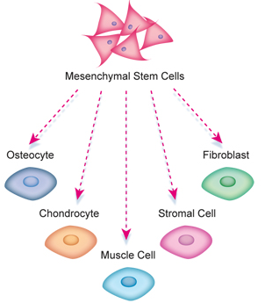
Mezenhimālās cilmes šūnas
(mezenhimālās stromālās šūnas)
Citas imūnsupresīvās šūnas
  Multipotentas - priekšteči mezodermālajiem šūnu tipiem (piem., adipocīti, osteoblasti, hondrocīti)

Slide 31
Mezenhimālās cilmes šūnas (MCŠ)
  Ne-hematopoētiskas izcelsmes
  Izolētas no daudziem pieauguša organisma audiem; īpaši daudz kaulu smadzenēs un taukaudos
  Piemīt imūnmodulatoras īpašības – spēj inducēt un regulēt toleranci perifērijā (naturālā tolerance) bez citu imūnšūnu palīdzības un antigēn-nespecifiskā veidā
  MCŠ imūnmodulatorās iedarbības ierosināšanai nepieciešama to iepriekšēja aktivēšana ar imūnšūnu sekretēto IFN-γ (vienu pašu vai kombinācijā ar TNF-α, IL-1α vai IL-1β)

Slide 32
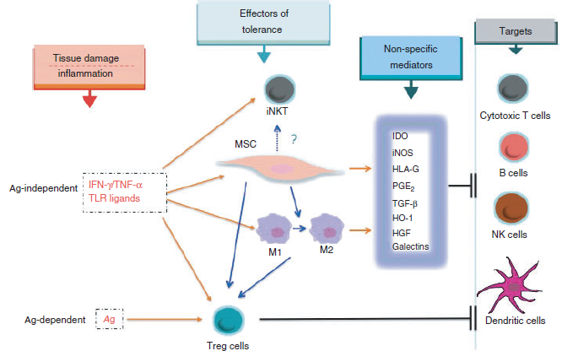
MCŠ un imūnšūnu savstarpējā mijiedarbība
Notes:
Mesenchymal stromal cells (MSC) are effectors and regulators of innate tolerance. In the presence of inflammatory stimuli MSC are
‘licensed’ to acquire non-specific immunosuppressive properties that are mediated by a number of partly redundant soluble molecules. MSC also
facilitate the recruitment of other immunoregulatory networks that are similarly activated following acute inflammation, amongst these monocytes/
macrophages with an anti-inflammatory profile (M2) as well as regulatory T (Treg) cells. The composition of the inflammatory milieu is
also fundamental to skew natural killer T (NKT) cells towards an immmunostimulating or anti-inflammatory phenotype. In contrast to NKT
cells, MSC and M1-2 cells, Treg cells require the initial activation through the antigen receptor. Ag, antigen; HGF, hepatocyte growth factor;
HO-1, haem-oxygenase 1; IDO, indoleamine 2-3-dioxygenase; IFN-c, interferon-c; iNKT, invariant NK T cells; iNOS, inducible nitric oxide synthase;
PGE2, prostaglandin E2; TGF-b, transforming growth factor-b; TLR, Toll-like receptor; TNF-a, tumour necrosis factor-a.

Slide 33


Slide 34
Lekcijas izklāsts – 2.daļa
Imūnpriviliģētie audi, to bioloģiskā nozīme IESKATS
  Acis
  Sēklinieki
  Placenta un auglis
  Centrālā nervu sistēma (imūnprivliģēta vai tomēr nē?)

Slide 35
Imūnpriviliģētie audi
Spējīgi tolerēt introducētus antigēnus, neveidojot pret tiem iekaisuma reakciju
Evolucionāra adaptācija, kas izveidojusies, lai pasargātu vitāli svarīgās organisma struktūras no potenciāli postošām imūnās sistēmas iedarbības sekām – orgānu disfunkcijas un reproduktīvās sterilitātes
Peter Medawar 1940-jos aprakstīja novērojumu – pret audiem, kas transplantēti eksperimentālo dzīvnieku smadzenēs un acs priekšējā sienā, neveidojas imūnā atbilde
Mehānismi, kas nodrošina imūno privilēģiju, ir atšķirīgi dažādos audos, un šobrīd vēl nav līdz galam izprasti

Slide 36
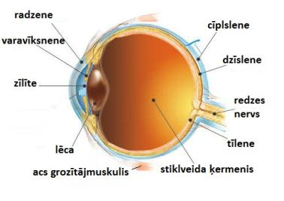
Acs - redze ir izšķiroša zīdītāju izdzīvošanai
Imūno toleranci nodrošinošās acs anatomiskās īpatnības:
Acs-asins barjera
Vaskulatūras
neesamība
radzenē
Limfātiskās sistēmas
neesamība acs
priekšējā kambarī
Redze var tikt ļoti viegli traucēta, ja acī rodas iekaisums (=>saduļķošanās)
Notes:
Anatomiskās īpatnības ierobežo adaptīvās imūnsistēmas šūnu piekļuvi acij

Slide 37
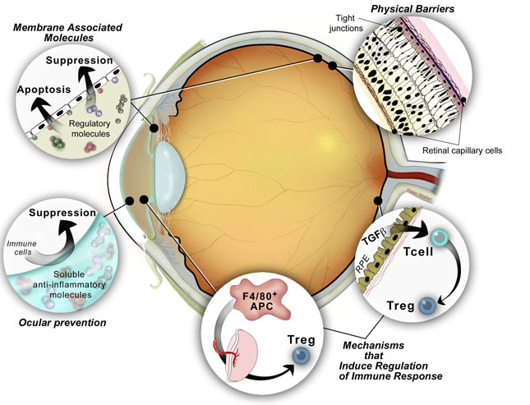
Acs imūnā tolerance
Konstitutīvi ekspresē Fas ligandu, PD-L1
Acs-asins barjera
αMSH, vazointestinālais peptīds, sopmatostatīns, TGF-β, IDO
Priekšējā kambara-asociētā imūnā izvairīšanās
Notes:
RPE – retinal pigment epithelium cells
Copyright © 2011 Streilein Foundation for Ocular Immunology
It is well known that immunology is basis for both health and disease in the eye. The immune response leads to protection of the eye, but when uncontrolled, the immune response may lead to immune inflammatory disease of the eye. The eye was originally thought to be a protuberance of the brain, but we now know that the eye is a unique organ designed for receipt of images with attributes of both the brain, and the peripheral immunology. Interestingly, studies of the eye are of interest to researchers who study mucosal immunity even though the ocular surface of the conjunctiva is the only part that is covered by mucosal surface. This interest has paid off since we now know that mechanisms of immune regulation found in the eye are shared by the gut. The study of ocular immune regulation may be a model for understanding immune regulation through out the body. So what is unique about ocular immunology? While all organs develop local mechanisms to protect against unregulated immune responses, the eye and other immune privileged sites have developed these mechanisms to their greatest degree. The eye, brain, testes, reproductive tract and the hair follicle all are able to be protected from infection or danger with immune responses that do not cause inflammation. It is well know that the symptoms of inflammation are redness, swelling and pain. If this were to occur in the eye the light path from the pupil to the retina (where images are perceived and sent to the brain) would be blocked resulting in lack of vision. Thus it is important to preserve this path. The eye is considered immune privilege because it does not develop the types of immune reactions that would cause bilateral damage to the organ.
The mechanisms that contribute to ocular immune privilege are multiple and overlapping. 1) Molecules that are normally expressed on the surfaces of cells for the purpose of activating immune responses are absent or down regulated. 2) The cells around the eye are tightly connected so that cells from the periphery (blood) have a difficult time entering the eye. 3) Since no barrier is perfect, if immune cells that could cause inflammation enter the eye, the cells lining the borders of the eye are able to modify their behavior by either inducing their cell death (apoptosis) or by modifying their function toward regulation of the immune response. 4) Soluble factors in the ocular environment are largely immunosuppressive. 5) The myeloid cells that carry antigens to the central lymphoid system (lymph nodes, spleen) are biased to inducing regulation of the immune response rather than immune responses. Since counter forces (trauma, infection, genetics) can offset the regulatory mechanisms in the eye, immune inflammation does occur on occasion and the consequences are synonymous with immune inflammatory diseases of the eye. In many cases the immune privileged regulatory mechanisms will be restored. In those cases where they are not restored, immunological therapy is being developed to assist the return of healthy ocular immune responses and immune privilege in the eye.

Slide 38
Simpātiskā oftalmija
Acs antigēni imūnajai sistēmai ir sveši - organismā nav tolerances pret tiem
Acs traumas gadījumā tie var kļūt redzami imūnsistēmai, atsevišķos gadījumos izveidojas simpātiskā oftalmija – autoimūna saslimšana, kad imūnsistēma vēršas pret ievainoto un veselo aci -t.s. bilaterālais difūzais granulomatozais uveīts
Reta saslimšana, veidojas 0.2% -0.5% neķirurģisku acs traumu gadījumos, un mazāk kā 0.01% acs ķirurģisku manipulāciju gadījumā

Slide 39
Sēklinieki
Daudzi sēklinieku antigēnu pirmo reizi tiek ekspresēti pubertātē –laikā, kad aktīvi sāk veidoties sēklinieki, un kad kompetentā imūnsistēma jau ir izveidojusies, un potenciāli satur sēklinieku antigēnu kompetentas B un T šūnas
Mehānismi:
Sēkliniekos, līdzīgi kā acīs un smadzenēs, ir sēklinieku-asins barjera ar specializētiem ciešiem starpšūnu kontaktiem endotēlijā
Androgēniem bagātā sēklinieku mikrovide iedarbojas nomācoši uz sēkliniekos rezidējošajiem makrofāgiem
Lokāla imūnsupresīva iedarbība ir TGF-β, ko konstitutīvi sekretē sēkliniekos esošās Leidiga, Sertoli un peritubulārās šūnas

Slide 40
Imūnsistēmas šūnas sēkliniekos
T šūnas sēkliniekos sastāda ~ 10-20% no imūnšūnām, starp tiem ir CTL (CD8+) un Th (CD4+); ir atrodamas arī NKT un NK šūnas
B šūnas normāli nav atrodamas sēkliniekos, pat iekaisuma reakcijas gadījumā
Makrofāgi ir lielākā imūnšūnu populācija sēkliniekos, spēj atbildēt uz infekcijas stimuliem un aktivēties (sekretē TNF-α un IL-1β). Sekretē savienojumus, ko Leidiga šūnas izmanto testosterona produkcijai. Nepieciešamas normālai Leidiga šūnu attīstībai un funkcijām.
Tuklās šūnas atrodamas mazā skaitā, kur tās regulē testosterona veidošanos
Neitrofili normāli audos nav atrodami, bet var tajos iekļūt iekaisuma stimulu ietekmē, kā arī pēc hormonu terapijas, un tad var veicināt audu bojājumu
Dendrītiskās šūnas relatīvi maz, neskaidra loma, iespējams veicina autoimūnu iekaisumu sēkliniekos
Eozinofilu ļoti maz

Slide 41
Placenta un auglis
Auglis un placenta - allogēns (dabīgs semi-allografts) mātes organismam
Grūtniecība imunoloģiski ir ļoti sarežģīts process, kurā mātes organismam jānodrošina aizsardzība sev un auglim no infekcijām, vienlaikus saglabājot toleranci pret augli un placentu
Pētījumi apstiprina trīs pamatprincipus:
Aizsardzību auglim no mātes imūnsistēmas nodrošina vairāki atšķirīgi mehānismi
Abi – gan māte, gan auglis – piedalās grūtniecības saglabāša-nā, panākot imūnpriviliģētu vidi
Augļa faktori ir tie, kas ierosina un vada mātes imūno atbildi
Notes:
Multiple mechanisms underlie the surprising
willingness of mothers to tolerate genetically
different fetal tissues during pregnancy. Chief among
these is the choice of HLA-G, a gene with few alleles,
rather than the highly polymorphic HLA-A and -B genes,
for expression by the placental cells that interface
directly with maternal blood and tissues.

Slide 42
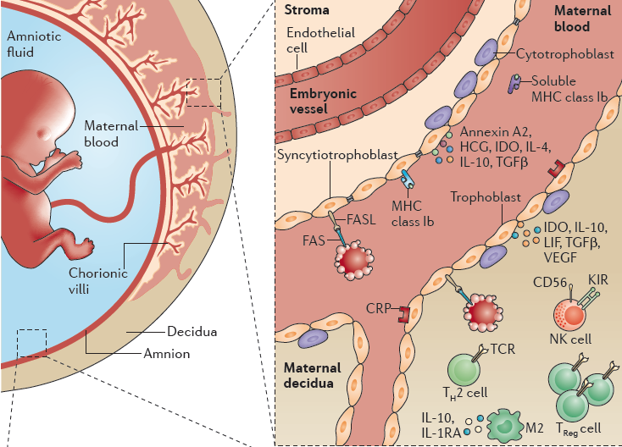
Notes:
unlike the CNS and the eye, the maternal vasculature does not penetrate the fetal parenchyma, and the placenta, which is located exterior to the fetal parenchyma, serves as the basic maternal–fetal interface. The mammalian placenta consists of fetus-derived chorionic villi bathed in maternal blood supplied by spiral arteries in the decidua. The chorionic villi contain branched embryonic blood vessels embedded in stroma ensheathed by the syncytiotrophoblast, which is a tightly interconnected epithelioid surface layer, a fusion product of cytotrophoblast progenitors81,82. An additional maternal–fetal interface is the amniotic sac, which is composed of an inner single epithelial layer joined by tight junctions and secretes the amniotic fluid. Thus, this interface is solely equipped with what we have termed an epithelial gate.
The decidua–trophoblast interface. Multiple immune-modulating mechanisms operate at the decidua–trophoblast interface (reviewed in REFS 81,82). The human decidua is populated by non-cytotoxic maternal uterine NK cells, which express killer-cell immunoglobulin-like receptors (KIRs) for non-classical MHC class I molecules expressed by trophoblasts, which are part of the barrier. At the decidua–trophoblast interface, decidual lymphocytes are biased towards a TH2‑type phenotype, existing TH1 cells are low producers of IFNγ, there are no TH17 cells, and increased proportions of CD4+ and CD8+ TReg cells are seen at this site compared with other tissues. The decidua also contains IL‑10- and IL‑1RA‑expressing M2 macrophages and an array of immunomodulatory factors such as IDO, FASL and leukaemia inhibitory factor (LIF; which induces TH2 cell polarization)81,82.
Embryo-derived epithelial-like trophoblasts, which separate maternal and fetal circulation, have an active role in immune-skewing. These cells do not express conventional MHC class Ia molecules, thereby avoiding CD8+ T cell cytotoxic attack, but they do express membrane-bound and soluble non-classical MHC class Ib molecules (such as HLA‑G and HLA‑E in humans, and Qa‑2 in mice83), which downmodulate NK and CD8+ T cell responses84,85, promote a TH2‑type phenotype86 and induce tolerogenic dendritic cells that are associated with TReg cell generation87,88. Trophoblasts also express IDO, FASL and the glycoprotein annexin A2, which inhibits lymphocyte proliferation and antibody secretion81,82. They secrete complement regulatory proteins, TH2‑promoting cytokines such as IL‑4 and IL‑10 (REFS 89,90), and the hormone human chorionic gonadotropin, which is a chemoattractant for TReg cells91. The decidua–trophoblast interface is characterized by progesterone secretion92 and a TH2‑type bias93, as well as the production of soluble FASL94,95, IL‑10 and TGFβ81,82. The trophoblast cells circumvent antibody-mediated damage by expressing high levels of complement regulatory proteins96 and reduce cell-mediated immunity by expressing inhibitory members of the B7 family97. Together, these features suggest an immune-skewing nature for this gate, which suppresses certain effector arms of the immune system — including M1 macrophages, CTLs and TH1 cells — and activates alternative effector functions in the form of M2 and TH2‑type, regulatory and pro-resolving responses
AFP, α‑fetoprotein; CRP, complement regulatory protein; FASL, FAS antigen ligand; HCG, human chorionic gonadotropin; IDO, indoleamine‑2,3‑dioxygenase; IL, interleukin; IL‑1RA, IL‑1 receptor antagonist; KIR, killer-cell immunoglobulin-like receptor; LIF, leukaemia inhibitory factor; M2, alternatively activated macrophage; NK, natural killer; TCR, T cell receptor; TGFβ, transforming growth factor-β; TH, T helper; TReg, regulatory T; VEGF, vascular endothelial growth factor.

Slide 43
Centrālā nervu sistēma
Anatomiskās īpatnības smadzenēs – nav tradicionālās limfātiskās sistēmas, un ir maz dendrītisko šūnu
Asins-smadzeņu barjera: ciešie kontakti starp CNS asinsvadu endotēlija šūnām un to zemā mikropinocitozes spēja mehāniski neļauj iekļūt imūnšūnām, antivielām un imūnmediatoriem (arī farmakoloģiski priviliģēta vieta)
Neiropeptīdiem piemīt imūnsupresīvas īpašības
Smadzenēs bagātīgi rezidē makrofāgi (mikroglija), kas tiek aktivēti, ja smadzenēs notiek audu bojājums vai infekcija, tomēr to aktivācijai nepieciešami spēcīgāki signāli, un tie nav spējīgi šo iekaisumu efektīvi uzturēt
Zemu ekspresētas MHC molekulas
BET!!! Iekaisuma un slimību gadījumā tiek nodrošināta limfocītu iekļuve smadzenēs, lokālās un perifērās imūnsistēmas aktīva mijiedarbība. Imūnā atbilde uz CNS antigēniem ir virzīta uz B šūnu atbildi.

Slide 44
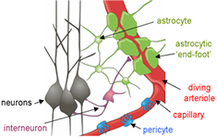
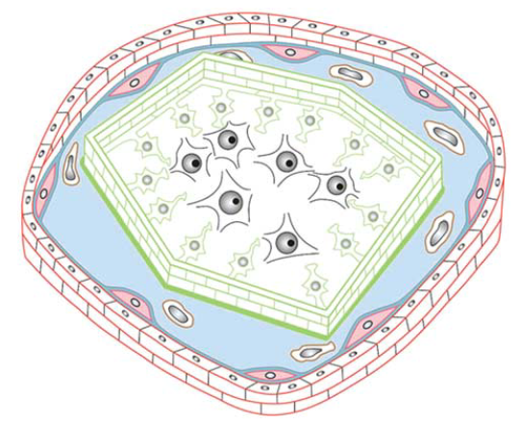
Neirovaskulārā vienība
Cerebrospinālais šķidrums
Endotēlijs
Perivaskulārie makrofāgi
Mikroglija/astrocīti
Neironi
Notes:
Immunosurveillance is restricted to the castle moat, where
perivascular macrophages (brown cells) serve as guards that
continuously collect information from within the castle, and present
this information to the messengers, the immunosurveilling T cells
that can cross the outer wall. If in their communication with the
castle moat guards, T cells recognize their antigen they will get
activated, clonally expand and open gates in the outer castle wall
allowing the entry of more immune cells from the periphery. Within
the castle moat, the immune cells then mount an invasion of the
castle, breaching the inner castle wall and entering the castle with
the aim to eliminate any intruders. If for reasons unknown, T cells
turn their attack to the inhabitants of the castle; chronic immune cell
invasion of the castle will eventually kill many of the castle
inhabitants leading to neuronal deficits as observed in chronic
neuroinflammatory diseases of the CNS.

Slide 45
Izmantotie avoti & tālāk lasīšanai
Tolerance & Imūnsupresorās šūnas
Abbas, Abul K., CELLULAR AND MOLECULAR IMMUNOLOGY, 7th edition, Elsvier Sounders
PMID: 22661634
PMID: 20829011
http://www.nature.com/nri/posters/tregcells/index.html
www.nature.com/nri/posters/mdscs
PMID: 19737784
PMID: 23566714
PMID: 22804624
Imūnprivileģētie audi
http://www.streilein-foundation.org/ocular_immunology.html
PMID: 20948803
PMID: 23435332
PMID: 23072749

