Slide 1
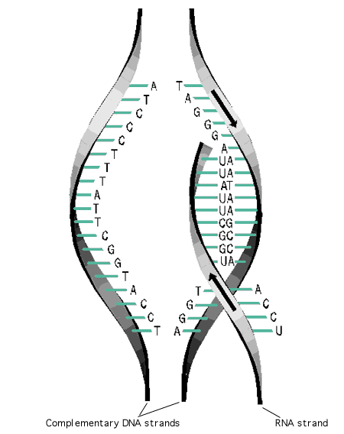
Transcription

Slide 2
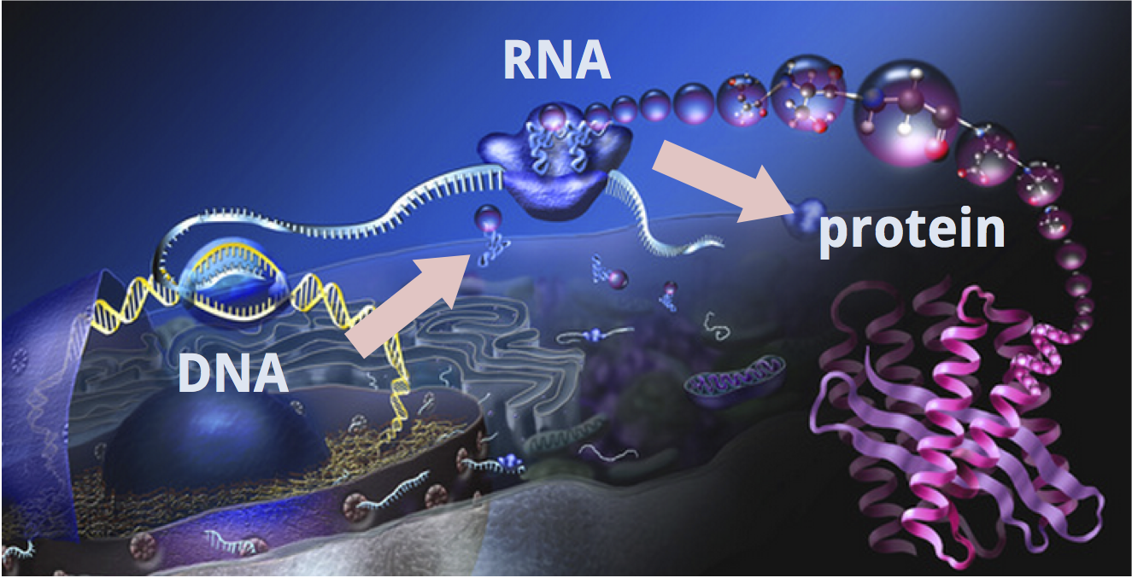
Central dogma of life.
The central dogma describes the flow of genetic information from DNA to RNA to protein.
translation
transcription
Transcription is the first part of the central dogma of molecular biology.

Slide 3
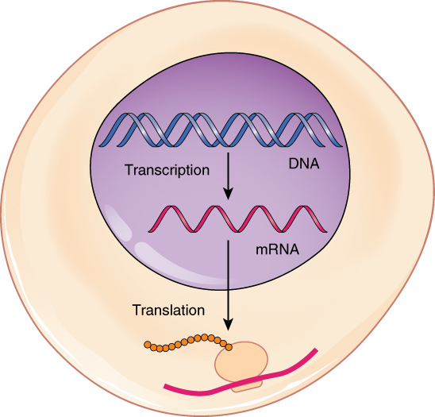
Transcription
In eukaryote, DNA never leaves the nucleus,
so its information (instructions)
must be copied.
In transcription genetic instructions
about how to make proteins
is transferred from
DNA to messenger RNA (mRNA).

Slide 4
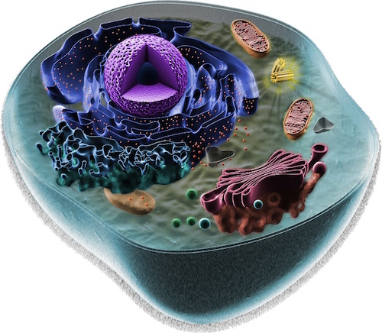
In animal cells, DNA is found in the nucleus and the mitohondria.
The mitochondria have
a very small fraction of total
cellular DNA
a very limited number of genes
The vast majority of the DNA of a cell is located in the hromosomes
of the nucleus.

Slide 5
Gene is a unit of DNA that contains the information to specify synthesis of a single polypeptide chain or
functional RNA.
A transcription unit is a linear sequence of DNA that extends
from transcription start site to a transcription stop site.

Slide 6
Four – base language of DNA
A
G
T
C
transcribed
Four – base language of RNA
A
G
U
C
20- amino acid language of proteins
translated

Slide 7
However, the great majority of the cellular DNA is never transcribed
in any cell.
The fraction of coding DNA in the genome is rather small, because
of the noncoding nature of much of the sequence within genes.
Considerable fraction of the genome contains repeated sequences which are nonfunctional and are not transcribed into RNA. Defective copies of functional genes- pseudogenes and gene fragments.
Different cells transcribe different segments of the DNA-
transcriptional units which are discrete units, spaced irregularly
along the DNA sequence.

Slide 8
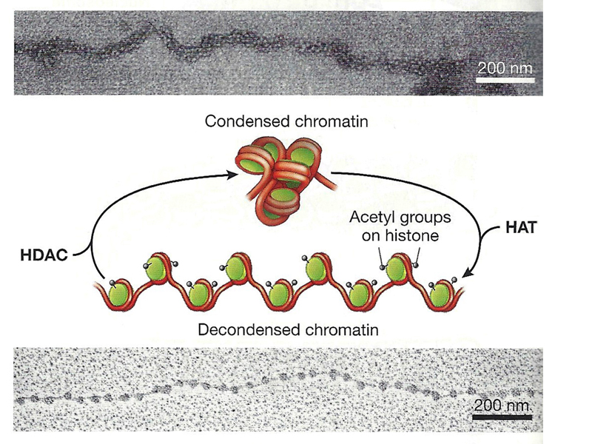
Histone modification and chromatin remodeling
Transcriptionally inactive DNA is organized in a condensed chromatin structure with a tight association between the core histones and the DNA.
The dense packing of nucleosomes can deny access to DNA interacting proteins.
Histone modification and chromatin
remodeling can reversibly change local
chromatin structure from a condensed to
a more accessible conformation.

Slide 9
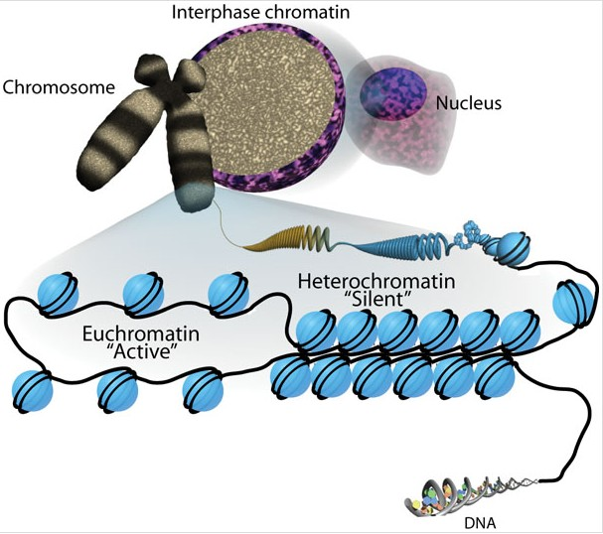
Euchromatin and heterochromatin
Chromatin has been described as existing in
two distinct ﬂavors:
euchromatin (dispersed and
not readily stainable ) and
heterochromatin (small, darkly staining).
Euchromatin is relatively accessible and associated with actively transcribed genes and active histone modiﬁcations.
Heterochromatin is condensed,
transcriptionally inactive, and
associated with repressive
histone modiﬁcations.

Slide 10
Histone
Histone tails comprise 25- 30% of histones mass.
Histone tails are rich in Lys (K), Ser (S) and Arg (R) which are subject to modifications.
Lys (K): acetylation, methylation and ubiquitination
Ser (S): phosphorylation
Arg (R): methylation

Slide 11
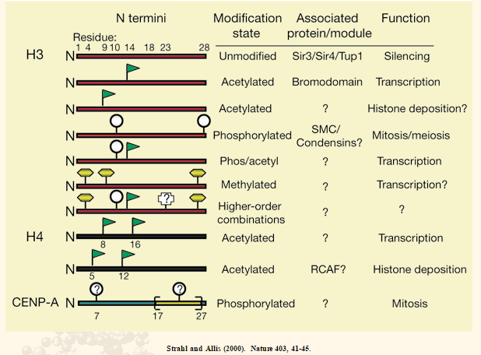
Histone code
The overall resulting pattern of histone
residue modifications in specific
regions of a chromatin form a histone
code which dictates a particular
biological outcome.

Slide 12
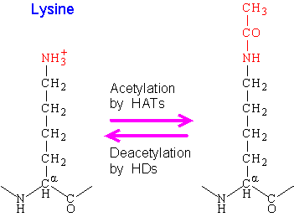
Histone acetylation
Various histone acetyltransferases (HATs) are known to catalyze the addition of acetyl groups (CH3CO) to the NH3⁺ amino group on the side chains of up to 13 of the 30 lysine residues at the exposed histone tails.
HATs function as transcriptional co-activators.
When the charged Lys side chains are modified
they lose positive charges, resulting in reduced affinity between histones and DNA
they are targets for chromatin remodeling machines.
RNA Pol and transcription factors find it easier to access the promoter region.
HATs recently renamed as lysis (K) acetyl transferases (KATs).

Slide 13
Histone deacetylation
Histone deacetylases (HDACs) remove acetyl groups from Lys residues and promote transcriptional repression.
HDACs are recruited as part of a corepressor complex
Increases interaction of DNA and histones

Slide 14
Histone methylation
Histone methyltransferases (HMTs) are enzymes that catalyze the transfer of methyl groups to certain Arg (R) and certain Lys (K) residues in histone proteins.
Histone Arg methylation is involved in transcriptional activation.
Histone Lys methylation can be a signal for transcriptional repression.
Methylation can be mono-, di-, or tri-methylated.
Mono methylation is related with gene activation while tri methylation is related with gene repression.

Slide 15
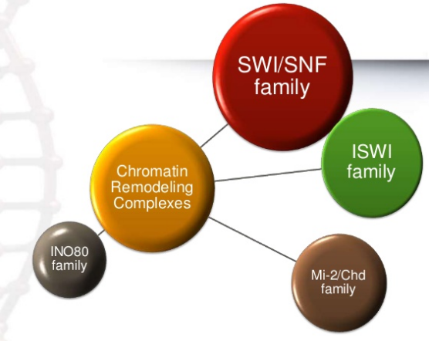
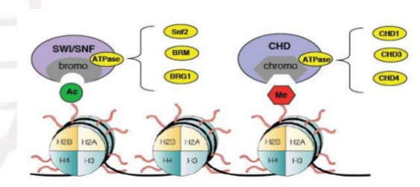
Chromatin remodelling complexes
Contain multiple (more than 10) subunits. In addition to ATPase domains, they exibit other
domains which interact with modified histones.
This permitts concerted action between histone modifications and chromatin remodelling.
contain bromodomains that
interact with acetylated Lys residues
in histones
contain chromodomains that
interact with methylated Lys residues
in histones

Slide 16
Chromatin remodeling
Chromatin remodeling (protein) complexes use energy provided by hydrolysis of ATP to change temporally the structure and position of nucleosomes.
Chromatin remodellig factors are multiprotein complexes with some subunits showing helicase activity.
ATP-dependent chromatin remodeling complexes can move, eject or restructure nucleosomes.
Remodeling improves access to DNA or histone binding sites recognized by transcriptional regulators or histone modifiers.

Slide 17
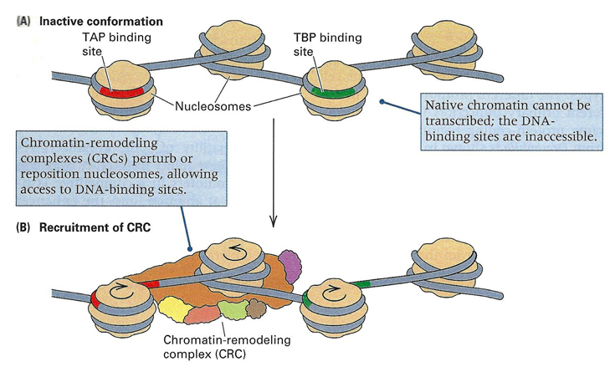
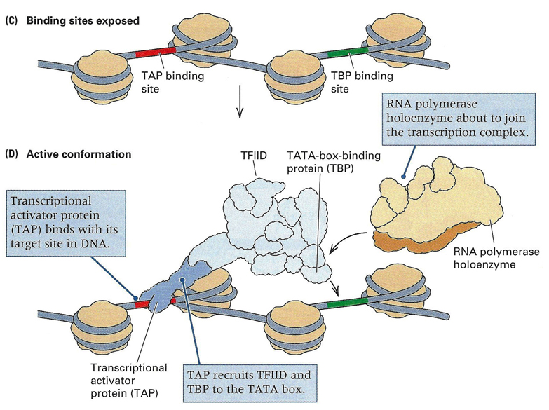
Chromatin remodelling
The remodeling can involve altered positioning of the nucleosomes, causing them to slide along the DNA.
As a result of nucleosome sliding, sequences previously wrapped round histone octamers
become more accessible.

Slide 18
Steps of transcription
Eukaryotic transcription proceeds in three sequential stages:
Initiation is the beginning of transcription.
The enzyme RNA polymerase binds to a region of gene called the
promoter. This signals the DNA to unwind.
2. Elongation is the addition of nucleotides to the mRNA strand.
RNA polymerase reads the unwound DNA strand and builds the
mRNA, using complementary base pairs.
3. Termination is the ending of transcription.
RNA polymerase crosses a stop/termination sequence in the
gene and detaches from DNA.

Slide 19
RNA polymerases
Eukaryotic cells contain 3 distinct nuclear RNA polymerases.
They transcribe different classes of genes.
RNA polymerase I
RNA polymerase II
RNA polymerase III
A pre-rRNA 45S, which
matures into 3 largest
ribosomal RNA (rRNA):
28S*
18S
5.8S
Protein coding
genes
Some snRNAs
microRNA
Transfer RNA (tRNA) genes
5S rRNA (the smalest
species of ribosomal RNA)
Small nuclear RNA (snRNA) involved in splicing
Small cytoplasmic (scRNA)
involved in protein transport
*rRNA S is designated according to their rates of
sedimentation during velocity centrifugation.
RNA Pol I transcribe 1 gene at ≈ 200 copies. The gene for the 45S pre- rRNA is present in tandem aray.
RNA Pol II transcribe ≈ 25000 genes.
RNA Pol III transcribe 30- 50 genes at variable copy numbers.

Slide 20
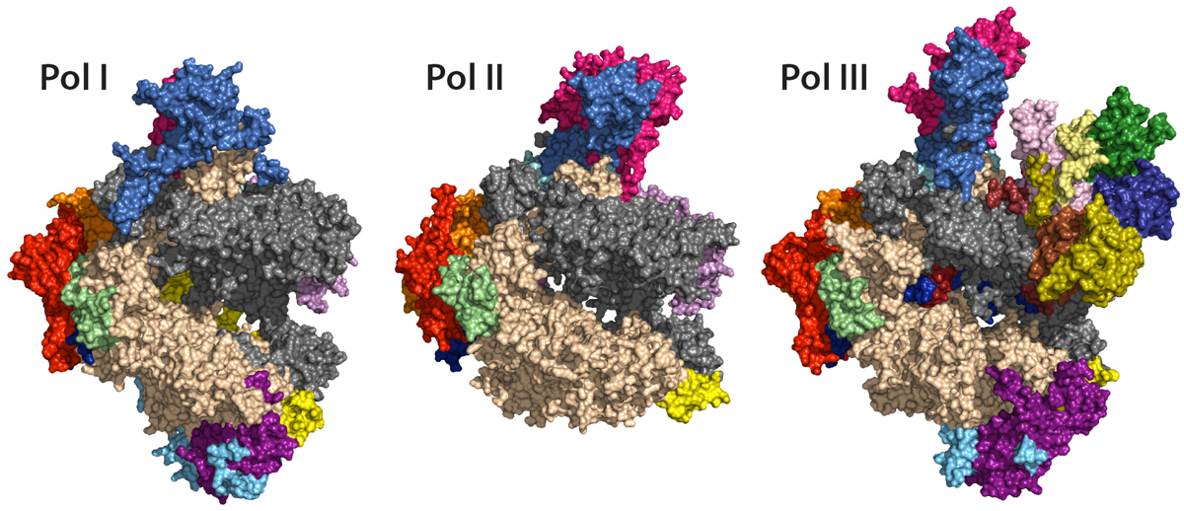
RNA polymerases
All 3 of the nuclear RNA polymerases are complex enzymes,
consisting of 8 to 17 different subunits each.
Although they recognize different promoters and transcribe
distinc classes of genes, they share several common features.

Slide 21
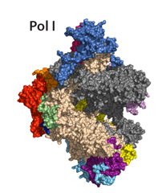
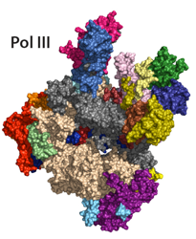
RNA polymerase I and III
RNA Pol (from yeast) crystal structure was resolved in 2013.
RNA Pol I is a 590 kDa enzyme that consists of 14 subunits.
Twelve of its subunits have identical or related
counterparts in RNA Pol II and III.
RNA Pol III consists of 17 subunits.

Slide 22
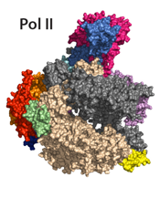
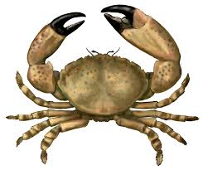
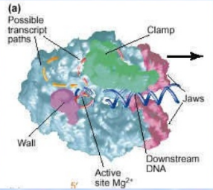
RNA polymerase II
RNA Pol II is a 550 kDa enzyme that consists of 12 subunits.
Twelve subunits shaped like a crab claw.
Jaws grip template and clamps lock template at catalytic
site for high processivity.
Contains Mg²⁺ ions at catalytic site.

Slide 23
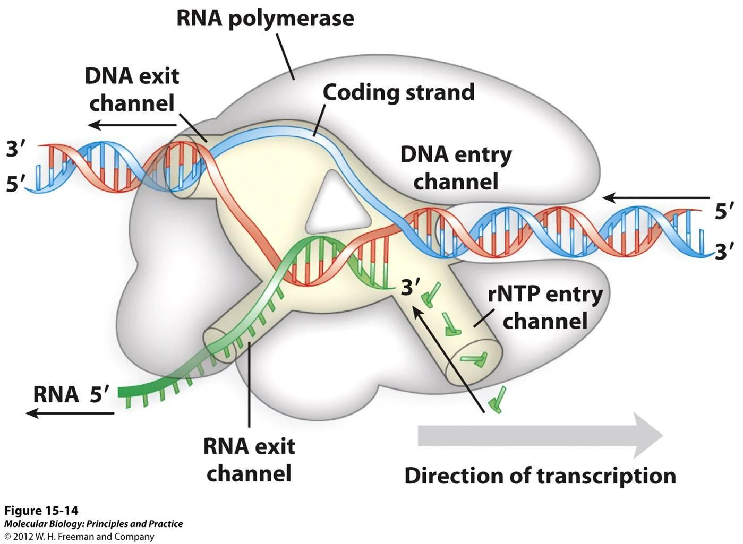
There are various channels allowing
DNA, RNA and
NTPs move into and out of
the RNA Pol II active
center cleft.

Slide 24
Transcription factors
Eukaryotic RNA polymerases cannot initiate transcription by themselves.
RNA Pol II can not recognize the promoter and unwind the DNA double helix.
Specific proteins called transcription factors are required for RNA Pol
to initiate transcription.
Two general types of transcription factors have been identified.
General transcription factors are involved in transcription from all
RNA Pol promoters and constitute part of the basic transcription
machinery.
Additional transcription factors bind to DNA sequences that control
the expression of individual genes and responsible for
regulating gene expression.

Slide 25
Regulatory elements and transcription factors
Combination of short sequence elements in the immediate vicinity of a gene act as a recognition signals for transcription factors.
A major group of such short sequence elements is clustered upstream of the coding sequence of the gene, where they collectively constitute the promoter.
Recognition signals for transcription factors (promoter elements) are said to be cis-acting because their function is limited to the DNA duplex on which they reside.
The transcription factors are said to be trans- acting, because they are synthesized by remotely located genes and required to migrate to their site of action.

Slide 26
Promoters
Promoter lies upstream of the gene.
Promoters can be about
100- 1000 base pairs long.
Common cis-acting elements of promoters:
The TATA box , often TATAAA and usually found 25-30 base pairs upstream (-25) from the start site of transcription. Only about 10-15% of mammalian genes contain TATA boxes, while the rest contain other core promoter elements.
The GC box , often GGGCGG, found in a variety of genes, many lacking a TATA box.
The CAAT box , often located at position -80. It is usually the strongest determinant
of promoter efficiency.

Slide 27
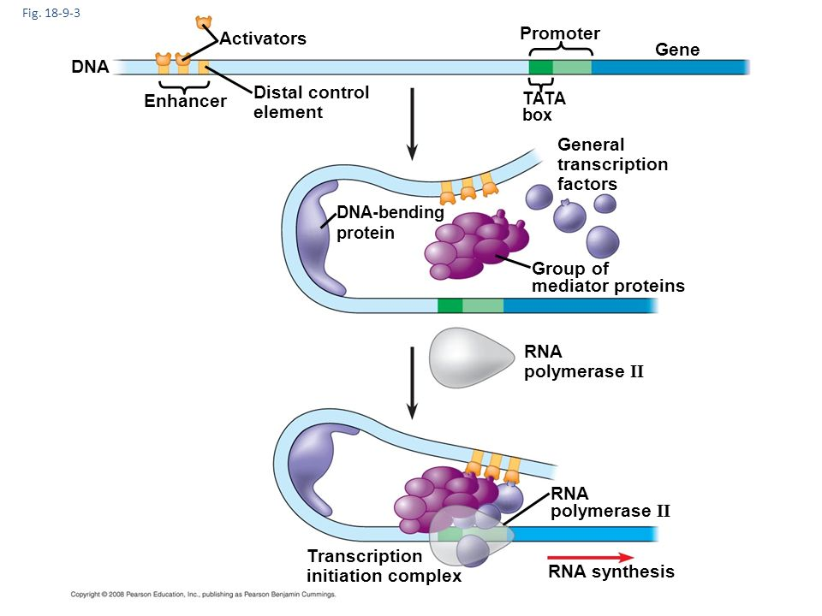
Enhancers
Enhancers are stretches of DNA bases,
about 50 to 150 bp in length.
A cis-acting sequence that
can increase the activities of many promoters.
Enhancers can exert their stimulatory actions
over distances of several thousand base pairs.
Can function in any location (upstream
or downstream) relative to promoter.
They bind gene regulatory proteins, and subsequently, the DNA between the promoter and enhancer loops out, allowing the proteins bound to the enhancer to interact with the
transcription factors bound to the promoter.

Slide 28
Initiation step
The structure of promoter – polymerase complex undergoes
structural changes to proceed transcription.
Approximately 14 base pairs of DNA at the transcription site unwinds
by RNA Pol II and general TF and form a transcription “bubble”.
Direction of RNA synthesis occurs in a 5’- 3’ direction (3’- end
growing).

Slide 29
Preinitiation complex
General transcription factors (GTF) combine with RNA Pol to form
preinitiation complex.
Preinitiation complex
is able to initiate transcription
helps position RNA Pol II over gene transcription start sites,
denatures the DNA
positions the DNA in the RNA Pol II active site for transcription

Slide 30
Preinitiation complex
Preinitiation complex contains:
RNA Pol II
Six general transcription factors (TF)
TFIIB
TFIIA
Coactivator complex
TFIID
TFIIE
RNA Pol and general TF bind the
preinitiation complex in a specific order.
TFIIH
TFIIF

Slide 31
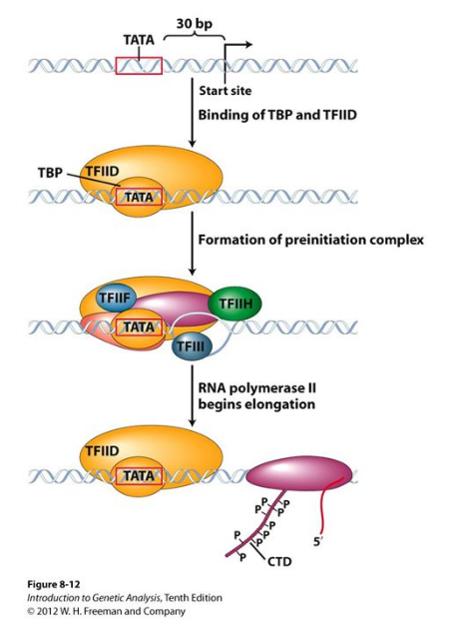
Transcription initiation
TATA binding protein (TBP), part of TFIID complex, must bind to promoter before other general TF and RNA Pol II can form preinitiation complex.
Most genes lack a TATA box and use an initiator element (Inr) or downstream core promoter instead. TBP binds non-sequence specifically, bringing the remaining portions of TFIID to the promoter.

Slide 32
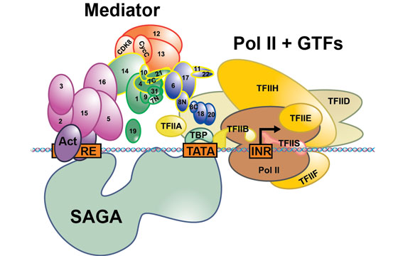
RNA Pol and GTF bind the preinitiation complex in a specific order.
TFIIA interacts with TBP subunit of TFIID
forming the DA complex. It is facilitate formation
of the preinitiation complex.
TFIIB binds next forming DAB complex.
TFIIB brings the DNA into proper position
for entry into the active site of RNA Pol II. DAB
complex recruits RNA Pol II and TFIIF.
RNA Pol II with TFIIF help bind to a region
from -34 tp +17, generating DABPol IIF complex.
TFIIF helps to speed un the polymerization process.

Slide 33
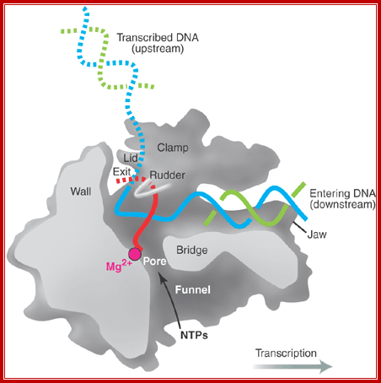
RNA Pol and GTF bind the preinitiation complex in a specific order.
Last the TFIIE and TFIIH bind to form the complete
preinitiation complex- DABPolIIFEH.
TFIIE may be involved in DNA melting at the
promoter and helps to open and close the
RNA Pol II Claw –like structure,
which enables movement down the DNA strand.

Slide 34
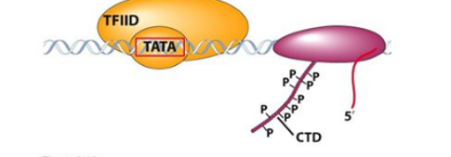
RNA Pol and GTF bind the preinitiation complex in a specific order.
Two TFIIH subunits are helicases,
which may unwind DNA around the initiation site,
creating a transcription bubble.
A transcription bubble is a molecular structure that occurs during the transcription of DNA when a limited portion of the DNA double strand is unwound.
Another subunit of TFIIH is a protein kinase that phosphorylates amino acids serines present in the C-terminal domain (CTD) of the largest subunit of RNA Pol II. This switches the RNA polymerase to start
producing RNA.

Slide 35
Coactivator complex
Mediator is a multiprotein complex that functions
as transcriptional coactivator. Mediator bridges between activators (Act) bound to regulatory DNA elements (RE) and the basal transcription machinery (Pol II and the GTF).
Mediator complex can be subdivided into four modules referred to as head, middle, tail and the dissociable kinase module and contains 31 subunits.
The mediator binds to the C-terminal domain (CTD) of RNA Pol II acting as a bridge between this enzyme and transcription factor. Coactivators are necessary to integrate multiple regulatory signals.
Recent studies have linked mutations in Mediator with various human diseases, including Alzheimer disease, congenital malformations, mental retardation and cancer.

Slide 36
SAGA
SAGA (Spt-Ada-Gcn5 acetyltransferase) is a multi-protein chromatin modifying complex and functions as transcriptional coactivator.
SAGA opens up the chromatin landscape for binding of additional transcription factors and the pre-initiation complex (PIC).

Slide 37
Elongation step
Once the RNA Pol has synthesized a short stetch (≈ 10 nucleotides) of RNA,
transcription shifts to elongation step.
This transcription stage requires further conformational changes in RNA Pol
that leads it to grip the template more firmly.

Slide 38
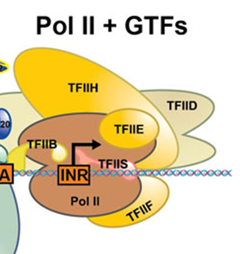
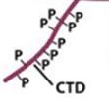
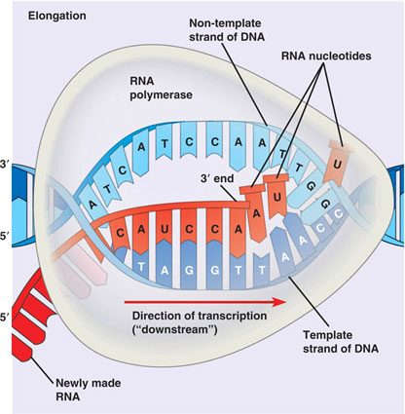
Elongation step
Phosphorylation of CTD (carboxyl tail domain) of RNA Pol II subunit, allows separation of RNA Pol II from general TFs to start elongation phase of transcription.
During RNA elongation, TFIIF (has helicase activity) remains attached to the RNA Pol II, but all of the other TF have dissociated from PIC.
RNA Pol uses NTPs to synthesize a RNA transcript.
RNA Pol can only add nucleotids to the 3' end of the strand so like DNA Pol. RNA must be synthesized in the 5' to 3' direction.
Only one of the unwound DNA strands acts as a template for the mRNA synthesis.
The DNA that has been transcribed, re-winds to form a double helix.

Slide 39
Termination step
Eukaryotic protein genes contain a poly-A signal located downstream of the last exon.
Transcription often terminates at 0.5 - 2 kb downstream of the poly-A signal,
but the mechanism is unclear.
Transcription stops and mRNA polymerase and the new mRNA transcript
are released from DNA.
The DNA double helix reforms.

Slide 40
Post- transcriptional modifications
RNA processing
The RNAs produced during transcription are called primary transcripts of
protein coding genes. They are precursor mRNAs (pre-mRNAs).
The precursor mRNA is subjected to many changes so called post-
transcriptional modifications (RNA processing)- terminal base additions,
base modifications, splicing.
This process is required to produce functional mRNAs.
This mRNAs then must be exported to the cytoplasm before it can be
translated into protein.

Slide 41
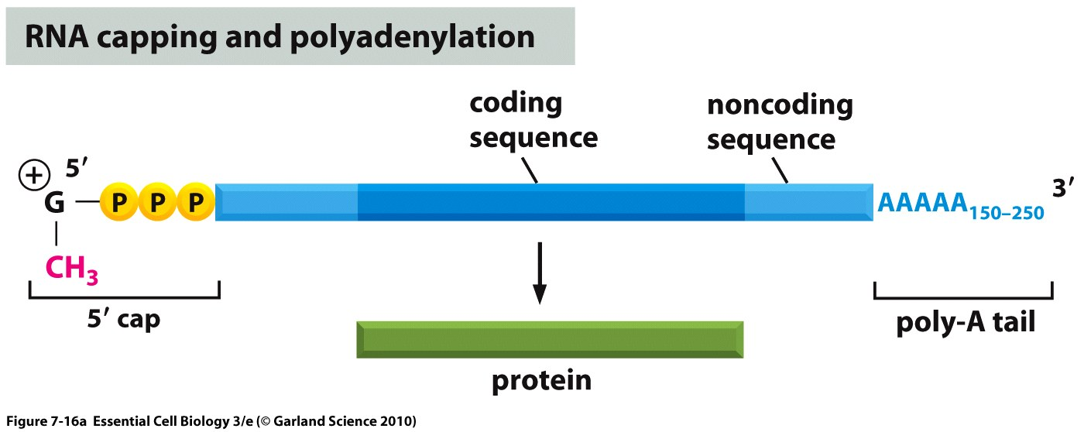
RNA processing
1. RNA capping
2. RNA polyadenylation
3. RNA splicing

Slide 42
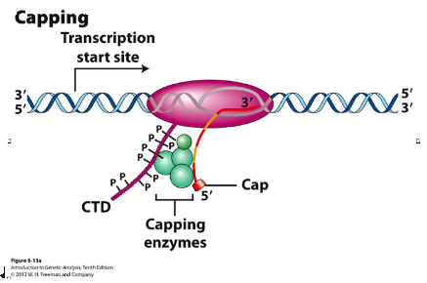
RNA capping
The 5’ end of RNA chain emerges from the
surface of RNA Pol II.

Slide 43
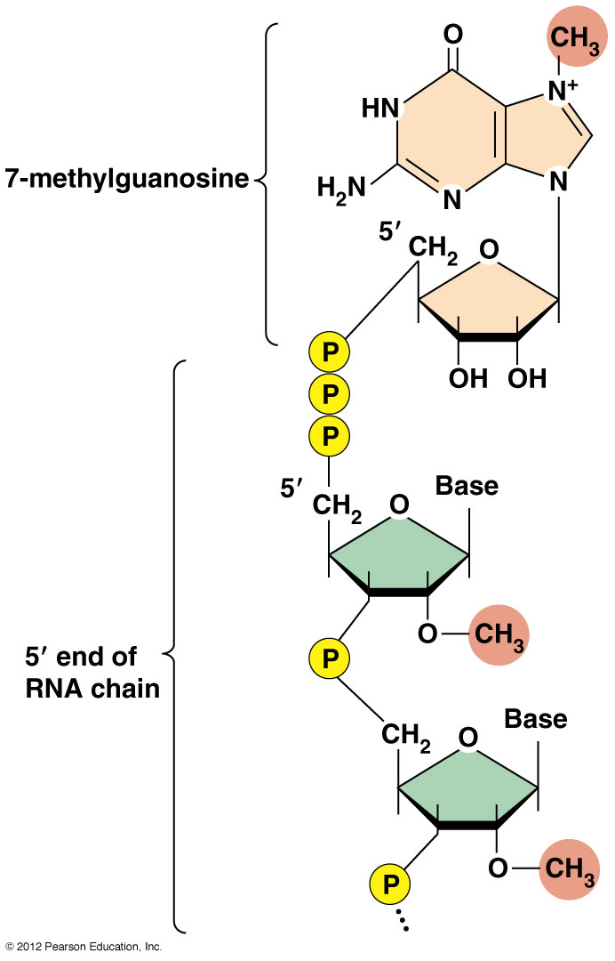
RNA capping
Immediately a methylated nucleoside,
7-methylguanosine (m⁷G) is linked to the
first 5’ nucleotide of the RNA transcript by
a special 5’- 5’ phosphodiester bond.
5’-5’ triphosphate bridge
As this bond effectively bridges the 5’
carbon of the first nucleotide of the
(m⁷G) residue to the 5’ carbon of
the first nucleotide, the 5’ end is said to be
blocked or capped.

Slide 44
RNA capping
Cap functions:
to protect RNA transcript from 5’- 3’
exonuclease attack. Decapped mRNA molecules are rapidly degradated
to facilitate transport from the nucleus to the cytoplasm
to facilitate RNA splicing
to play an important role in the attachment of the ribosomal 40S subunit to the mRNA (required for mRNA translation).

Slide 45
RNA polyadenylation
Virtually all mRNA have a number of adenylate residues at their 3’- end –
poly(A)-tail.
These A’s are not encoded in the genes.
Instead, pre-mRNA is cleaved at defined site at the 3’ end
and a poly(A) polymerase adds 150- 200 adenylate residues.

Slide 46
RNA polyadenylation
The cleavage and adenylation reactions occur if
The sequence 5'- AAUAAA-3' a major polyadenylation signal (PAS) sequence is located near the 3' end of the pre-mRNA molecule.
Cleavage occurs at a specific site located 15- 30 nucleotides downstream of the AAUAAA element and is usually 5'-CA-3‘ sequence.
A G/U-rich sequence (Downstream Signal Element) is also usually present further downstream on the pre-mRNA.

Slide 47
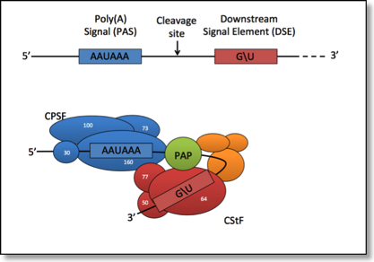
RNA polyadenylation
Two multisubunit proteins:
Cleavage and Polyadenylation Specificity Factor (CPSF)
and
Cleavage Stimulation Factor (CStF)
are transferred from RNA Pol II to the mRNA molecule and
bind to the sequence elements.
This complex cleaves the mRNA between the PAS and the G/U- rich sequence at the cleavage site 5'-CA-3‘.

Slide 48
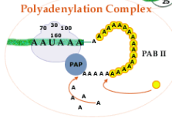
RNA polyadenylation
Polyadenylate Polymerase (PAP) then adds about 200 adenine units to the new 3’ end of the mRNA molecule using adenosine triphosphate (ATP) as a precursor.
However, polyadenylate polymerase (PAP) sticks poorly to the end of the pre-mRNA until
approximately 20 A’s have been added.
Then, poly(A)-binding protein (PAB) has bound to the short poly(A)-tail and the polyadenilate polymerase is more firmly bound until 150-200 A's are rapidly added.
PAB protein also protects the 3'end from ribonuclease digestion.

Slide 49
RNA polyadenylation
RNA polyadenylation functions:
to facilitate transport of the mRNA molecules to the cytoplasm
to stabilize at least some of the mRNA in the cytoplasm
(shortening of poly(A) tails is associated with mRNA degradation)
to facilitate translation by permitting enchanced recognition of the
mRNA by the ribosomal machinery.

Slide 50
Exons, introns and gene ends
Introns – regions of mRNA that do not code for protein (interventing sequences). More than 85% of the nucleotides are intronic sequences.
Exons – gene coding sequences (expressed sequences).
Introns usually contain ”useless” DNA, however some of them can contain regulating sequences or functional noncoding RNA.
Introns can range in size from 10 to 1000 base pairs.
Introns are commonly found in eukaryotes and less common in unicellular eukaryotes (yeast), and even rarer in prokaryotes.
The 5’ and 3’ ends of the gene contains UnTranslated Regions (UTR). UTRs contains regulating sequences such as promoters.

Slide 51
pre-mRNA splicing
The initial transcription involves the production of
pre-mRNA complementary to the entire length of the gene.
Splicing involves removing only the intron regions by excision from transcribed
pre-mRNA and connecting only the exon regions (exon ligation) to produce mRNA.

Slide 52
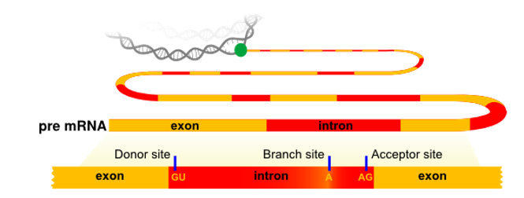
Regulatory elements in pre-mRNA splicing
Pre-mRNAs contain a “splicing code” made up of
loosely defined consensus sequences that define the splice junctions
bewildering number and diversity of relatively short cis-acting elements within exons as well as introns.

Slide 53
Regulatory elements in
pre-mRNA splicing
mRNA splicing requires the nucleotide sequences at the exon/intron boundaries
(splice junctions) to be recognized.
There are several conserved motifs in the nucleotide sequences near the intron–exon boundaries that act as essential splicing signals.
In most cases, introns start from the sequence GU as 5' splice sites and end with the sequence AG as 3' splice site (the GT-AG rule).
These sequences are crucially important for splicing, however they are not sufficient to signal the presence of an intron.
A third functionally important site in splicing is a highly conserved nucleotide A at the branch site. It is usually located very close to the end of the intron, approximately 20–50 bases before the terminal AG dinucleotide.

Slide 54
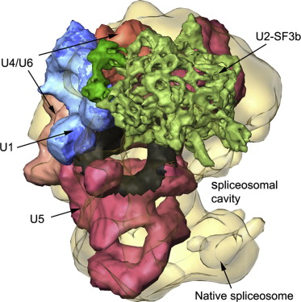
RNA splicing
Splicing is catalyzed by the large RNA/protein
complex named spliceosome.
Spliceosome is a complex comprised of five types of
small nuclear RNA (snRNA) (typically 100-300
nucleotides in length) and more than 50 proteins.
Each of the snRNA molecules is attached to specific
proteins to form small nuclear ribonucleoproteins-
snurps (snRNPs), called U1, U2, U4, U5 and U6.
snRNPs contribute to the process of splicing by recognizing sequences in the mRNA or promoting rearrangements in spliceosome conformation. The spliceosome catalyzes a reaction that results in intron removal and the "gluing" together of the protein-coding exons.

Slide 55
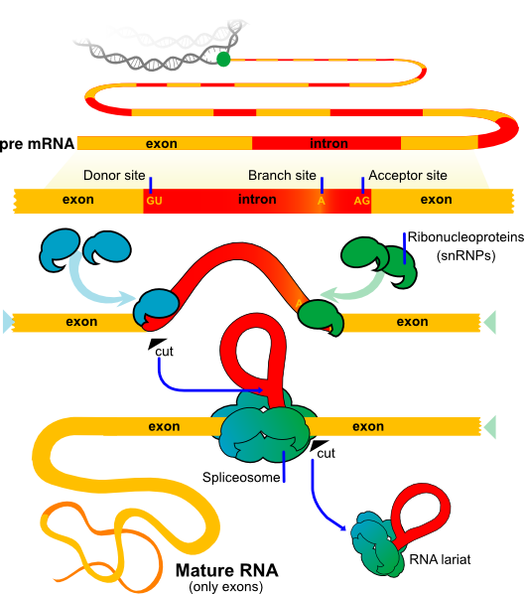
pre-mRNA splicing
snRNPs recognize and bind to both the 5’ and 3’
ends of the intron and cause the intron to
form a loop.
Cut is made at the 5' splice site and the 5' end of the intron is subsequently connected to the conserved adenine found in the branch point sequence, forming the so-called "lariat" structure.
Cleavage at the 3’ splice junction, leading to
release the intronic RNA as a lariat, and splicing
of the exonic RNA segments.

Slide 56
Regulatory elements in pre-mRNA splicing
The remaining information required for splicing is contained within relatively short (~6 nucleotide) sequences located within both exons and introns that either enhance or suppress splicing.
Exonic splicing enhancers (ESEs) and exonic splicing silencers (ESSs) activate or repress splicing, respectively, from within exons.
Intronic splicing enhancers (ISEs) and intronic splicing silencers (ISSs) function from within introns.
In contrast to the consensus splice sites, these regulatory elements are not well defined in sequence and position.

Slide 57
Regulatory elements in pre-mRNA splicing
Two groups of trans-acting splicing factors
can interact with enhancers and silencers:
members of the serine arginine (SR) family of proteins and
members of the Heterogenous ribonucleoprotein particles (hnRNPs).
The hnRNP proteins contains one or more RNA-binding domains and a domain for interaction with other proteins.
In general, SR protein binding at ESE facilitates exon recognition whereas hnRNPs are inhibitory.

Slide 58
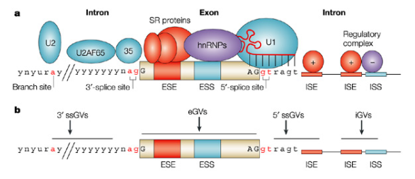
pre-mRNA splicing and diseases
Essentially all exons contain splicing elements.
Genomic variants (GVs) can affect different splicing regulatory elements, leading to aberrant splicing.
Up to 25% of synonymous (in terms of amino acid coding) substitutions can disrupt normal splicing as can nonsynonomous and termination codons.
For some genes, up to 50% of point mutations within exons affect splicing.

Slide 59
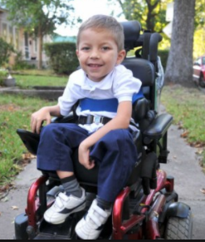
pre-mRNA splicing and diseases
Example of the detrimental effect of mutations in exonic splicing signals.
Spinal muscular atrophy (SMA)
SMA is a common, often fatal, neuromuscular disease and a leading genetic cause of infant mortality.
SMA is characterized by degeneration of motor neurons resulting in progressive muscular atrophy and weakness.
SMA is caused by mutation in motor neuron- SMN2 gene.
SMN is a ubiquitously expressed protein that plays
a critical role in small nuclear ribonucleoproteins- snRNP biogenesis.

Slide 60
pre-mRNA splicing and diseases
Spinal muscular atrophy (SMA)
There are two SMN genes, SMN1 and SMN2, both of which encode the same open reading frame.
The vast majority of SMA patients have deletions of the SMN1 gene .
In the SMN2 gene they have a single nucleotide substitution, a C->T change at position 6 in exon 7.
This mutation, though it does not change the amino acid coding, significantly alters the splicing pattern of the SMN2 pre-mRNA, causing frequent skipping of exon 7 that produces an inactive and unstable protein lacking the last 16 amino acids.

Slide 61
pre-mRNA splicing and diseases
Spinal muscular atrophy (SMA)
Two models have been proposed to explain exon 7 skipping in SMN2:
the substitution disrupts an ESE, which the splicing activator binds;
it creates an ESS to which the splicing supressor hnRNP binds.
Splicing is altered because of the balance of positively and negatively-acting splicing factors
has been shifted.

Slide 62
pre-mRNA splicing
It is vital for the introns to be removed precisely, as any left-over intron nucleotides,
or deletion of exon nucleotides, may result in a faulty protein being produced.
An imprecise intron removal thus may result in a frameshift, which means that the genetic code would be read incorrectly.
This is because the amino acids that make up proteins are joined together based on codons, which consist of three nucleotides.
EXON: ”BOBTHEBIGFATCAT”
if intron before this exon imprecisely removed then exon sequence would become unreadable:
EXON: ”OBT HEB IGF ATC AT”.

Slide 63
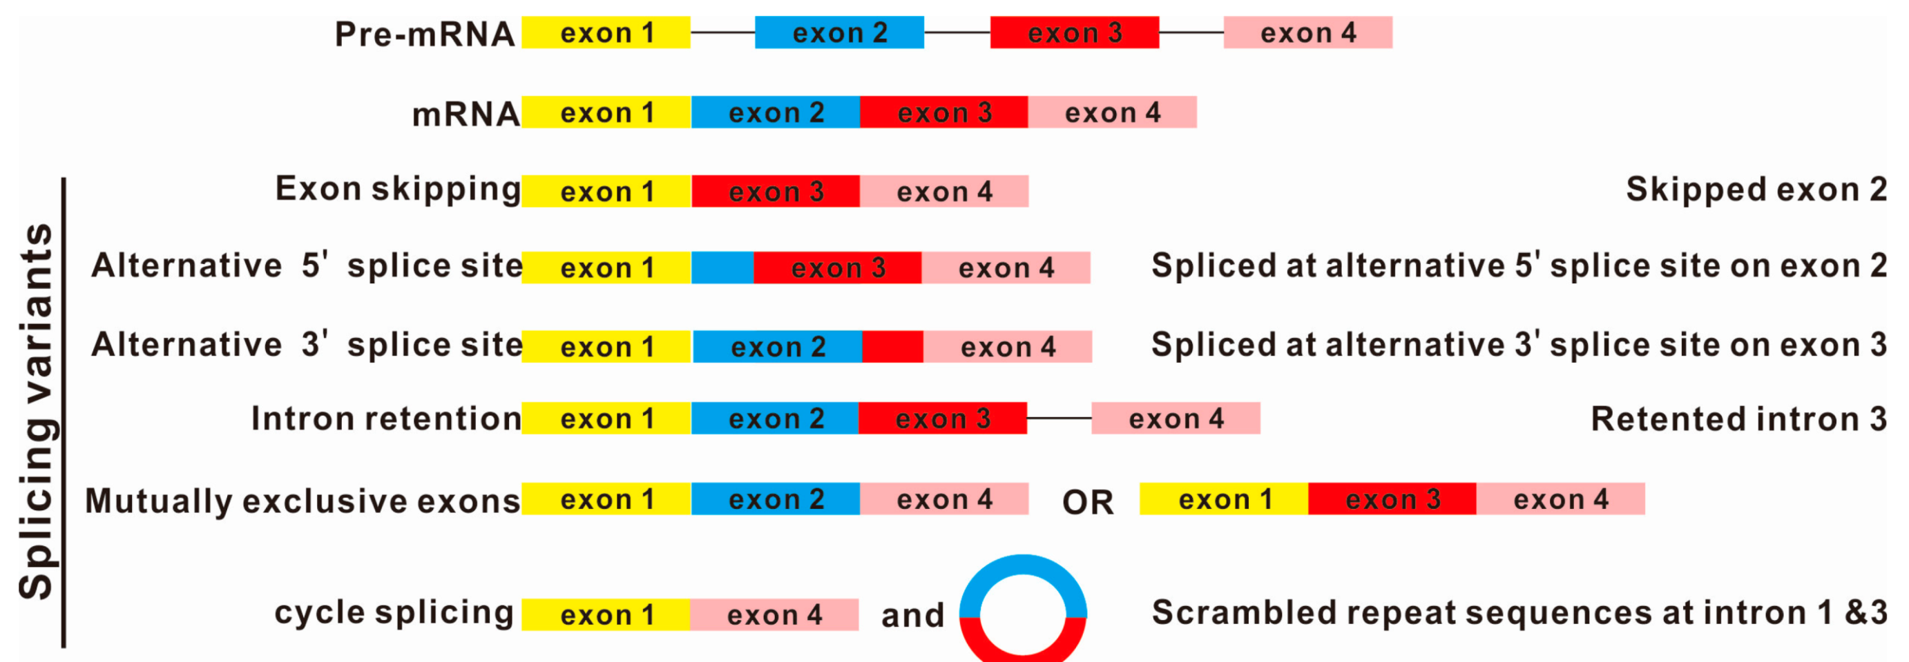
Alternative splicing
Alternative splicing refers to the way that different combinations of exons can be joined together to produce different mature mRNAs that encode different protein sequences.
One example of a human gene that undergoes alternative splicing is fibronectin.
Over 20 different isoforms of fibronectin have been discovered.

Slide 64
Alternative splicing
Alternative splicing allows production of a large variety of proteins from a limited amount of DNA. It provides tremendous opportunities for enrichment of the transcriptome and proteome without the need for expansion of the genome.
Explains how 25000 genes of the human genome can encode the more than 80000 different mRNAs.
It is now thought that between 30 and 60% of human genes undergo alternative splicing.
Importantly, alternative splicing can also be regulated differently in cell type-,
developmental stage-, or signal-dependent patterns.
Many human diseases (15%) may be connected to problems with splicing.

Slide 65
RNA editing
Any process, other than splicing, that results in a change in the sequence of a RNA transcript such that it differs from the sequence of DNA template.
Enzymatic altering of pre-mRNA sequence.
Common in mitochondria of protozoans and plants and chloroplasts, where more than 50% of bases can be altered.
Much rarer in higher eukaryotes.

Slide 66
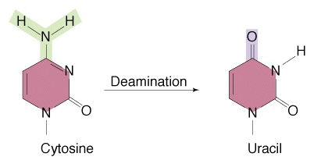
RNA editing
The human apolipoprotein ApoB gene encodes 14.1 kb mRNA transcript and
a 4536 amino acid product, apoB 100.
In the intestine a specific cytosine deaminase, APOBEC1, converts a single cytosine
at nucleotide 6666 to uridine, thereby generating a premature stop codon.
The truncated mRNA encodes a product , apoB48, identical in sequence to the first
2152 amino acids of ApoB 100. Only ApoB100 low density lypoprotein can transport
cholesterol to the cell.
Editing of human apoB pre-mRNA

Slide 67
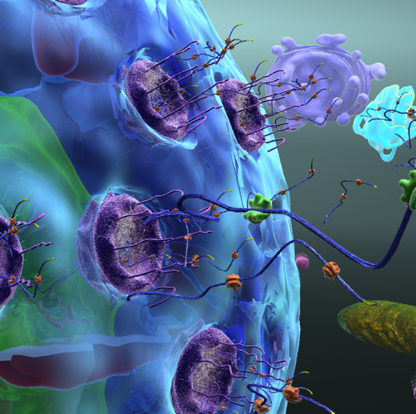
The processed mRNAs then must
be exported through the
nuclear pores to the
cytoplasm before it can be
translated into protein.

Slide 68
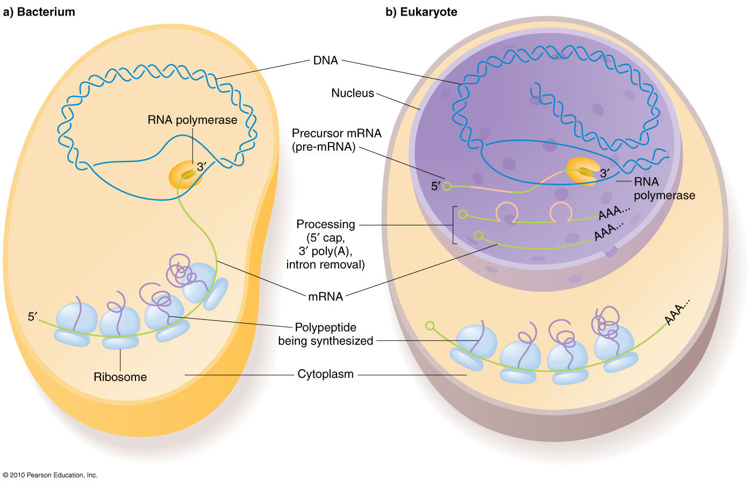
Transcription in prokaryotes vs eukaryotes
In prokaryotes, transcription
occurs in the cell cytoplasm,
and both transcription and
translation happen simultaneously.
In eukaryotes, transcription occurs
in the cell nucleus,
and transcription and translation
differ in space and time.

Slide 69
Transcription in prokaryotes vs eukaryotes
Promoters
In prokaryotes, the promoter consist of two short sequences at -10 and
-35 positions from the transcription start site (Pribnow box).
The sequence at -10 is called the Pribnow box, and usually consists of the
six nucleotides TATAAT. The Pribnow box is absolutely essential to start transcription
in prokaryotes.
The other sequence at -35 usually consists of the six nucleotides TTGACA.
Its presence allows a very high transcription rate.
In eukaryotes, promoters are extremely diverse.

Slide 70
Transcription in prokaryotes vs eukaryotes
Enhancers
Eukaryotic transcription can be enhanced by proteins called enhancers
which are bind to a different place of DNA that is away from
the transcribing region.
This is not reported in prokaryotic transcription.

Slide 71
Transcription in prokaryotes vs eukaryotes
RNA Pol
RNA polymerases performs essentially the same reaction in all cells.
Prokaryotic cells have only a single RNA Pol while in eukaryotic
cells there are three- RNA Pol I, II and III.
Prokaryotic RNA Pol consists of five subunits (α,β,β’,ω).
Eukaryotic RNA Pol consists of 8-17subunits.

Slide 72
Transcription in prokaryotes vs eukaryotes
In eukaryotes, a complex of histone proteins and DNA
should be accessible, before the transcription.
In prokaryotic cells, DNA is not bound to the histone proteins.
Therefore, transcription occurs directly.

Slide 73
Transcription in prokaryotes vs eukaryotes
mRNA produced as a result of transcription is not modified in
prokaryotic cells.
Eukaryotic cells modify mRNA by RNA splicing, capping and
polyadenylation.

Slide 74
Translation

