Slide 1
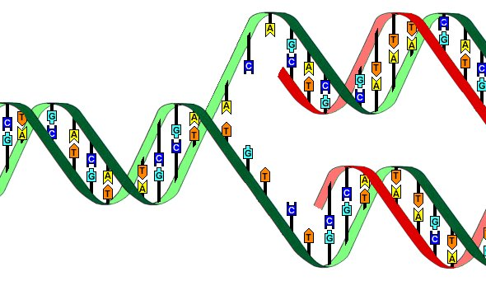
DNA replication and repair

Slide 2
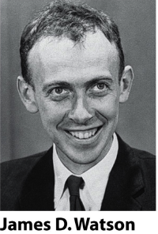
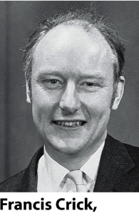
Watson and Crick noted that the structure
of DNA itself suggested a mechanism
for its replication.
They wrote:
”It has not escape our notice, that the specific base pairing
we have postulated immediately suggests a copying mechanism”.
The copying process in which a single DNA molecule
becomes two identical molecules is called replication.
DNA replication = DNA synthesis

Slide 3
Replication occurs in all living organisms and
is the basis for biological inheritance.
The basic mechanisms of DNA replication are similar across organisms.
Copying of a cell’s DNS is not a trivial task!
There are about 6.5 billion base pairs of DNA in your genome,
all of which must be accurately copied when any one of your trillions
of cells divides.
Cell must duplicate all its DNA before cell division.

Slide 4
The cell cycle
Cell cycle is a series of events that prepares a cell to dived.
The actual division process, called mitosis.
The eukaryotic cell cycle commonly is represented as 4 stages.
In proliferating human cells, the 4 phases of the cell cycle proceed
successively, taking from 10 to 20 hours depending on cell type and
developmental state .

Slide 5
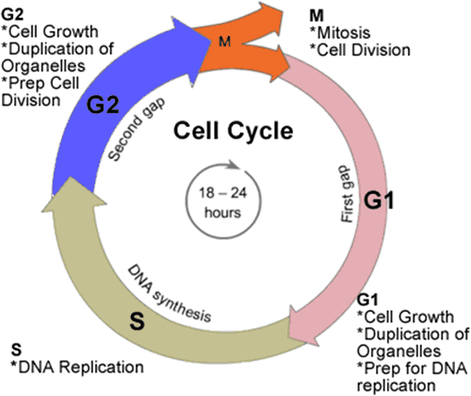
The cell cycle stages
G1- S – G2 - M
1. G1 stage stands for GAP 1
2. S stage stands for Synthesis
3. G2 stage stands for GAP 2
4. M stage stands for Mitosis
Uder certain conditions, such as starvation or when tissue has reached its final size, cells will leave the cycle and stop dividing.
This cell ”resting” state called G0 or GAP 0.
Cells in G0 carry out all their normal functions and can reenter
the cycle if conditions change.

Slide 6
Interphase
INTERPHASE =
G1 + S+ G2 phases
Interphase consists of the parts of the cell cycle that do not involve cell division.
Interphase is a very active phase of the cell cycle with many processes
occurring in the cytoplasm and nucleus.
The average cell spend up to 90% of it’s life in this phase.
Cell division or mitosis is one phase of the cell cycle.

Slide 7
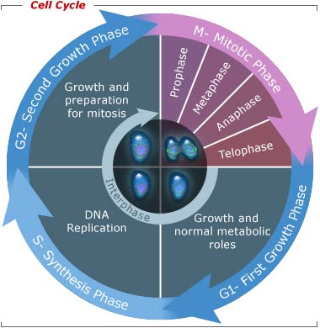
Interphase
G2 or growth phase
M or mitosis phase
one copy of the genomes is
segregated to each daugther
cell.
The cell splits itself into two
daughter cells.
Cells rapidly grows in size
Synthesize proteins
Prepare for mitosis
Any damaged DNA or
replication errors are
corrected.
G1 or growth phase
S or synthesis phase
Cells grows in size
Synthesize proteins
Produce organelles
(ribosomes, mitochondria)
Many of the DNA replication
regulatory processes
are initiated.
DNA replication
The amount of DNA in
the cell has doubled

Slide 8
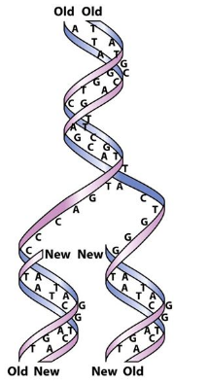
DNA replication
The strands of the original DNA duplex separate,
and each individual strain serves as a template for
the synthesis of a new strand.
Parent strands are the original chains of nucleotides.
Daughter strands are new chain of nucleotides.

Slide 9
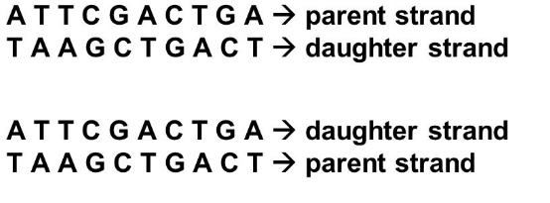
DNA parent and daughter strands.
Daughter strands are complimentary to parent strands.
The parent and daughter strands are antiparallel (5’-> 3’ and 3’-> 5’).
Each of two daughter helices is a nearly exact copy of the parental helix,
however it is not 100% the same due to mutations.

Slide 10
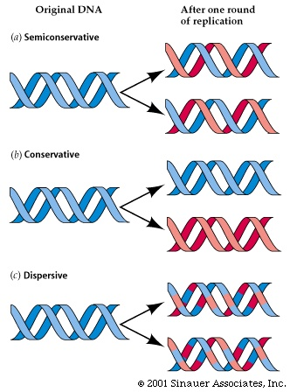
DNA replication models
There are three possible models that describe the accurate creation of the daughter chains.
Semiconservative:
parental DNA
Copies of replicated DNA each consists of
parental strand and daughter strand.
daughter DNA
parental DNA (original)
Conservative:
After replication, parental strands remain
together, daughter DNA strands form new
double helix.
parental DNA
daughter DNA
Disruptive:
Replicated DNA consists of a combination of
old and new DNA.

Slide 11
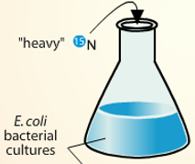
In 1954, Matthew Meselson and Franklin Stahl proved that semiconservative
model of DNA replication was correct.
They have used E.coli bacteria as a model system.
They cultured bacteria in a medium
containing a heavy isotope of nitrogen -¹⁵N.
The bacteria took up ¹⁵N and used it to synthesize new proteins and DNA.
¹⁵N
After many generations growing in the ¹⁵N
medium, the nitrogenous bases of E.coli
DNA were all labelled with heavy ¹⁵N.

Slide 12
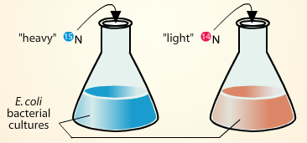
Matthew Meselson and Franklin Stahl experiment
Then, the bacteria were switched to
medium containing a light isotope
of nitrogen -¹⁴N and allowed to
grow for several generations.
¹⁵N
¹⁴N
E.coli DNA made after the switch would have be made up of ¹⁴N.
They collected samples in each E.coli generation and
extracted DNA.

Slide 13
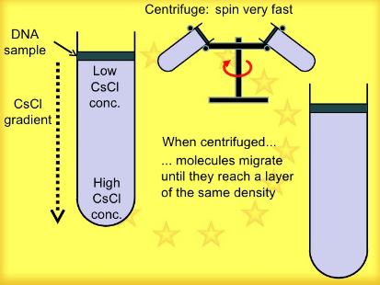
Matthew Meselson and Franklin Stahl experiment
They measured the density of the DNA using
CsCl density gradient centrifugation.
Normal ¹⁴N DNA
Heavy ¹⁵N DNA

Slide 14
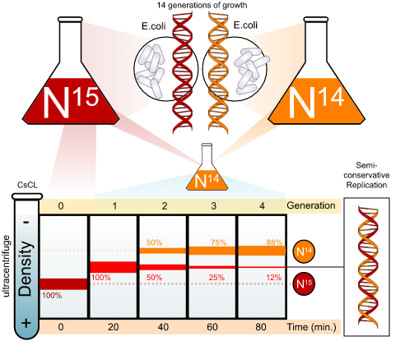
Matthew Meselson and Franklin Stahl experiment
The samples at the start of experiment
produced a single heavy ¹⁵N DNA band.
DNA isolated after one round of
replication also produced a single band,
but this band was higher (between the
density of the heavy ¹⁵N and light ¹⁴N).
Generation 2 DNA produced two bands.
One was in the same position as band
from the first generation. The second
was higher at the position of light ¹⁴N DNA.
Their results demonstrated that DNA replicated semiconservatively.

Slide 15
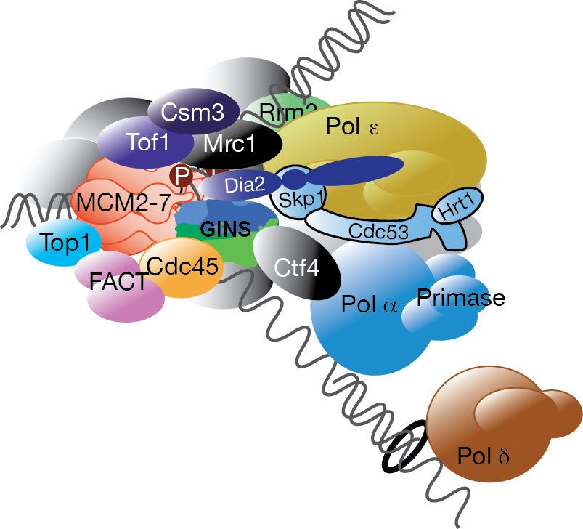
Replisome
Extreme accuracy and efficiency of DNA replication is necessary in order
to preserve the integrity of the genome in successive generations.
The replication machinery is a massive complex coordinating many proteins all working at the site of replication,
forming the ”replisome”.
Various essential catalytic activities are present in replisomes such as the Mcm2-7 DNA helicase or DNA polymerases. Other components have no known catalytic activity.
A major function of these proteins is to facilitate regulation and coordination with other pathways such as the DNA damage response or chromatin assembly.

Slide 16
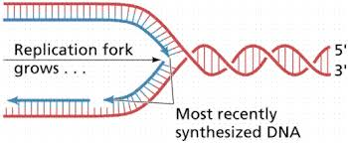
Replication fork
The DNA region at which all these proteins
come together to carry out synthesis of the
daughter strands is called the replication fork.

Slide 17
Core proteins at the replication site
Topoisomerases – prevents torsion by DNA breaks
Helicases – separates 2 strands
Primase – RNA primer synthesis
Single strand binding proteins – prevent reannealing of single strands
DNA polimerase – synthesis of new strand
Tethering protein – stabilises polymerase
DNA ligase – seals nick via phosphodiester linkage

Slide 18
The steps of DNA replication
Initiation (unwinding)
Proteins bind to DNA and open up double helix
Prepare DNA for complementary base pairing
Elongation
Proteins connect the correct sequences of nucleotides
into a continuous new strand of DNA
Termination
Proteins release the replication complex

Slide 19
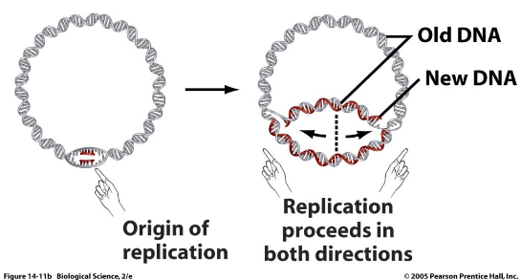
Initiation step
DNA replication is initiated at specific points, which have been termed
origins of replication.
Bacterial chromosomes
have a single point of origin.
Eukaryotic chromosomes
have multiple points of origin.

Slide 20
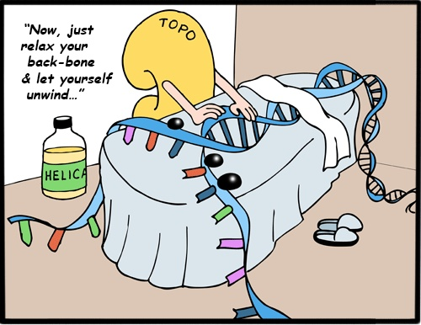
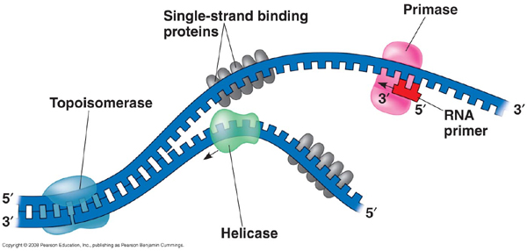
Initiation (unwinding) step
The first step in DNA replication is the separation of the two DNA strands that make up the helix.
DNA gyrase (class II topoisomerase) start the process of DNA unwinding by breaking (nicking) a single DNA strand. The tension holding the helix in its coiled form is released.
Replication fork

Slide 21
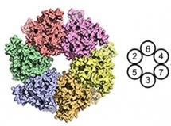
Initiation (unwinding) step
DNA helicase is an enzyme which unwinds the helix at origins of
replication.
Its doughnut like structure wraps around DNA and breaks the hydrogen bonds between the strands.
In eukaryotes, Mcm 2- 7 complex acts as a helicase.

Slide 22
Initiation (unwinding) step
Single- stranded binding proteins (SSB) work with helicase to keep the parental DNA helix unwound.
Single-stranded DNA is highly unstable and can form hydrogen bonds with itself (secondary structures as “hairpins).
SSB coats the unwound strands with rigid subunits that prevents strands snapping back together in a helix.
SSBs also stabilize single- stranded DNA by binding to it.
In eukaryotes, heterotrimeric Replication Protein A (RPA1-3) acts as SSB.

Slide 23
Elongation step
A single strand of DNA by itself is not suitable for polymerisation.
This is because the chemical reactions catalysed by DNA polymerases
require a free 3' OH in order to initiate nucleotide chain elongation.
DNA polymerase can not start chain elongation de novo. It requires
a pre-existing chain of nucleotides.

Slide 24
Elongation step
This problem is solved by RNA primase (a type of RNA polymerase).
RNA primase synthesizes and adds on each
unwound DNA strand a short
(5-10 nucleotides long) RNA
sequences (RNA primers) that are
complimentary to DNA sequence.
DNA polymerase alpha (Pol α) extends the RNA primer with
deoxynucleotides for another 20 nucleotides, forming a mixed RNA- DNA primer. Pol α starts a new DNA strand.

Slide 25
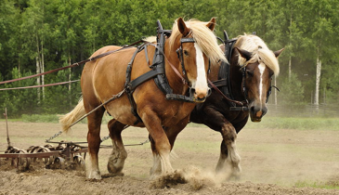
Elongation step
DNA polymerases
DNA polymerases are the main working horses of the replication process.
DNA polymerases have catalytic 5’-3’ polymerase activity.
The main DNA polymerases
involved in eukariotyc
cell replication:
DNA polymerases have also 3’-5’ exonuclease activity, allowing it to back up and remove nucleotides, correcting errors.
DNA epsilon
DNA delta
DNA alpha

Slide 26
Enzymatic activities of polymerases
5’-3’ polymerase activity
5’-AAGTCACC-3’ 5’-AAGTCACCG-3’
3’-TTCAGTGGCAAGC-5’ 3’-TTCAGTGGCAAGC-5’
+G
5’-3’ polymerase activity is present in all DNA and RNA polymerases
It will NEVER be a 3’-5’ polymerase activity!

Slide 27
Enzymatic activities of polymerases
3’-5’ exonuclease (editing) activity
5’-AAGTCAC -3’ 5’-AAGTCAC-3’
3’-TTCAGTGGCAA-5’ 3’-TTCAGTGGCAA-5’
A
-A
Normally, only one mismatched nucleotide is removed
3’-5’ exonuclease activity is present in most (but not all) DNA and RNA polymerases. It is not present in DNA polymerase alpha.

Slide 28
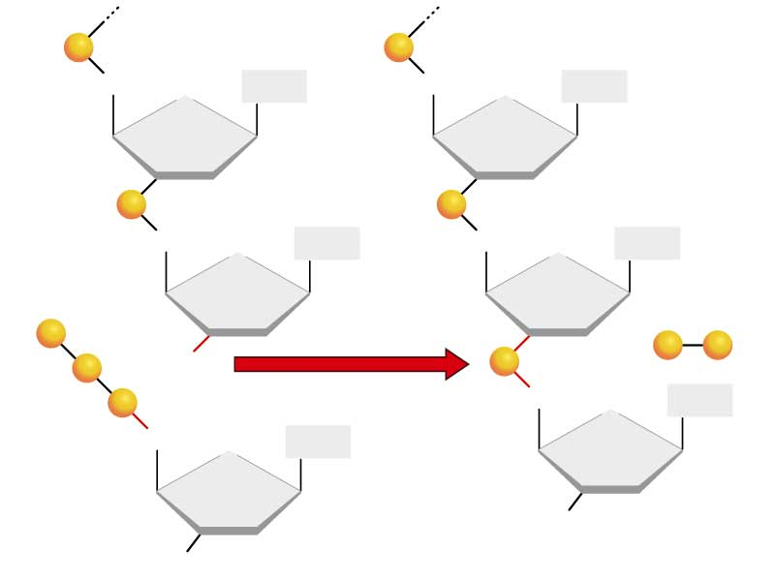
DNA polymerization reaction
5' end of strand
O
P
OH
O
P
OH
3’ OH group is needed to
react with the phosphate
group on the 5’ end of the
next nucleotide to
form a phosphodiester bond.
CH₂
Base
CH₂
Base
O
O
O
P
OH
O
P
OH
CH₂
Base
CH₂
Base
O
O
H₂0
OH
+
OH
OH
O
P
OH
3'
O
P
P
O
O
P
OH
OH
O
P
OH
+
Synthesis reaction
CH₂
OH
OH
O
P
OH
O
Base
5'
CH₂
Base
O
OH
3'
3' end of strand
OH

Slide 29
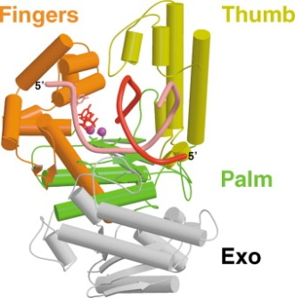
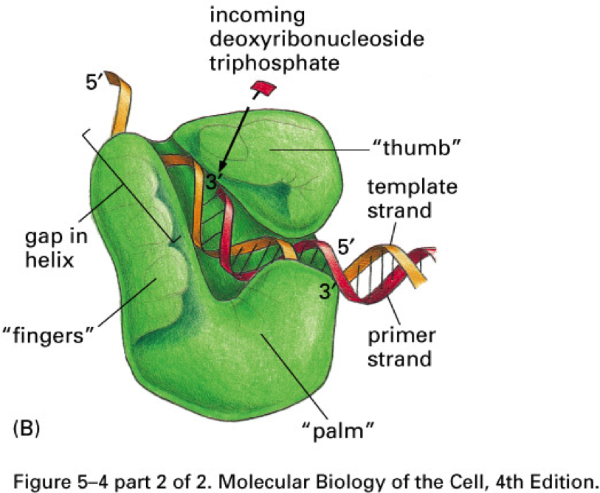
DNA polymerase structure
The overall architecture of a DNA polymerase resembles a human right hand
and consisits of three domains: palm, fingers and thumb.
Template DNA is threaded through the palm.
Thumb and fingers wrapped around the DNA.
The finger domain function to bind the NTPs
with the template nitorgenious base.
The thumb domain plays a role in translocation
and positioning of DNA.

Slide 30
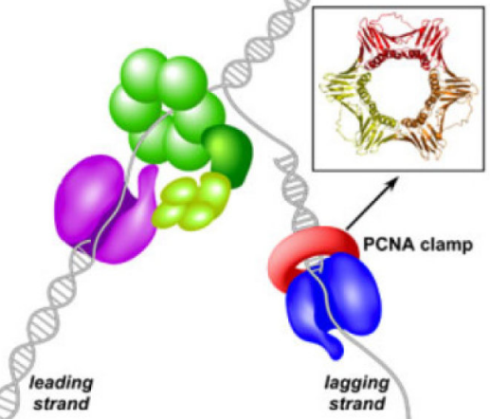
However, the conformation of DNA polymerases does not allow for their stable interaction
with the template DNA.
To strengthen the interaction between template and polymerase, DNA sliding clamps have evolved.
This sliding clamp is a homotrimer – PCNA (proliferating cell nuclear antigen), which form a ring structure.
The daugther duplex DNA passes through the PCNA central hole. That enables DNA Pol epsilon and delta to remain stably associated with a single template strand for thousands of nucleotides.
PCNA- dependent stabilization of DNA polymerases enhances polymerase
processivity up to 1000- fold.

Slide 31
The Leading and lagging strands
the leading strand
When the two parent DNA strands are separated
to begin replication, one strand is oriented in the
5’ to 3’ direction while the other strand is
oriented in the 3’ to 5’ direction.
5’
3’
Two daughter strands must run in opposite directions:
the lagging strand
For one daughter strand the direction of chain growth must be 5’ to 3’ direction.
This is the leading strand.
For other daughter strand the direction of chain growth must be 3’ to 5’ direction.
This is the lagging strand.

Slide 32
The Leading and lagging strands
Since DNA polymerases can only make
DNA in the 5' to 3' direction,
this poses a problem during replication.
the leading strand
5’
This means that the lagging and
leading strands synthesize
through different methods.
3’
the lagging strand

Slide 33
ε
Only the leading strand will have a free 3’ OH group at the point of bifurcation.
This will permit sequential addition of nucleotides and continuous elongation in the same direction in which the replication fork moves.
RNA primase adds the first nucleotides to the nascent chain.
DNA polymerase epsilon sits near the replication fork, moving as the fork does and adding nucleotides one after the other, preserving antiparallel orientation.
The nucleotides are added in the 5’ to 3’ direction.

Slide 34
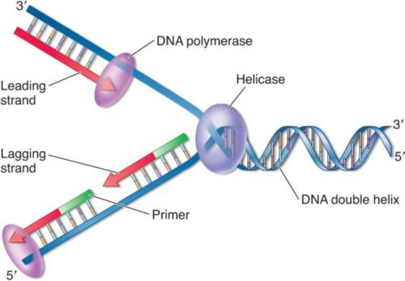
The lagging strand replication
The 5’ to 3’ direction of synthesis of the lagging strand is in opposite direction to that in which the replication fork moves.
As a result, synthesis of the lagging strand has to be
accomplished in steps.
The lagging strand replicates in a small fragments , called
Okazaki fragments.
Okazaki fragments are stretches of 100- 200 nucleotides in
humans that are synthesized in the 5’ to 3’ direction
away from replication fork.
This type of replication is called discontinuous.

Slide 35
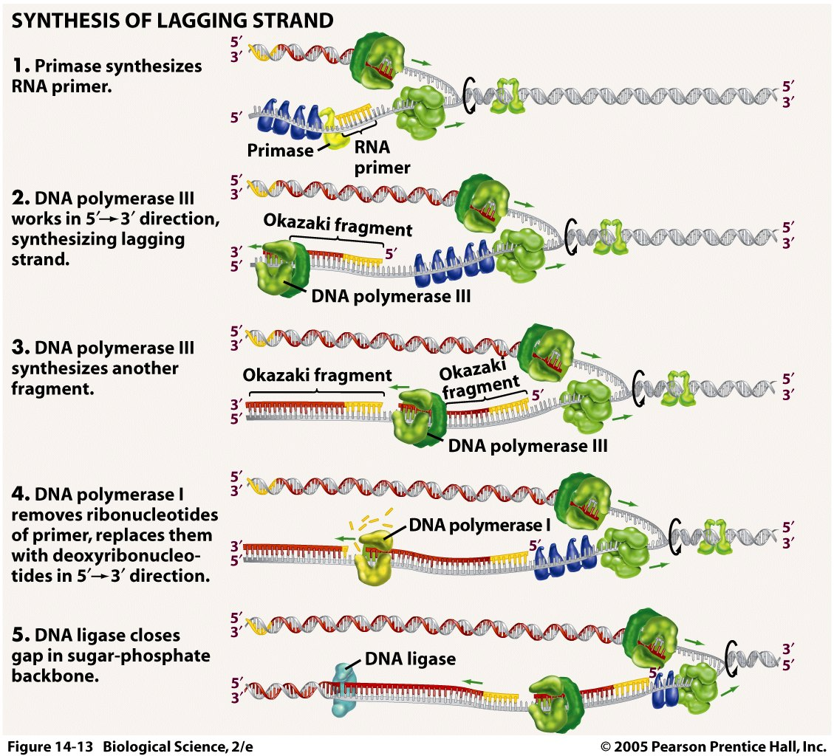
Every 100 -200 nucleotides,
RNA primers are added by a primase.
δ
DNA polymerase δ synthesize
lagging strand (Okazaki fragment)
in 5’ –3’ direction.
δ
δ
DNA polymerase δ will let go of
DNA once it meets the next RNA
primer.
δ
Ribonuclease H will recognize
RNA primer and cut it out.
DNA ligase closes the gaps in
the DNA strand.

Slide 36
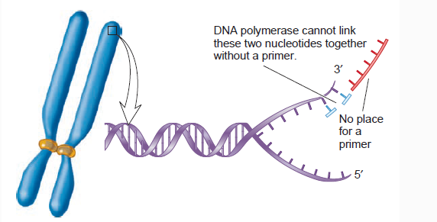
Replication problem at the ends of linear chromosomes.
Eukaryotes have linear chromosomes, and linear chromosomes have an end problem.
Problem caused by the fact that DNA polymerase can only add nucleotides to the 3’ end of preexisting polynucleotide.
DNA replication is unable to reach the very end of the chromosomes.

Slide 37
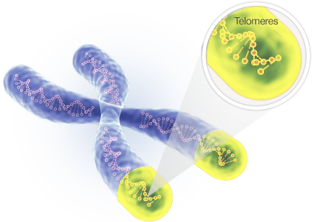
Replication problem at the ends of linear chromosomes.
DNA replication ends at the telomere region of repetitive DNA close to the ends.
Telomeres contain short, repetitive sequences, usually TTAGGGG.
This sequence is repeated approximately 2,500 times in humans
Telomeres length is about 15000 base pairs.

Slide 38
Telomers
Telomeric DNA protects the organism's genes from being eroded through successive rounds of DNA replication
Telomeric DNA aids in preventing separate chromosomes from fusing
Telomeric DNA and associated proteins prevent the ends from activating the cell's systems for monitoring DNA damage

Slide 39
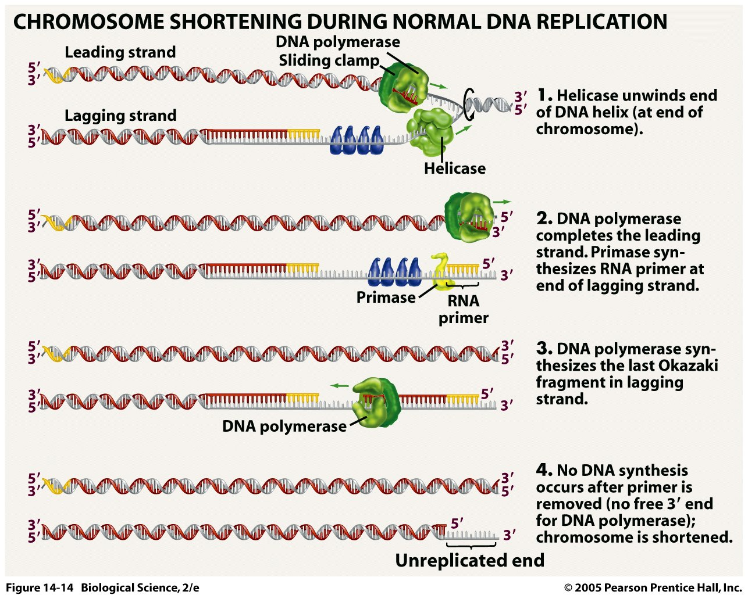
The leading strand
synthesis can be completed.
The lagging strand
synthesis cause the end
problem.

Slide 40
Telomerases
To prevent the loss of genetic information due to chromosome shortening,
additional DNA sequences are attached to the ends of telomeres.
In 1984, Carol Greidner and Elizabeth Blackburn discovered an enzyme called
telomerase, that prevents chromosome shortening.
They received the 2009 Nobel Prize in physiology or medicine for their discovery.
The telomerase contains a piece of RNA associated with its protein.

Slide 41
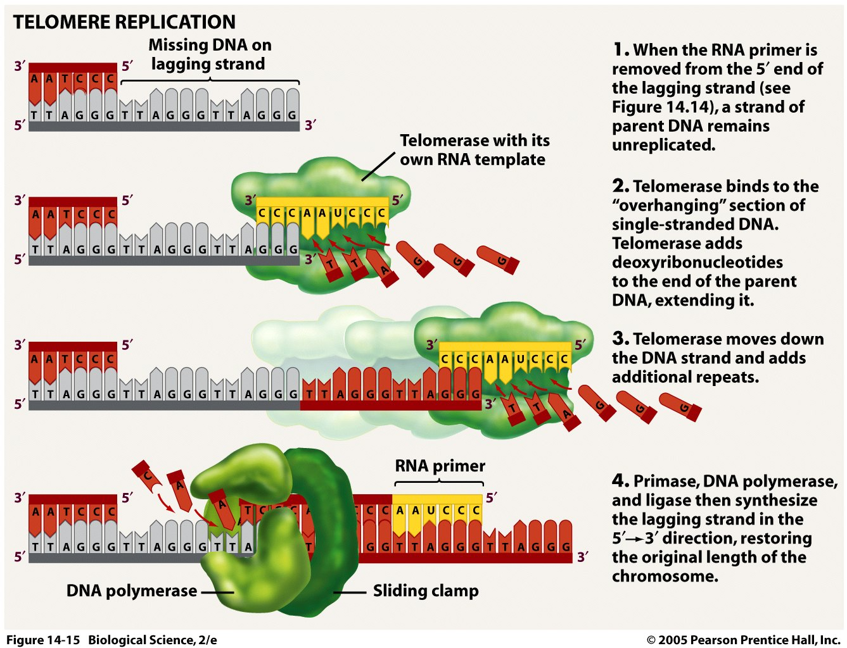
Telomerase produce
DNA in direction
3’ to 5’.

Slide 42
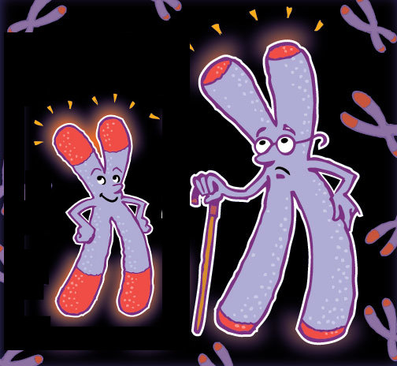
Is telomerase always active?
Active in children, germ and stem cells of adults
Inactive in somatic cells of adults
So, chromosomes actually get shorter – this is why we get old and die...
In humans, average telomere length declines from about 11 000 base pairs at birth to less than 4000 base pairs in old age.
Activation of telomerase in adult mice increase their life span.
Telomerase is active in most tumours.

Slide 43
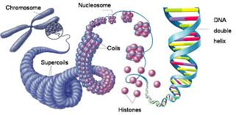
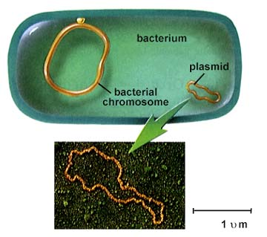
Some differences in replication among prokaryotes and eukaryotes
Reasons:
1. Eukaryotic chromosomes are typically much longer than prokaryotic
2. Eukaryotic chromosomes are linear, not circular

Slide 44
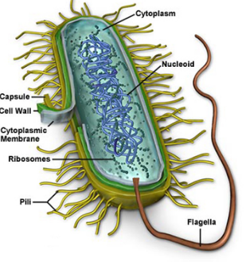
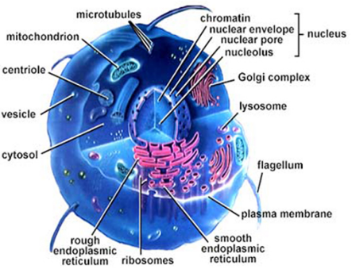
Prokaryotic vs. eukaryotic DNA replication
Location
DNA is present as a DNA-protein complex
called nucleoid.
DNA is located inside the nucleus.
The DNA replication occurs in the cytoplasm
of the cell.
The nucleus is the site for
DNA replication.

Slide 45
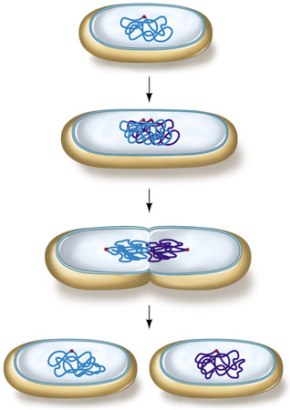
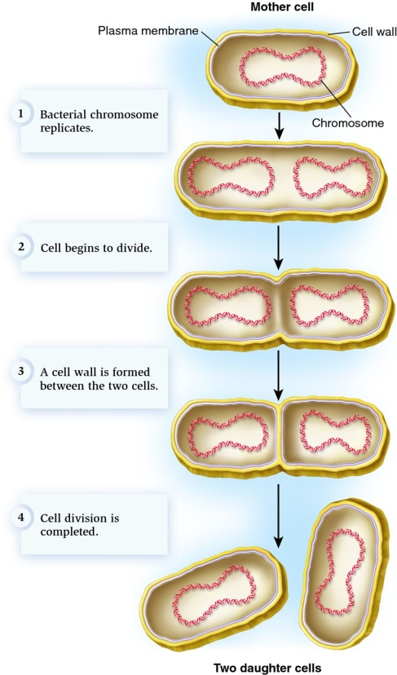
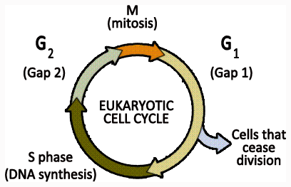
Prokaryotic vs. eukaryotic DNA replication
Stage of cell division
Since prokaryotes do not have a nucleus,
they undergo a simple division
called binary fission (“splitting in two”).
Cell division is more complicated.
The nucleus is divided in a process called
mitosis.
DNA replication is the first step of cell
division.
DNA replication occurs during the
synthesis (S) phase of cell cycle.

Slide 46
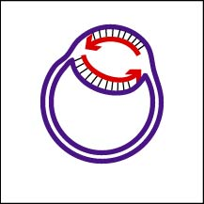
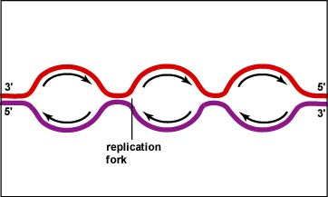
Prokaryotic vs. eukaryotic DNA replication
Initiation of replication
Due to the high amount of material to
be copied, DNA molecule contains
multiple origins of replication (over 1000)
on each chromosome.
DNA contain a single origin of replication
and a single replicon (the DNA region between
origin of replication and termination site).
Each chromosome has several replicons.
Origin of replication sites
is about 100-200 or more nucleotides.
Each origin of replication
is formed of about 150 nucleotides.

Slide 47
Prokaryotic vs. eukaryotic DNA replication
Okazaki fragments
Okazaki fragments are long, with the typical
length about 1000- 2000 nucleotides
Okazaki fragments ranges between
100 and 200 nucleotides.

Slide 48
Main differences among eukaryotic and prokaryotic replication forks
In eukaryotes RNA primer is first extended by DNA Pol α, then by DNA Pol δ or ε. In prokaryotes extension is done solely by DNA Pol III.
In eukaryotes, RNA primer is excised by RNase H and then gap filled by DNA Pol. In prokaryotes DNA Pol I is able to both excise RNA and fill in DNA.
Overall the proteins involved in replication have similar functions in eukaryotic and
prokaryotic cells, but have different names.

Slide 49
Prokaryotic vs. eukaryotic DNA replication
Termination of replication
The termination occurs at specific termination sites in both cells.
A single termination site is present midway
between the circular chromosome. The
two replication forks meets at this site,
halting the DNA replication.
DNA has several termination sites along
the chromosome.
A part of DNA present at the ends of
chromosomes does not get replicated.
The lagging strand is shorter than the
leading strand.

Slide 50
Speed of DNA replication
The genome of complex eukaryotes is huge and the process of DNA replication
should be incredibly fast.
The speed of DNA replication for the humans is about 50 nucleotides per second per
replication fork. This is a low speed comparing to the speed of the bacterial DNA
replication.
It would take a month to replicate a chromosome of 250 million base pairs.
Human genome can be copied only in a few hours because many replication
forks take place at the same time (multiple origins of replication).
The bacteria genome contains 4.7 million base pairs. The speed of DNA replication
in bacteria is much higher about 1000 nucleotides per second, and thus is done in
no more than 40 minutes.
That is a reason why during process of bacterial replication the rate of errors much higher.

Slide 51
Failure to complete DNA replication leads to chromosome breaks, translocation, loss of heterozygosity or cell death.

Slide 52
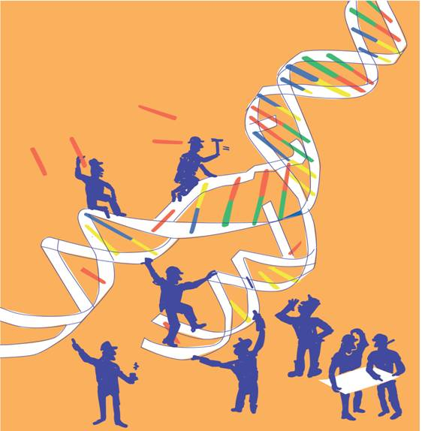
Mechanisms
for maintaining DNA integrity
DNA damage and repair

Slide 53
DNA damage and repair
Process of DNA replication during cell division is prone to error.
The rate at which DNA polymerase adds incorrect nucleotides during DNA replication is a major factor in determining the spontaneous mutation rate in an organism.
The frequency at which human DNA undergoes lasting, uncorrected errors range from 1 x 10⁻⁴ to 1 x 10⁻⁶ mutations per gamete for a given gene.
This means that we would expect to find one mutation at a specific locus per one million gametes.

Slide 54
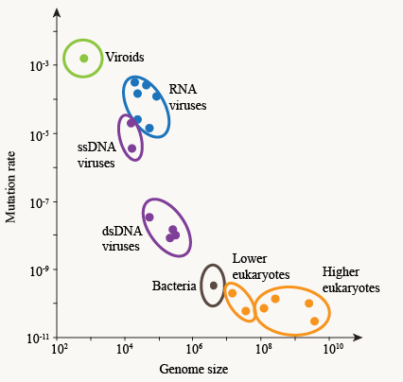
Mutation rates can differ between the organisms
The highest per base pair per generation mutation rates are found in viruses.
DNA viruses have mutation rates between 10⁻⁶ to 10⁻⁸ mutations per base per generation, and RNA viruses have mutation rates between 10⁻³ to 10⁻⁵ per base per generation.
RNA virus mutation rates are especially
high partially due to not having
a proofreading mechanism.

Slide 55
Environmental agents that damage DNA integrity
Radiations
Ionizing radiation – gamma rays and x-rays
Ultraviolet rays, especially the UV-C rays (260 nm) that are
absorbed strongly by DNS and the longer UV-B that penetrates
the ozone shield
Highly reactive oxygen radicals produced during normal cell
respiration and other biochemical pathways

Slide 56
Environmental agents that damage DNA integrity
Chemicals
Plant and microbial products, e.g. the Aflatoxin produced in
moldy peanuts
Aromatic hydrocarbons, such as found in cigarette smoke
Chemicals used in chemotherapy, especially for
cancer treatment.
It has been estimated that an individual cell can suffer
up to one million DNA changes per day.

Slide 57
DNA repair mechanisms
Cells have evolved a number of mechanisms to detect and repair the various types of damage that can occur to DNA, no matter whether this damage is caused by the environment or by errors in replication.
DNA repair processes exist in both prokaryotic and eukaryotic organisms, and many of the proteins involved have been highly conserved throughout evolution.

Slide 58
Mechanisms used by cells to correct replication errors
Proofreading
corrects errors during DNA replication
Mismatch repair
fixes mispaired bases right after DNA replication

Slide 59
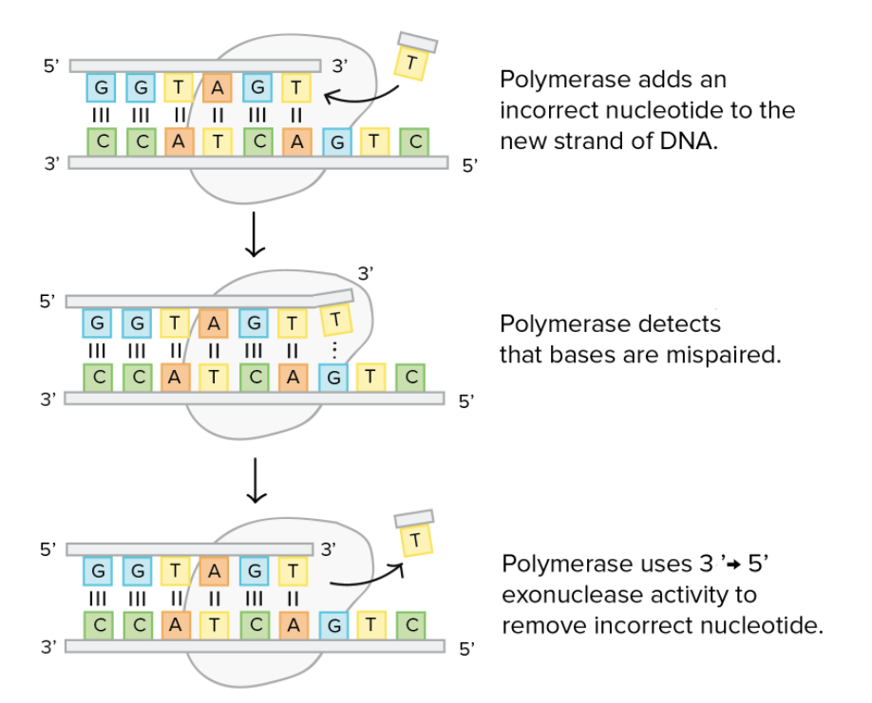
DNA proofreading
DNA polymerase makes about
1 in 10000 base pairing errors.
During DNA replication,
most DNA polymerases
"check their work" with each base
that they add.
This process is called proofreading.

Slide 60
DNA mismatch repair
Immediately after DNA replication, any remaining mispaired bases (that were not fixed during proofreading) can be detected and replaced in a process called mismatch repair.
Mismatch repair can also detect and correct small insertions and deletions that happen when the polymerases "slips," losing its footing on the template.​

Slide 61
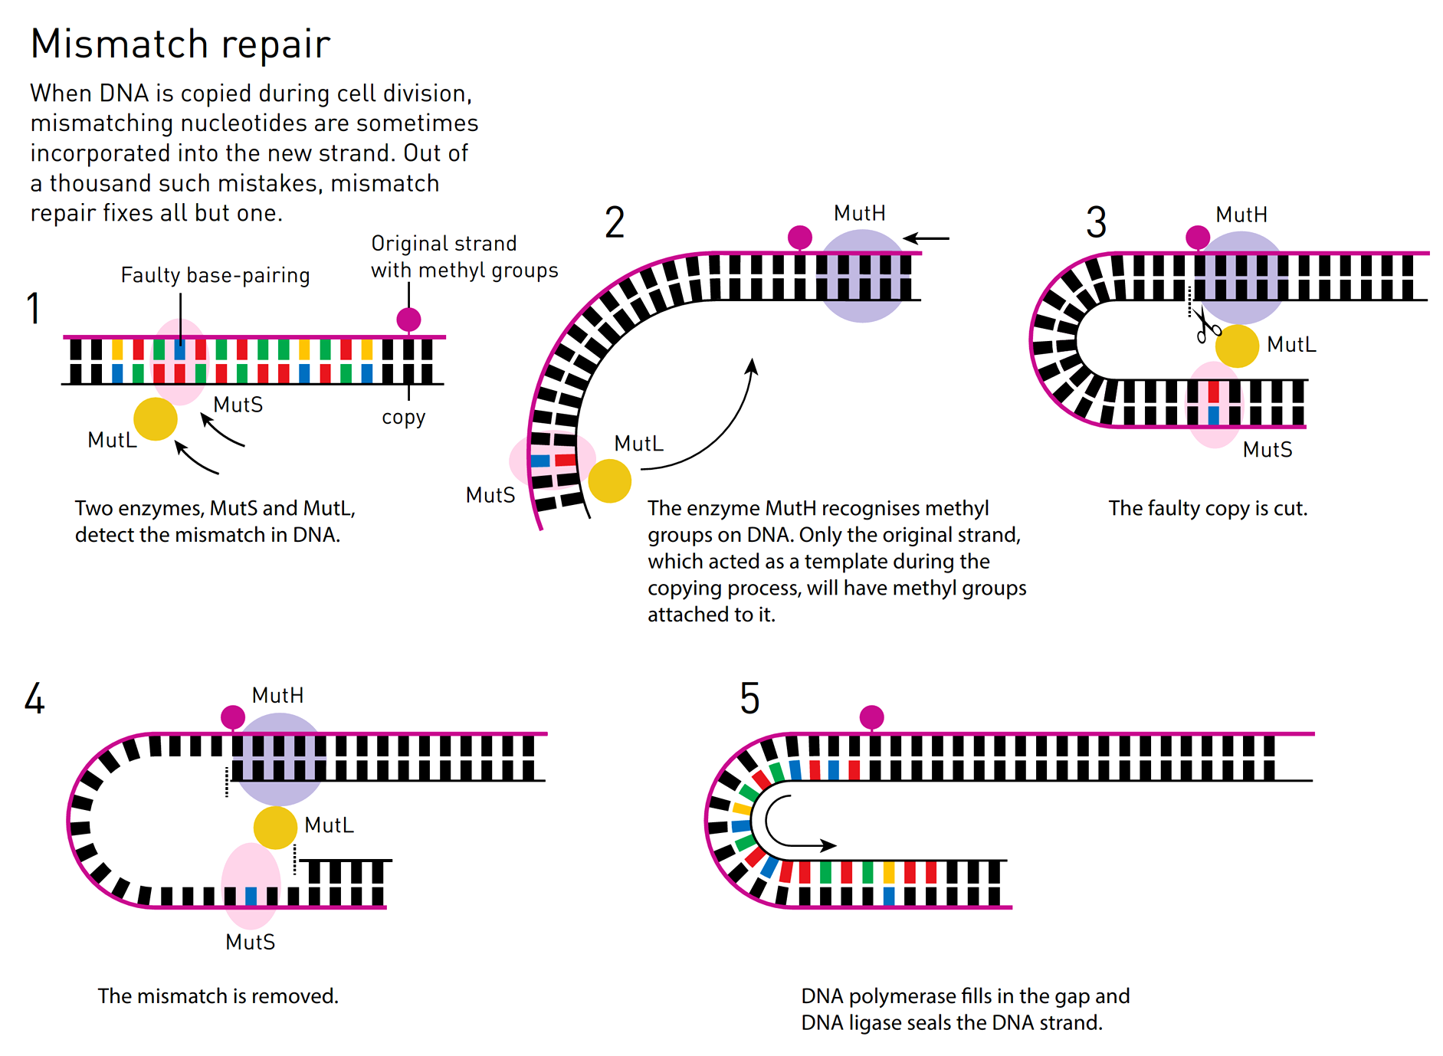
A second protein complex cuts
the DNA near the mismatch,
and more enzymes chop out
the incorrect nucleotide and
a surrounding patch of DNA.

Slide 62
DNA mismatch repair
When two bases are mispaired (like the G and T), how the proteins involved in DNA repair can tell which of the two base should be removed and replaced?
In bacteria, original and newly made strands of DNA can be told apart by a feature called methylation state. An old DNA strand will have methyl (−CH​3​​) groups attached to some of its bases, while a newly made DNA strand will not yet have gotten its methyl group.
In eukaryotes, the processes that allow the original strand to be identified involve recognition of nicks (single-stranded breaks) that are found only in the newly synthesized DNA.

Slide 63
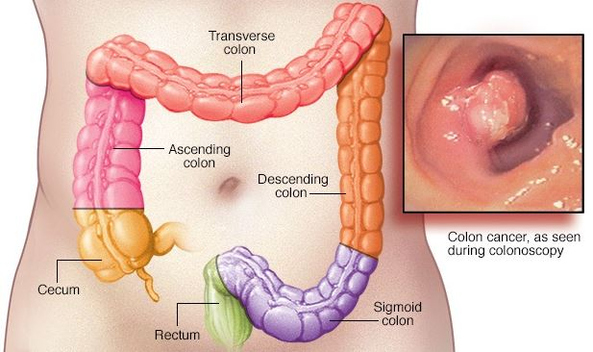
Diseases caused by impaired mismatch repair process
Hereditary nonpolyposis colorectal cancer (HNPCC) or Lynch syndrome, is an inherited disorder that increases the risk of many types of cancer, particularly colorectal cancer. People with Lynch syndrome also have an increased risk of cancers of the stomach, small intestine, liver, ovarian, upper urinary tract, brain, and skin.
The hereditary mutation of one of the five DNA mismatch repair genes (MSH-2, MSH-6, MLH-1, PMS-1 ve PMS-2) results in disease.
Since mismatched bases are not repaired in the cells of people with this syndrome, mutations accumulate much more rapidly than in the cells of an unaffected person.
Accounts for 2-5% of all colon cancers

Slide 64
DNA damage and repair mechanisms
DNA can be damaged at almost any point in a cell's lifetime, not just during replication.
DNA is getting damaged all the time by outside factors like UV light, chemicals, X-rays and spontaneous chemical reaction.
Our cells have repair mechanisms to detect and correct many types of DNA damage.

Slide 65
Repair processes that help fix damaged DNA
Direct reversal
Some DNA-damaging chemical reactions can be directly "undone" by enzymes in the cell.
photoreactivation
methyl group removal
Excision repair
Damage to one or a few bases of DNA is often fixed by removal (excision) and replacement of the damaged region:
base excision repair- the damaged base is removed
nucleotide excision repair- a patch of nucleotides is removed.
Double-stranded break repair:
there are wo major pathways:
non-homologous end joining (NHEJ)
homologous recombination, used to repair double-stranded breaks in DNA (that is, when an entire chromosome splits into two pieces).

Slide 66
Direct reversal DNA damage repair
DNA damage is fixed simply by reversing the chemical reaction that caused it.
DNA damage often just involves an extra group of atoms getting attached to DNA through a chemical reaction.

Slide 67
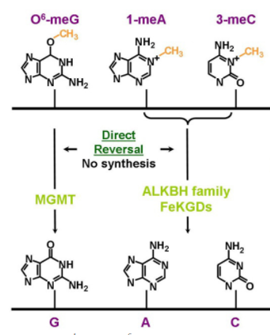
Direct reversal DNA damage repair
Methyl group removal
Guanine can undergo a reaction that attaches
a methyl –CH₃ group to an oxygen atom in the base.
The methyl-bearing guanine, if not fixed,
will pair with thymine (T) rather than cytosine (C)
during DNA replication.
MGMT- O-6-methylguanine-DNA methyltransferase and
Fe(II)/α-ketoglutarate dioxygenases (FeKGDs)
are enzymes that can remove the methyl group,
reversing the reaction and returning the base to normal.
The methyl group is transferred to the enzyme itself,
inactivating the protein.

Slide 68
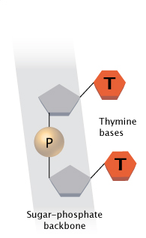
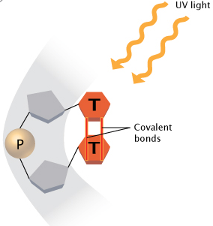
Direct reversal DNA damage repair- photoreactivation
UV radiation causes
formation of thymine dimers
These pyrimidine covalently linked (C-C or T-T) dimers arise on the same strand of DNA.

Slide 69
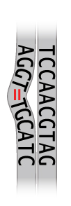
Direct reversal DNA damage repair- photoreactivation
Both of these lesions distort DNA's structure,
introducing bends or kinks and thereby impeding transcription and replication.
One "hot spot" for UV-induced damage is found within a commonly mutated oncogene, the p53 gene.

Slide 70
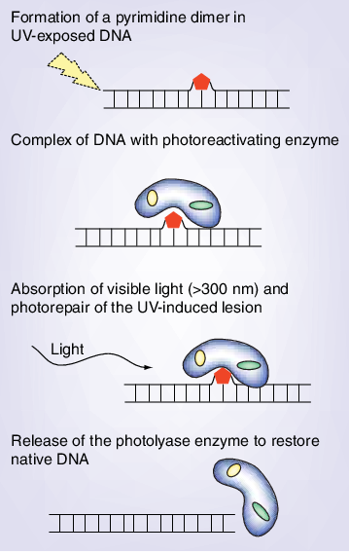
Direct reversal DNA damage repair- photoreactivation
In photoreaction process, an enzyme – DNA photolyase
reverses the dimerization reaction by breakdown the
covalent bond upon absorbing blue light.
Photoreaction occurs in bacteria, yeast, insects, plants
and some vertebrates, but is no longer working in humans.

Slide 71
Repair processes that help fix damaged DNA
Direct reversal
Some DNA-damaging chemical reactions can be directly "undone" by enzymes in the cell.
photoreactivation
methyl group removal
Excision repair
Damage to one or a few bases of DNA is often fixed by removal (excision) and replacement of the damaged region:
base excision repair- the damaged base is removed
nucleotide excision repair- a patch of nucleotides is removed.
Double-stranded break repair:
there are wo major pathways:
non-homologous end joining (NHEJ)
homologous recombination, used to repair double-stranded breaks in DNA (that is, when an entire chromosome splits into two pieces).

Slide 72
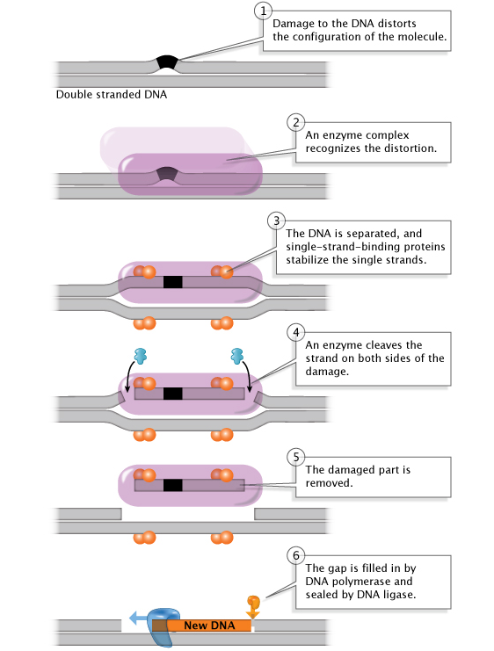
Nucleotide excision repair (NER)
Nucleotide excision repairs DNA injures caused by
UV radiation or carcinogenic substances like
those found in cigarette smoke.
In eukaryotes, this complex process relies
on the products of approximately 30 genes.
The XP genes are among them.

Slide 73
Nucleotide excision repair (NER) associated diseases
Defects in some of the genes involved in NER have been shown to cause the human disease
xeroderma pigmentosum (XP),
predisposition to development of skin cancer (risk of skin cancer is elevated about a thousand fold over normal).

Slide 74
Nucleotide excision repair (NER) associated diseases
Xeroderma pigmentosum (XP)
XP -autosomal recessive disorder has a frequency of 1 in every 250,000 individuals of all races and ethnic groups.
People with xeroderma pigmentosum are extremely sensitive to UV light. They develop severe sunburns from just a few minutes in the sun, and about half will get skin cancer by the age of 10 unless they avoid the sun.
When NER process doesn't work, thymine dimers and other forms of UV damage can't be repaired leading to genetic instability and skin cancer.

Slide 75
Nucleotide excision repair (NER) associated diseases
Xeroderma pigmentosum
The molecular basis of XP has been attributed to mutations in any of the eight XP genes.
The XPA, XPC and XPE proteins are needed to recognize the photoproducts in DNA and initiate the repair process.
XPB and XPD are part of the basal transcription factor. They are helicases that create the DNA strand opening.
XPG and XPF are endonucleases that allow resynthesis using nondamaged strand as template.

Slide 76
Repair processes that help fix damaged DNA
Direct reversal
Some DNA-damaging chemical reactions can be directly "undone" by enzymes in the cell.
photoreactivation
methyl group removal
Excision repair
Damage to one or a few bases of DNA is often fixed by removal (excision) and replacement of the damaged region:
base excision repair- the damaged base is removed
nucleotide excision repair- a patch of nucleotides is removed.
Double-stranded break repair:
there are wo major pathways:
non-homologous end joining (NHEJ)
homologous recombination, used to repair double-stranded breaks in DNA (that is, when an entire chromosome splits into two pieces).

Slide 77
Base excision repair (BER)
BER is the predominant mechanism that handles the spontaneous DNA damage caused by free radicals and other reactive species generated by metabolism.
Bases can become oxidized, alkylated, or hydrolyzed through interactions with these agents.
The deamination of cytosin to uracil happens at a significant rate in cells. Uracil will pair with adenine rather than cytosine, so an uncorrected cytosine-to-uracil change can lead to a mutation.
Deamination converts adenine to hypoxanthine, which hydrogen bonds to cytosine rather than to thymine.

Slide 78
A group of enzymes called
glycosylases play a key role in
base excision repair.
Each glycosylase detects
and removes a specific kind of
damaged base.
AP (apurinic/apyrimidinic) endonuclease

Slide 79
Repair processes that help fix damaged DNA
Direct reversal
Some DNA-damaging chemical reactions can be directly "undone" by enzymes in the cell.
photoreactivation
methyl group removal
Excision repair
Damage to one or a few bases of DNA is often fixed by removal (excision) and replacement of the damaged region:
base excision repair- the damaged base is removed
nucleotide excision repair- a patch of nucleotides is removed.
Double-stranded break repair:
there are wo major pathways:
non-homologous end joining (NHEJ)
homologous recombination, both used to repair double-stranded breaks in DNA (that is, when an entire chromosome splits into two pieces).

Slide 80
Ionizing radiation DNA damage repair
Ionizing (high energy) radiation introduce highly deleterious
double-strand breaks in DNA molecule
(splitting a chromosome in two).
They
interfere with transcription or replication
can lead to chromosomal rearrangements- pieces of one chromosome
become attached to another chromosome. Genes are disrupted in this process,
leading to hybrid proteins or inappropriate activation of genes.
If the break is not repaired large segments of chromosomes,
and the hundreds of genes they contain, may be lost.
A number of cancers are associated with such rearrangements.

Slide 81
Non-homologous end joining (NHEJ)
The process is initiated by the binding of the DNA- protein kinase (DNA-PK) complex (KU70/KU80 heterodimer) to the DNA ends.
KU dimer recruits DNA-PKcs catalytic subunit to form an active DNA-PK holoenzyme.
DNA-PK activation helps the recruitment of multiple proteins involved in the limited DNA end-processing (Artemis, pol μ, pol λ, and TDK) required to generate ligatable DNA ends.
Ligation is mediated exclusively by the LIG4/XRCC4 complex and is assisted by the ligation mediator XLF.
At the end of this process the DNA integrity at the break is restored, but the DNA sequence at the junction may be altered. NHEJ is an error-prone DSB repair mechanism.

Slide 82
Homologous recombination (HR)
In this process, the two homologous chromosomes come together, and the undamaged region of the homologue or chromatid is used as a template to replace the damaged region of the broken chromosome.
DNA ends are first processed in order to create single-strand overhangs, a process that is likely mediated by the MRN (Mre11/Rad50/Nbs1) complex.
Rad51, Rad52, and RPA associate with these overhangs, followed by the formation of a joint molecule by the damaged and undamaged strands.
Template guided DNA synthesis and resolution of the two strands then complete repair of the DSB.
Homologous recombination is “cleaner” than non-homologous end joining and does not usually cause mutations.

Slide 83
Many human diseases are associated with deficiencies in DNA DSB repair and can be characterized by neuropathology, immune deficiency, growth retardation or predisposition to cancer.
Ataxia-telangiectasia or Louis–Bar syndrome is a rare, neurodegenerative, autosomal recessive disease causing severe disability.
Ataxia refers to poor coordination and telangiestasia to small dilated blood vessels, both of which are hallmarks of the disease.
A-T affects many parts of the body:
It impairs certain areas of the brain causing difficulty with movement and coordination.
It weakens the immune system , causing a predisposition to infection.
It prevents repair of broken DNA, increasing the risk of cancer.
A-T is caused by a defect in the ATM gene.
ATM serine/threonine kinase (ATM), is a serine/threonine protein kinase that is recruited and activated by DNA double- strand breaks. It phosphorylates several key proteins that initiate activation of the DNA damage repair.

Slide 84
Mutations in an organism's DNA are a part of life.
The errors that slip through the DNA repair processes may sometimes be associated with disease, but they are also a source of variation that can be selected upon evolution and natural selection as beneficial to life.

