Slide 1
Basics of Genetics
2017/2018

Slide 2
Structure of the course
General genetics
lectures (7)
practice (3)
Molecular genetics
lectures (7)
practice (2)
Lectures: September 04 – December 11, 2017
Practice: September 04 – December 04, 2017

Slide 3
Teachers
Īzaks Rašals (Isaak Rashal)
General genetics, lectures
Head of the Plant Genetics Laboratory,
Institute of Biology, University of Latvia
izaks.rasals@lu.lv
Dace Grauda
General genetics, practice
Ilona Mandrika
Molecular genetics, lectures, practice

Slide 4
Evaluation
Completed laboratory works
Writing tests
general genetics
molecular genetics
Final score from both tests

Slide 5
Textbooks
Lectures
Any available textbook in part of general genetics
in tests nothing more than in lectures or/and laboratory works

Slide 6
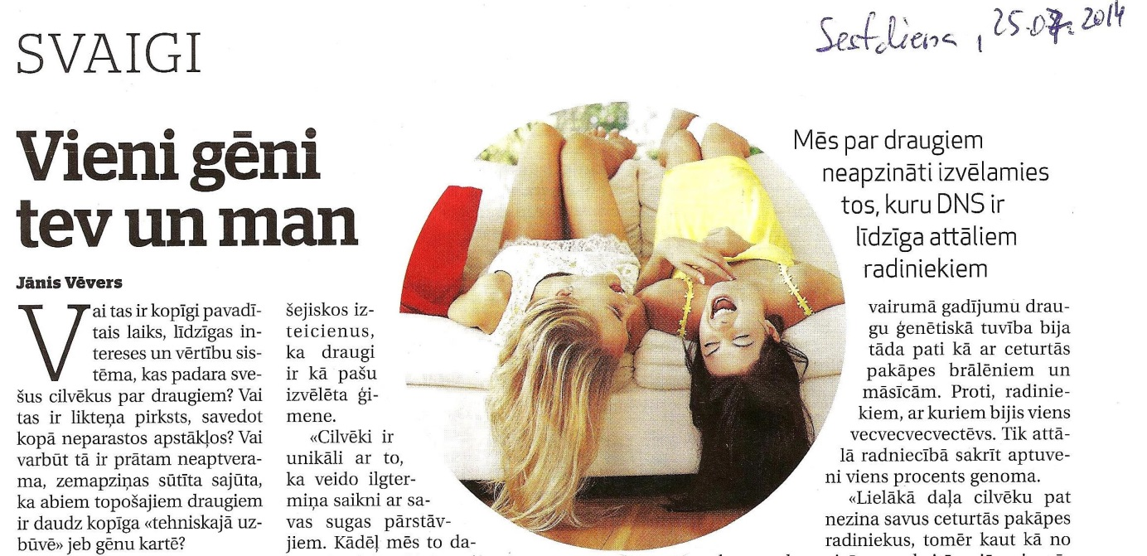
Genes controlling everything …

Slide 7
Subject of Genetics
Genetics – science about inheritance and variability
Inheritance and variability – two sides of the same process
similarity among parents and offspring, sibs etc.
difference ...

Slide 8
Importance of any science
theoretical
understanding of the world around us
applied
necessity of society

Slide 9
Theoretical importance of genetics
Development
evolutionary (phylogenesis)
changes of genotypes (adaptation)
not possible to understood without genetics
individual (ontogenesis)
realisation of the genetic information (any process in biology)
not possible to understood without genetics

Slide 10
Applied importance of genetics
What is needed for normal life of human being
food
good health
……………………..
Food sources
hunting
fishing
agriculture
technology
varieties (created by breeding)

Slide 11
Breeding
From genetics point of view breeding is the producing of new genotypes, which are suitable for human needs
evolution driven by humans
genetics theoretical background of breeding
understanding processes happened during the breeding
methods of creating and testing of new genetic variability

Slide 12
Health
Diseases
hereditary
understanding
choose of treatment
diagnostics (incl. prenatal)
genetic consultations
gene therapy
nonhereditary
understanding
diagnostics
producing of medicinal drugs (biotechnology)

Slide 13
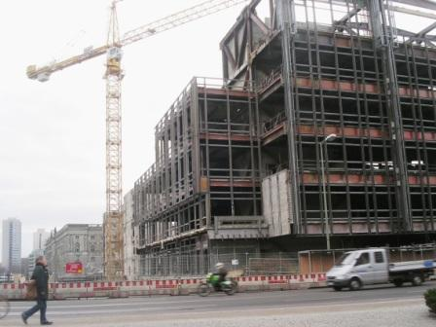
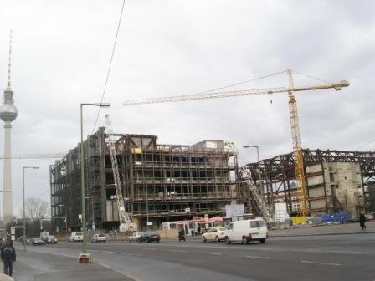
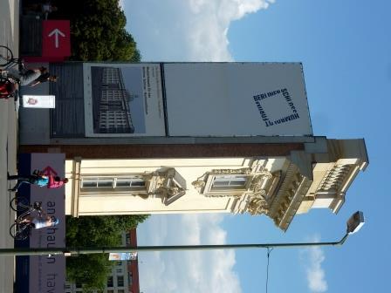
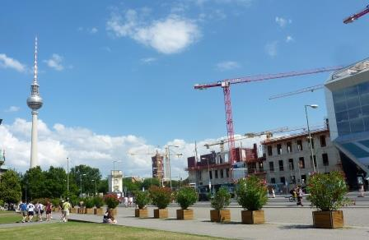
Health
Environment
diversity (including genetic)
mutagens
pollution from industry and agriculture
materials used in building construction
food (!)

Slide 14
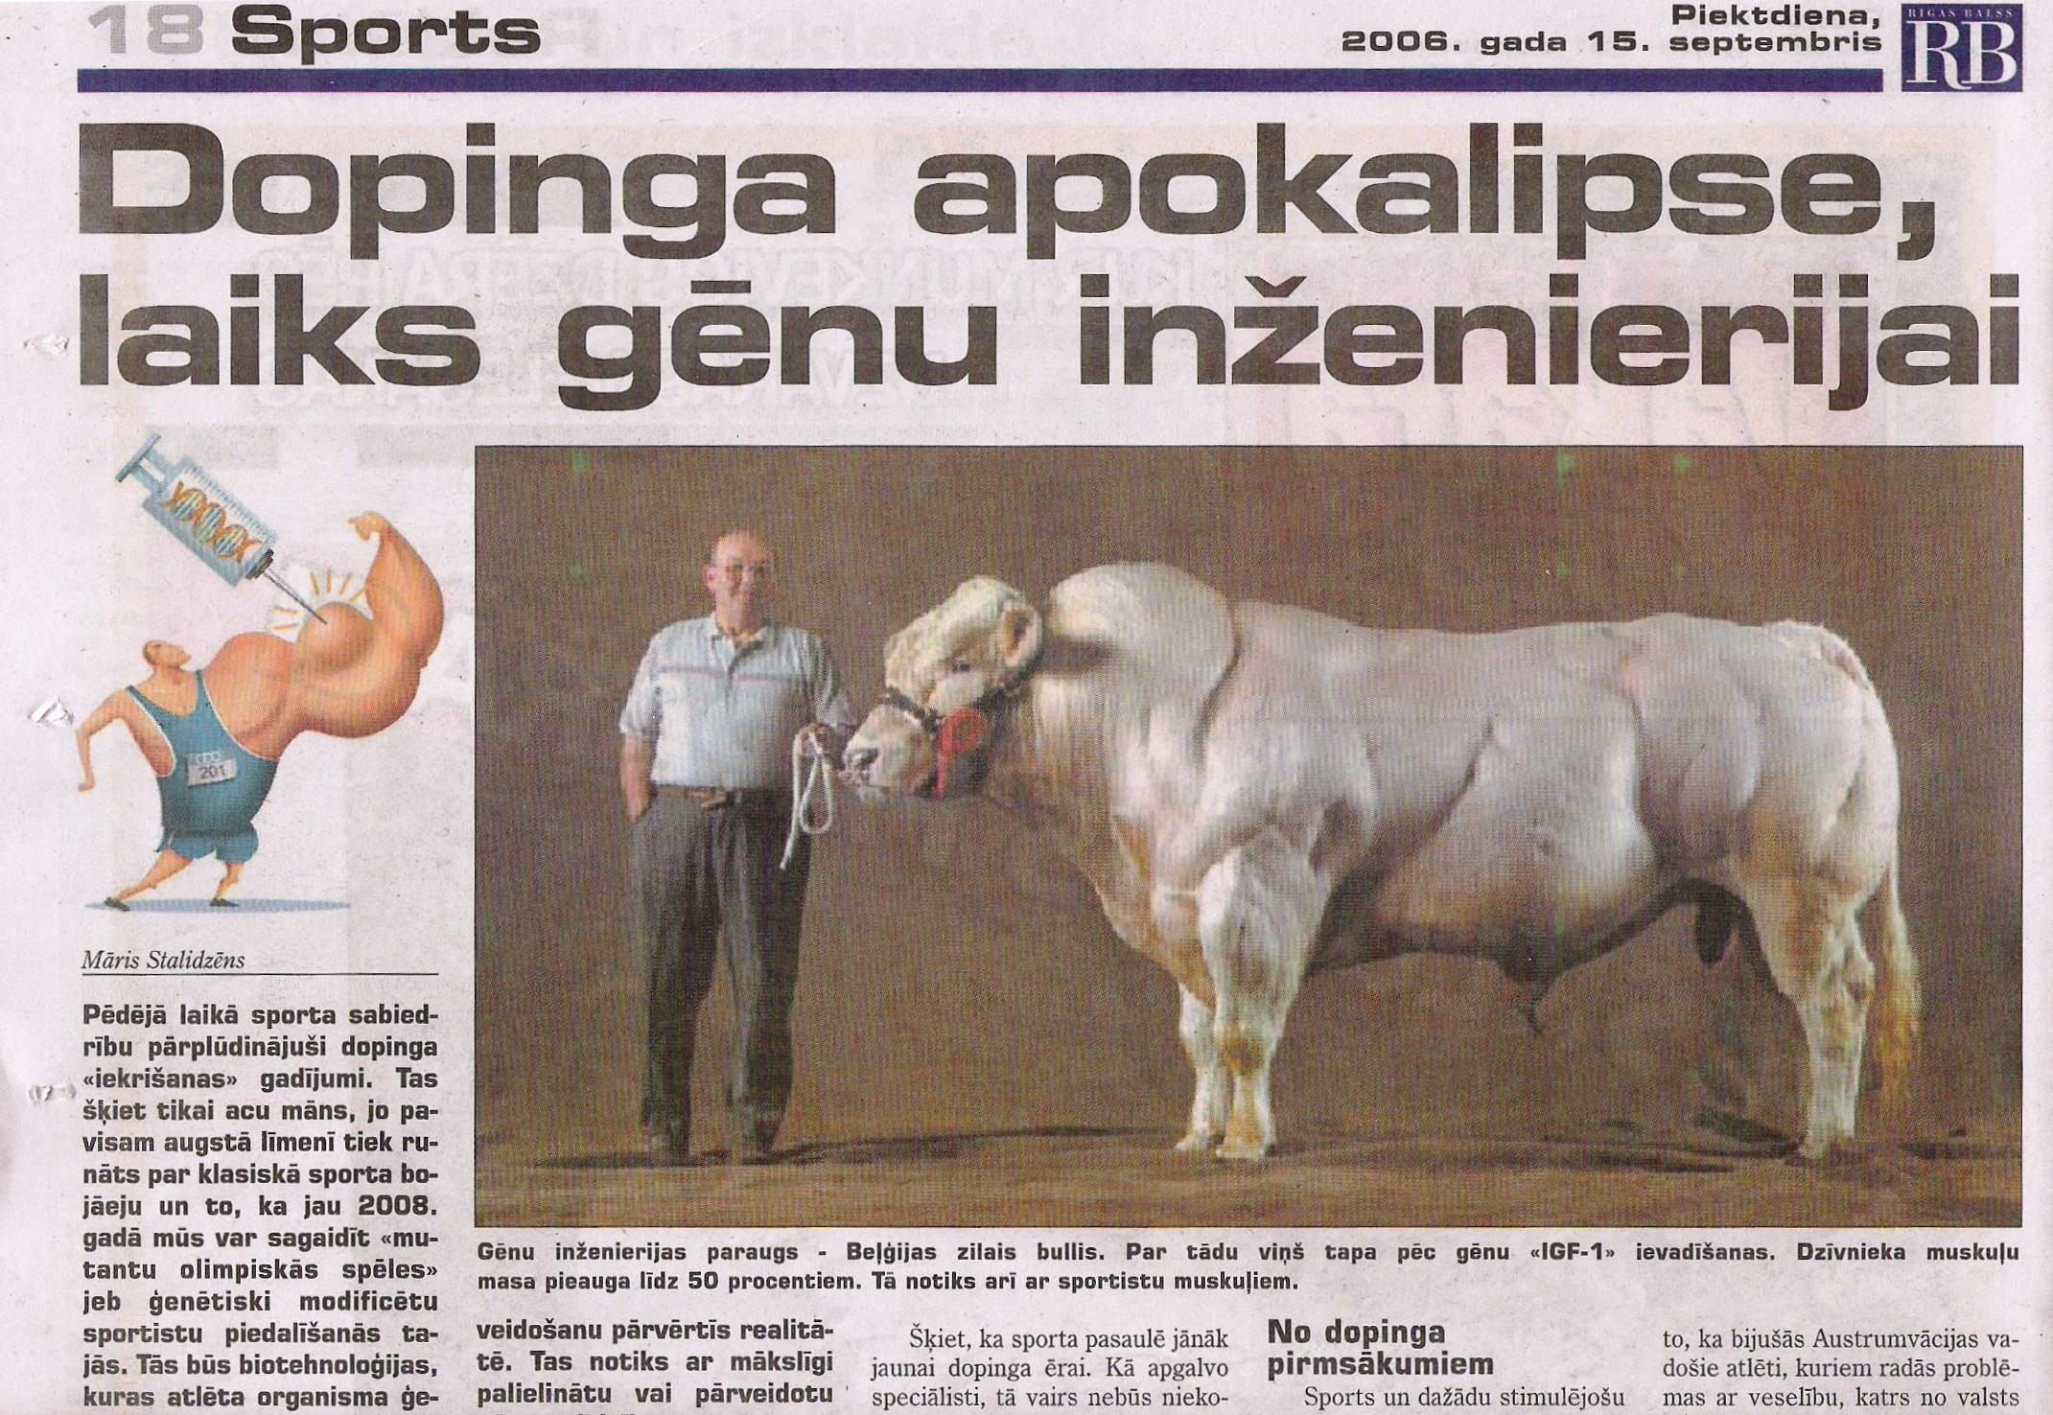
Medicine and sport

Slide 15
Medicine and sport

Slide 16
Contemporary genetics
Rapid progress thanks to development of methods of molecular biology and genetics
direct analysis of genome, including full sequencing
specific manipulation with genomes
Wide attention of the society to genetic achievements
GMO (genetically modified organisms, genetically engineered organisms)
animal (human) cloning
gene therapy

Slide 17
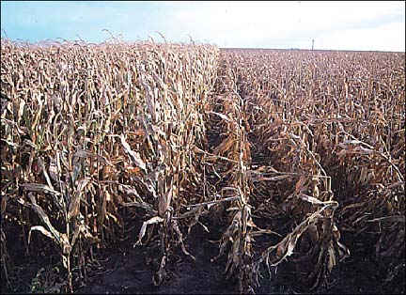
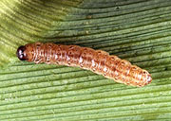
Maize hybrids with Bt gene
European corn borer Pyrausta nubilaris

Slide 18
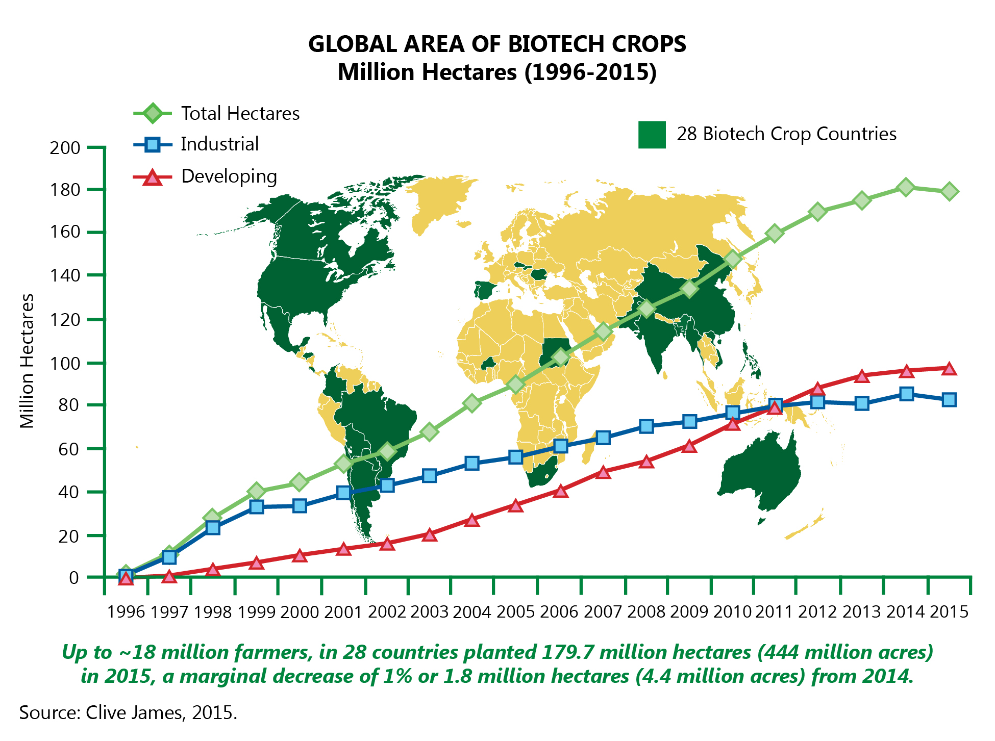

Slide 19
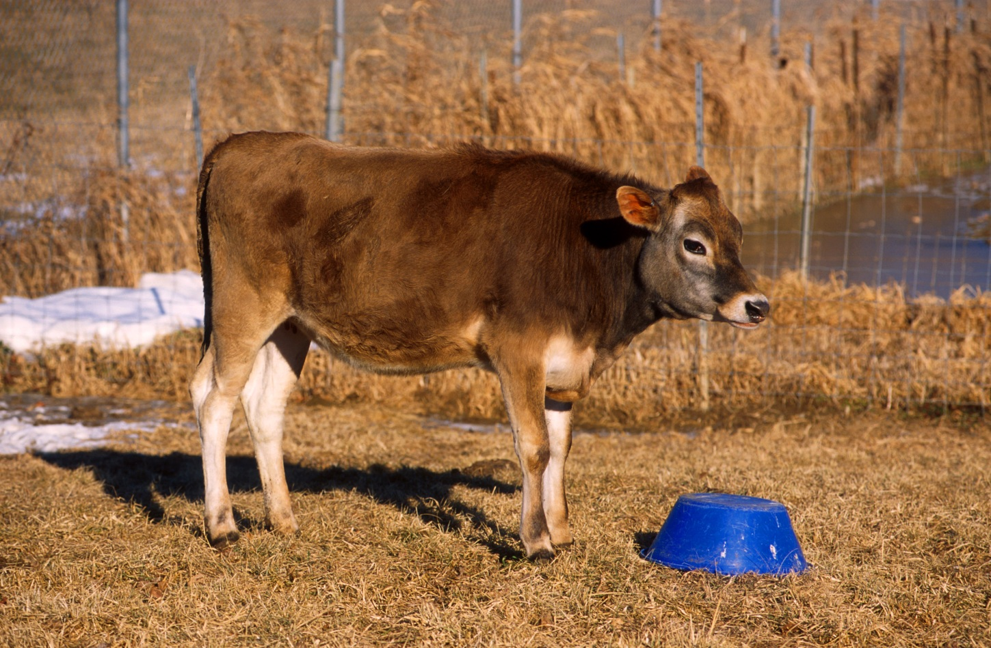
Annie (March, 2000) a first cloned cow with practically important gene
Goal: synthesis of the lysostaphin which suppress the development of the bacteria Staphylococcus aureus

Slide 20
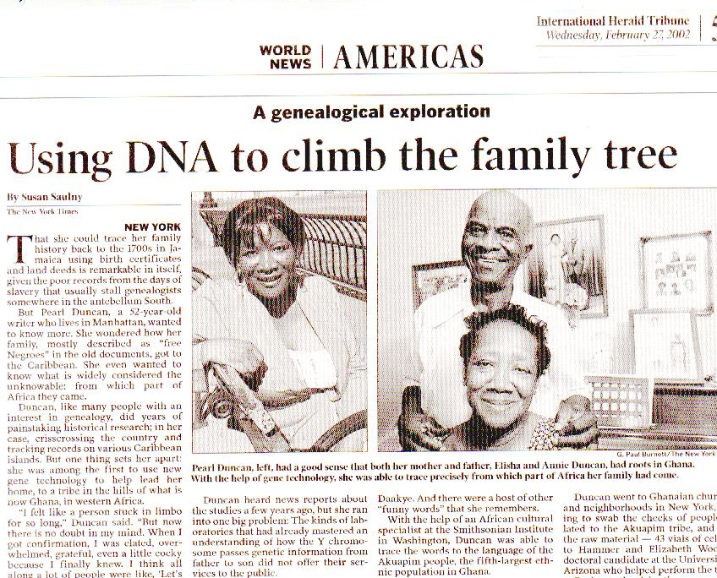

Slide 21
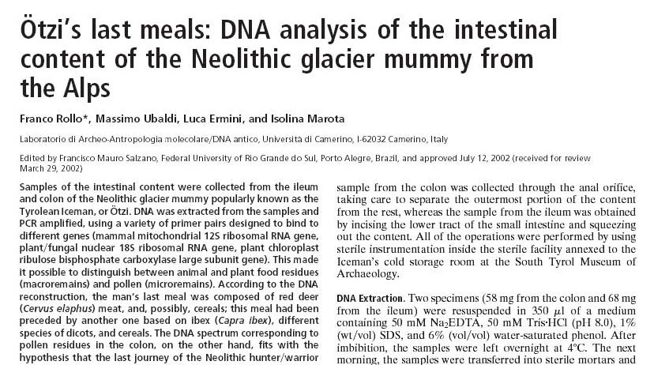

Slide 22
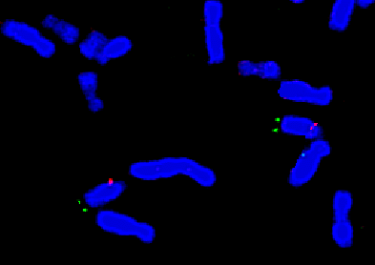
Test for deletion 15q11-13 (Prader-Willi syndrome)
Probe for detection of chromosome 15 (green)
Probe for detection of the deletion region (red)

Slide 23
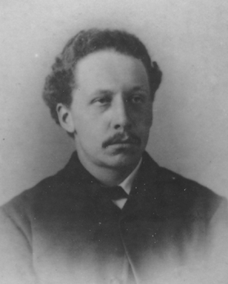
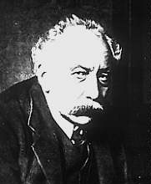
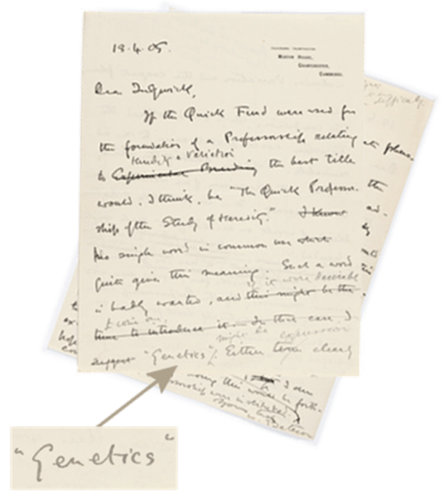
Genetics
As science since 1900. g.
The term genetics introduced by
William Bateson (UK) in 1905
(before and long after
as “mendelism”)
William Bateson
(1861-1926)
Letter to Adam Sedgwick

Slide 24
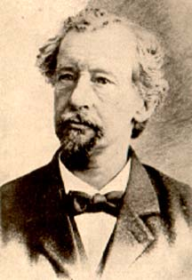
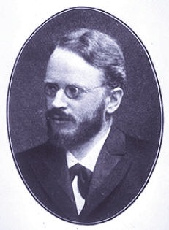
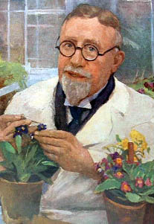
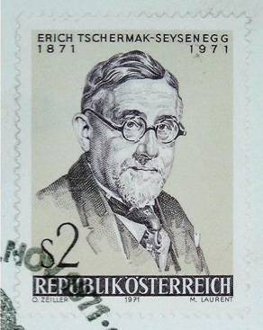
Recovering of Mendel's work, 1900
Hugo de Vries (1848-1935), The Netherlands
Carl Correns (1864-1933), Germany
Erich von Tschermak (1871-1962), Austria

Slide 25
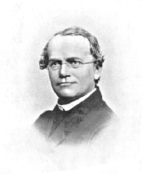
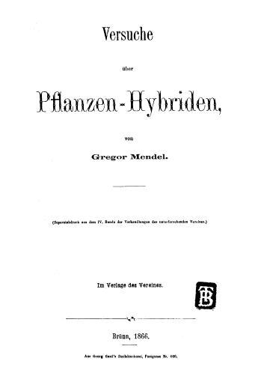
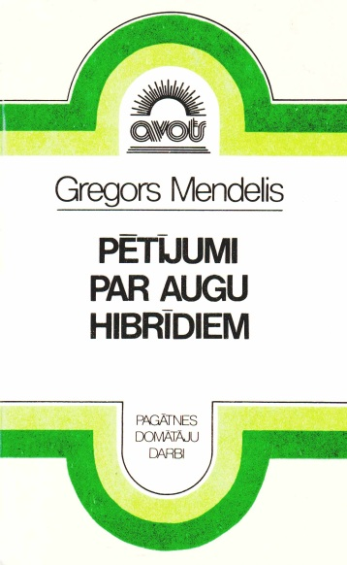
Georg Mendel (1822 - 1884)
Experiments with Plant Hybrids
lectures on February 8 and March 8, 1865, at the meetings of the Association for Natural Research in Brno
Published in the Proceedings of the Association, 1866
Verhandl. Naturforsch. Vereines Brünn, 1866, 4, Abhandlungen, S. 3-47
Original edition
Translation in Latvian, 1979

Slide 26
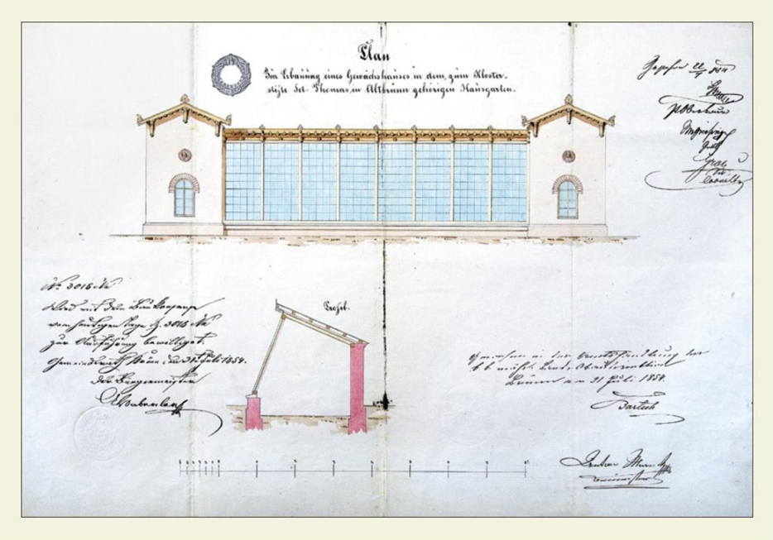
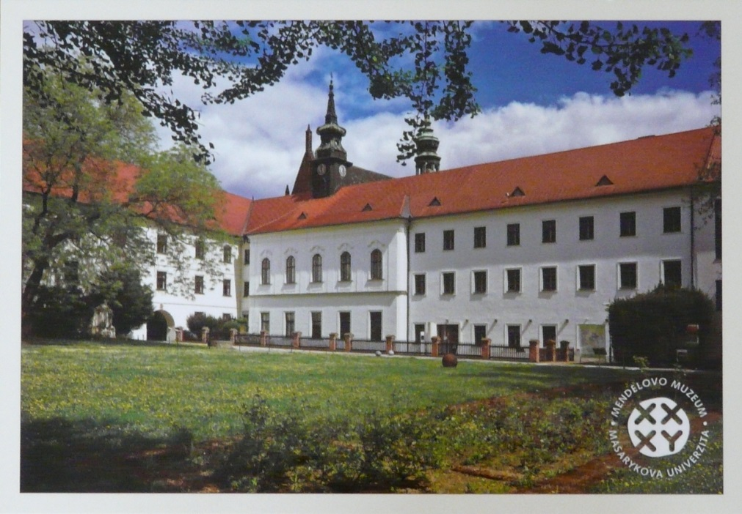
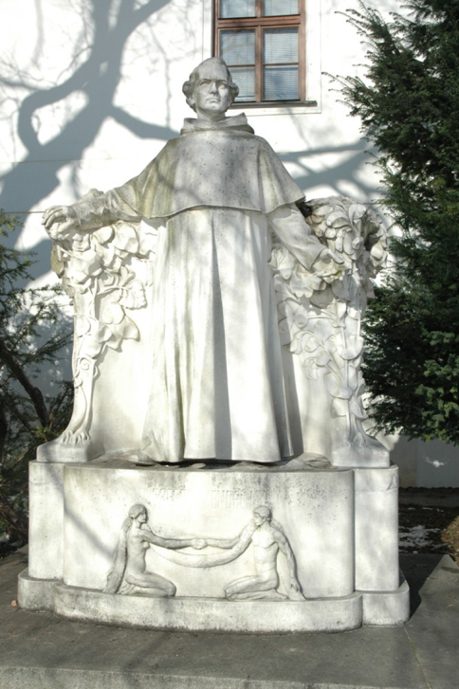
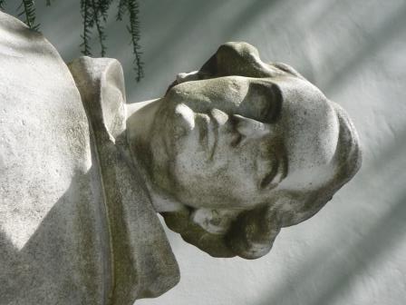
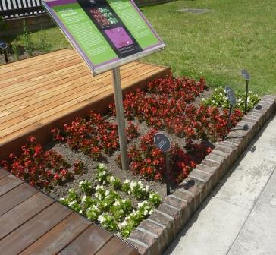
Place of the experiment

Slide 27
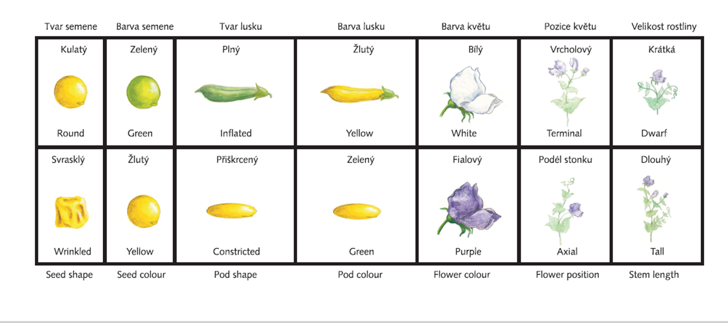
Traits of the pea used in the experiment

Slide 28
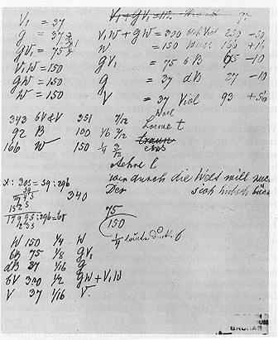
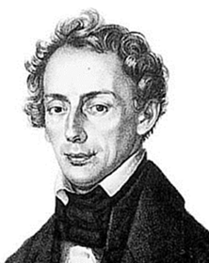
Main particularities of the Mendel experiment
using of [genetically] homogeneous lines
analysis of inheritance of separate traits
growing of all possible offsprings
mathematical analysis of the segregation
Christian Doppler

Slide 29
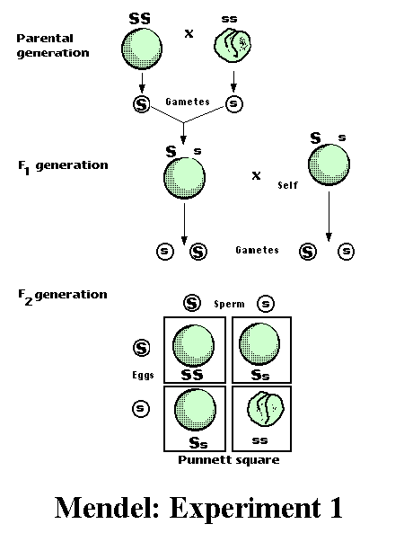
Mendel's experiment monohybrid crossing
Homogeneity of F₁
Segregation of phenotypes in F₂ 3:1

Slide 30
Main Mendel’s conclusions
traits are determined by special hereditary factors which each individuals get both from mother and father
these factors can be “hard” or “week” but they did not disappeared even if they function is not visible

Slide 31
Mendel's principles (rules)
1. Uniformity of F₁ generation.
2. Segregation in F₂ generation in particular proportions.
3. Independent assortment (independent segregation) of forms of separate traits.

Slide 32
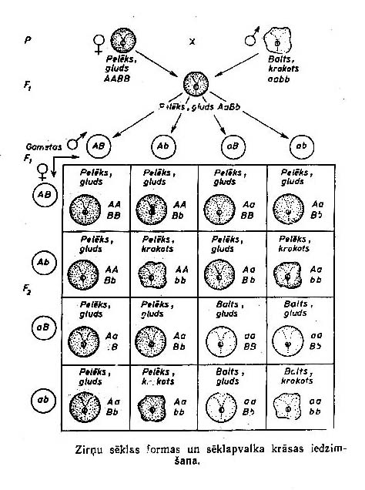
Dihybrid segregation
Genotypes (3^{n})
AABB 1
AABb 2
AAbb 1
AaBB 2
AaBb 4
Aabb 2
aaBB 1
aaBb 2
aabb 1
Phenotypes (2^{n})
A–B– 9
A–bb 3
aaB– 3
aabb 1

Slide 33
Model objects in general genetics
Prerequisites:
diploid
sexually propagated
easy cultivation of big numbers of individuals
short lifetime time

Slide 34
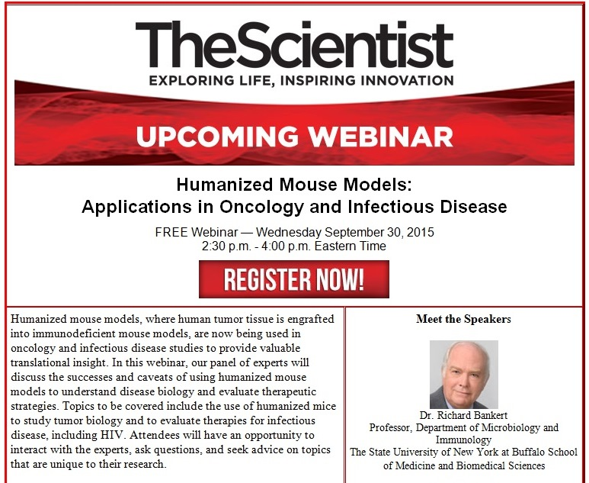
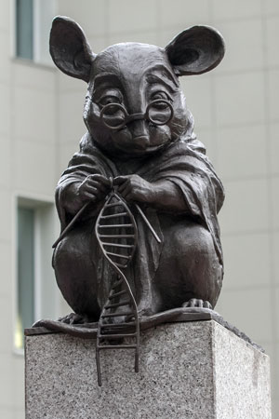
Model objects in genetics (sample)
pea (Mendel)
drosophila
Arabidopsis thaliana
mouse
rice
Escherichia coli
Saccharomyces cerevisiae

Slide 35
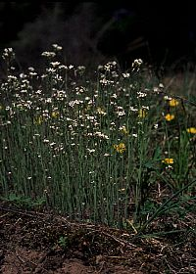
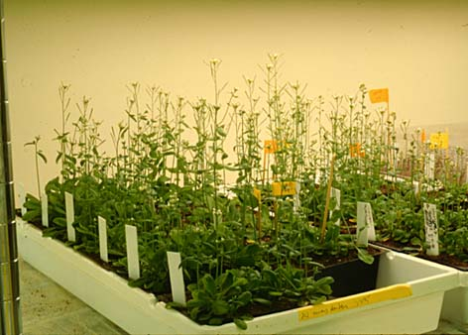
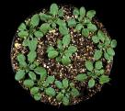
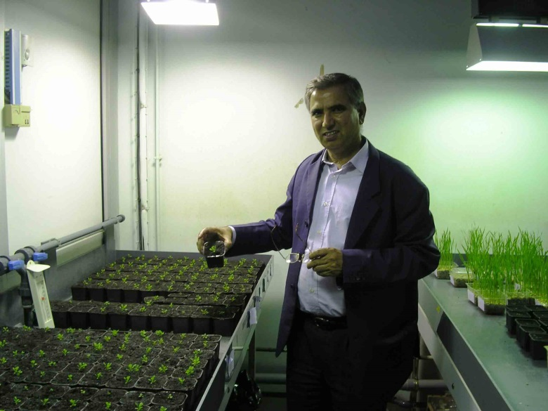
Arabidopsis thaliana (L.) Heynh.
Thale cress, mouse-ear cress, arabidopsis
Johannes Thal (1542–1583)

Slide 36
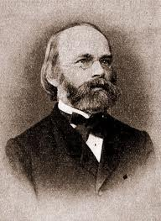
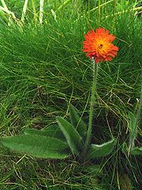
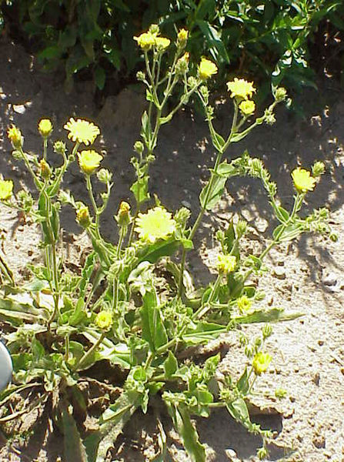
Hieracium – hawkweed, hierakion
Karl Wilhelm von Nägeli
(1817-1891)
[cytoblasts]

Slide 37
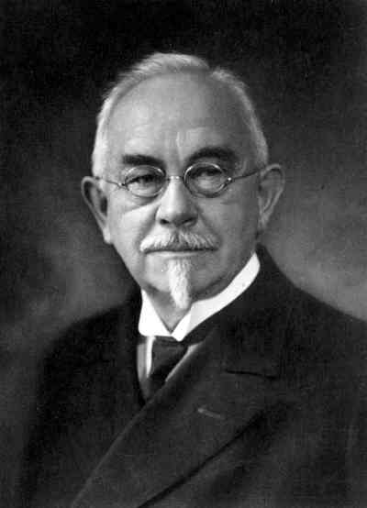
Gene
term introduced by Danish scientist W. Johannsen in 1909
Gene – a hereditary factor responsible for development of specific particularities of the organism
Wilhelm Johannsen
(1857-1927)

Slide 38
Gene
Gene: the fundamental physical and functional unit of heredity.
A gene is an ordered sequence of nucleotides located in a particular position on a particular chromosome that encodes a specific functional product (i.e., a protein or RNA molecule).
Length of a gene can varied from 100 bp till millions of bp

Slide 39
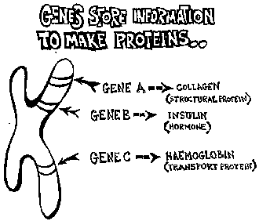
Genes

Slide 40
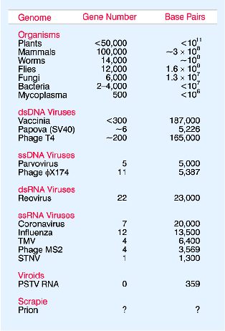
Number of genes

Slide 41
Allele - locus
Allele: an alternate form of a gene.
Variants that occur at the same locus
Multiple allele: number alleles of the one gene (more than two)
Locus: the part of a chromosome, wich coding:
functional gene – coding of a polypeptide chain or RNA
molecular marker

Slide 42
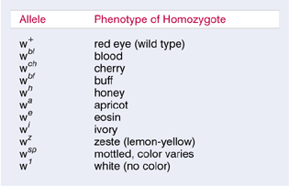
Multiple alleles
Eye colour of Drosophila

Slide 43
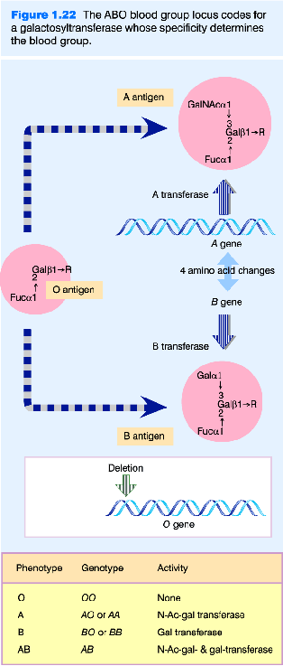
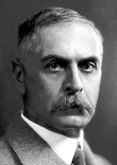
ABO blood groups
I^{A}-
ii
I^{B}-
Karl Landsteiner
(1868-1943)

Slide 44
Multiple alleles
Example: phenylketonuria
phenylalanine tyrosine
phenylalanine hydroxylase
Recently was considered that the enzyme is coded by the gene with two alleles (non-functional is recessive)
Molecular analysis shown more than 50 alleles in the locus
Most alleles has not phenotypic effect
8 alleles in homozygotic conditions have enzyme activity 1 – 50% from the norm.

Slide 45
Multiple alleles
How many alleles in an locus?
if a gene only 100 bp
in a position one of four nucleotides
possible number of alleles – 4¹⁰⁰
not all alleles have own phenotype
all alleles can be recovered only by sequencing
SNP - single nucleotide polymorphism

Slide 46
Genotype - genome
Genome – set of genes in the haploid chromosome complex
A B C D E F G
Characteristic for a species (typical, normal)
Genotype – set of all alleles (genes) of the particular individual
A B c D e F G
a B C d e F g
Different for the each individual

Slide 47
Trait, phenotype
Trait – morphological, anatomical, physiological, biochemical or another particularities of an individual.
Phenotype – set of the all traits of an individual.

Slide 48
Haploid - diploid
Haploid: a single set of chromosomes (half the full set of genetic material).
Present in the egg and sperm cells of animals and in the egg and pollen cells of plants. Human beings have 23 chromosomes in their reproductive cells.
Diploid: a full set of genetic material, consisting of paired chromosomes one chromosome from each parental set.
Most animal cells except the gametes have a diploid set of chromosomes. The diploid human genome has 46 chromosomes.

Slide 49
Homozygotic - heterozygotic
Homozygotic organism – an individual with the same alleles of the particular genes.
homozygotic conditions
Complete homozygotic organism – if all genes of an individual are in the homozygotic conditions
Heterozygotic organism – an individual with the different alleles of the particular genes.
heterozygotic conditions
AA
aa
Aa

Slide 50
Gene interactions in a locus
Dominant and recessive alleles
Dominance – one allele (dominant) in heterozygotic condition completely or partly depress manifestation of the other (recessive) allele.

Slide 51
Types of dominance
complete dominance
partial (incomplete) dominance
codominance
Complete dominance – the phenotype of heterozygote Aa is the same as the phenotype of the homozygote AA.

Slide 52
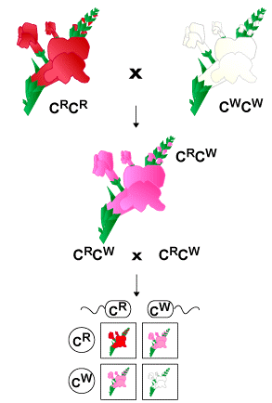
Types of dominance
Partial dominance – the phenotype of heterozygote Aa is the between of phenotypes of homozygotes AA and aa.
Codominance – products of both alleles are expressed.
P
F₁
F₂

Slide 53
Relationships of phenotype and genotype
If expressed a recessive trait
genotype is aa
If expressed a dominant trait
possible two genotypes: AA and Aa
if exact genotype is not known the designation A– is used
In case of partial dominance or codominance the phenotype allows to recognise all genotypes AA, Aa and aa

