Slide 1
Cancer Gene Therapy:
Past, Present and Future
Anna Zajakina, BMC
anna@biomed.lu.lv

Slide 2
What is Gene Therapy?
Gene therapy is a technique for introducing the genetic material of a gene in a patient that lacks that gene because of a mutation.

Slide 3
Five-year survival rates
pancreatic (4%)
lung (15%)
liver (7%)
glioblastoma (5%)
long-term side effects from chemotherapy

Slide 4

Gene therapy principles
AAV
Nucleus
Adenovirus
Therapeutic Protein
Retrovirus/Lentivirus
Target Cell
Naked DNA

Slide 5
Gene Therapy
1. Targeted delivery
2. Efficiency
3. Safety

Slide 6
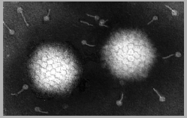

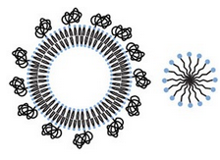

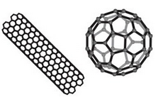


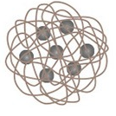

Targeted delivery
Viral
Non-viral
Quantum dots
Polymer
Lipid
Carbon-based
Gold
Magnetic
Dendrimer
Silica
Notes:
Polyamidoamine (PAMAM) dendrimers
Polymere.g., PLGA, glycerol, chitosan, DNA; monomers, copolymers, hydrogelsSome biodegradableDrug delivery; passive release (diffusion), controlled release (triggered)
DendrimerPAMAM, etc.Low polydispersity, cargo, biocompatibleDrug delivery
LipidLiposomes, micellesCan carry hydrophobic cargo, biocompatible, typically 50–500 nmDrug delivery
Quantum dotsCdSe, CulnSe, CdTe, etc.Broad excitation, no photobleaching, tunable emission, typically 5–100 nmOptical imaging
GoldSpheres, rods, or shellsBiocompatibility, typically 5–100 nmHyperthermia therapy, drug delivery
SilicaSpheres, shells, mesoporousBiocompatibilityContrast agents, drug delivery (encapsulation)
MagneticIron oxide or cobalt-based; spheres, aggregates in dextran or silicaSuperparamagnetic, ferromagnetic (small remanence to minimize aggregation), superferromagnetic (~10 nm), paramagneticContrast agents (MRI), hyperthermia therapy
Carbon-basedCarbon nanotubes, buckyballs, grapheneBiocompatibleDrug delivery

Slide 7
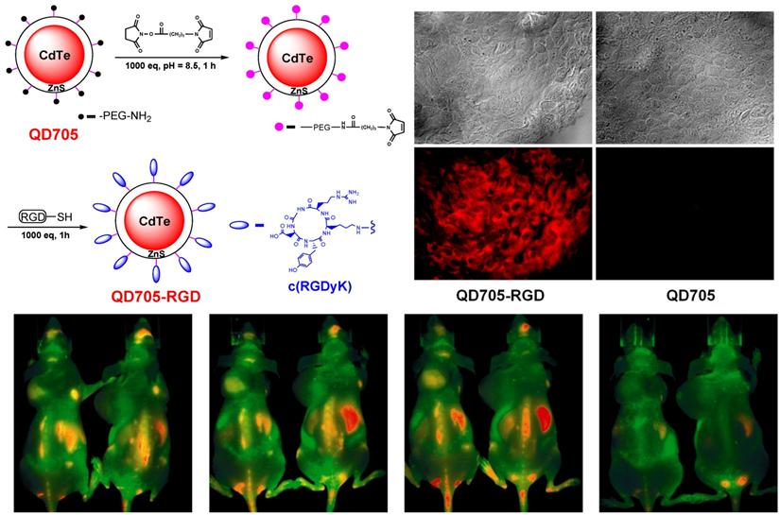
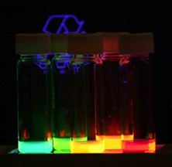
Theranostics 2011; 1:102-126. doi:10.7150/thno/v01p0102
Integrin Targeting for Tumor Optical Imaging
Notes:
c(RGDyK) functionalized QDs targeted to U87MG tumor tissues in vitro and in vivo. (A) Frozen U87MG tumor tissue staining using 50 nM QD705 (control experiment) and QD705-RGD. (B) In vivo NIR fluorescence imaging of U87MG tumor bearing mice injected with 200 pmol of QD705 (left) and QD705-RGD (right), respectively. Images were taken at 6 h after injection. Adapted with permission from
Fluorescence signal of QD705-RGD was observed in the tumor as early as 20 min after i.v. injection (200 pmol of QD705-RGD, 6-10 nmol of peptide).
Kadmija telurīds
Arginine glicine asparagin skābe

Slide 8
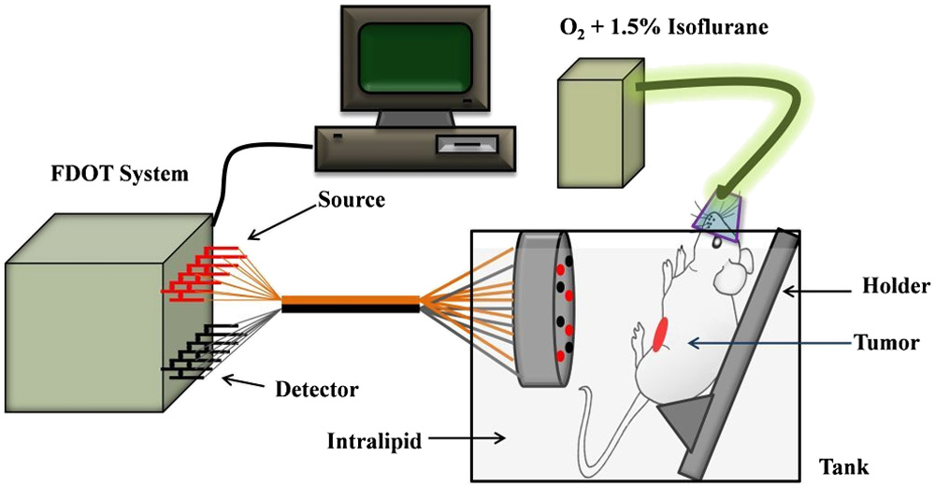
In vivo fluorescence imaging setup.

Slide 9
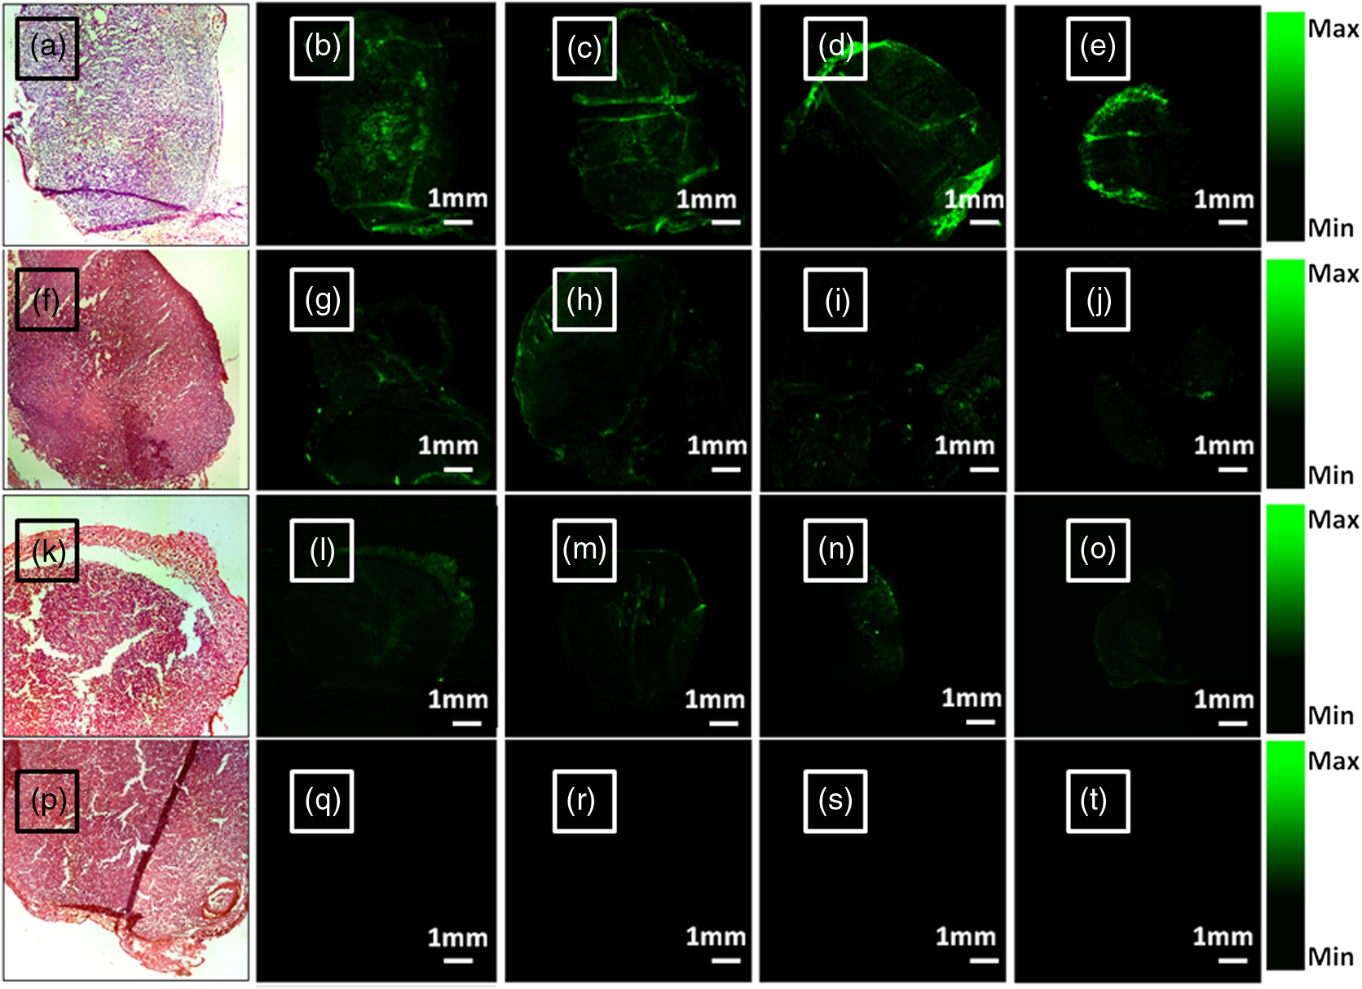
Enhanced fluorescence diffuse optical tomography with indocyanine green-encapsulating liposomes targeted to receptors for vascular endothelial growth factor in tumor vasculature
Journal of Biomedical Optics 18(12), 126014 (December 2013)

Slide 10
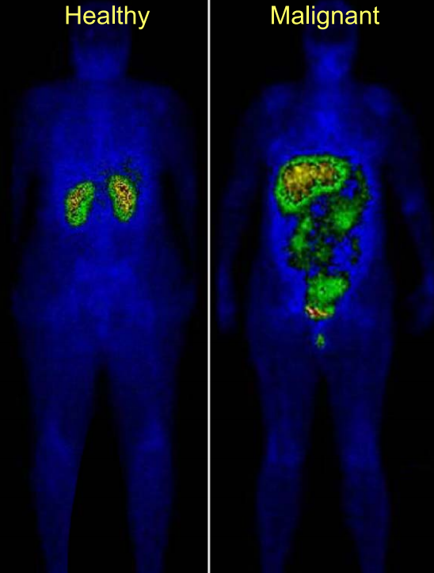
folate-targeted imaging
Scintigraphic image of both a healthy individual and an
ovarian cancer patient obtained 4 h following intravenous
administration of 2 mg 111In-DTPA-folate (courtesy of Endocyte)
Note that uptake of the folate-targeted imaging agent in the healthy
individual is primarily limited to the kidneys, while uptake in the
cancer patient is also seen in the malignant tissue.
Notes:
Radioizotopu imaging

Slide 11
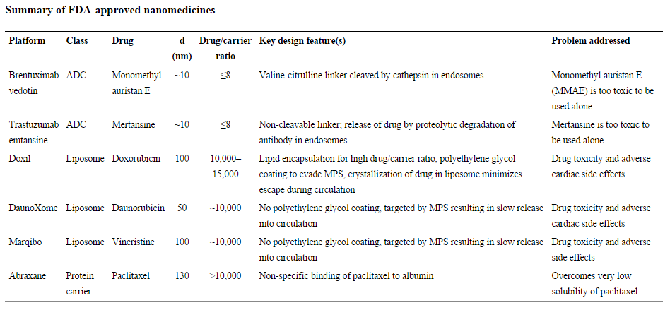
Notes:
Vīrusiem nav konkurentu

Slide 12
Why Viruses?
Viruses through the time of evolution have evolved to infect the cells with great specificity
Viruses tend to be very efficient at transfecting their own genome into the host cell genome.
This allows them to produce new viral particles at the period of synthesis of the cell
Notes:
Итак почему вирусы надо использовать в генной терапии рака и вообще в генной терапии.
Vīrusi evolūcijas gaitā attīstījās pielāgojās piegādāt savu ģenētisko materiālu...

Slide 13
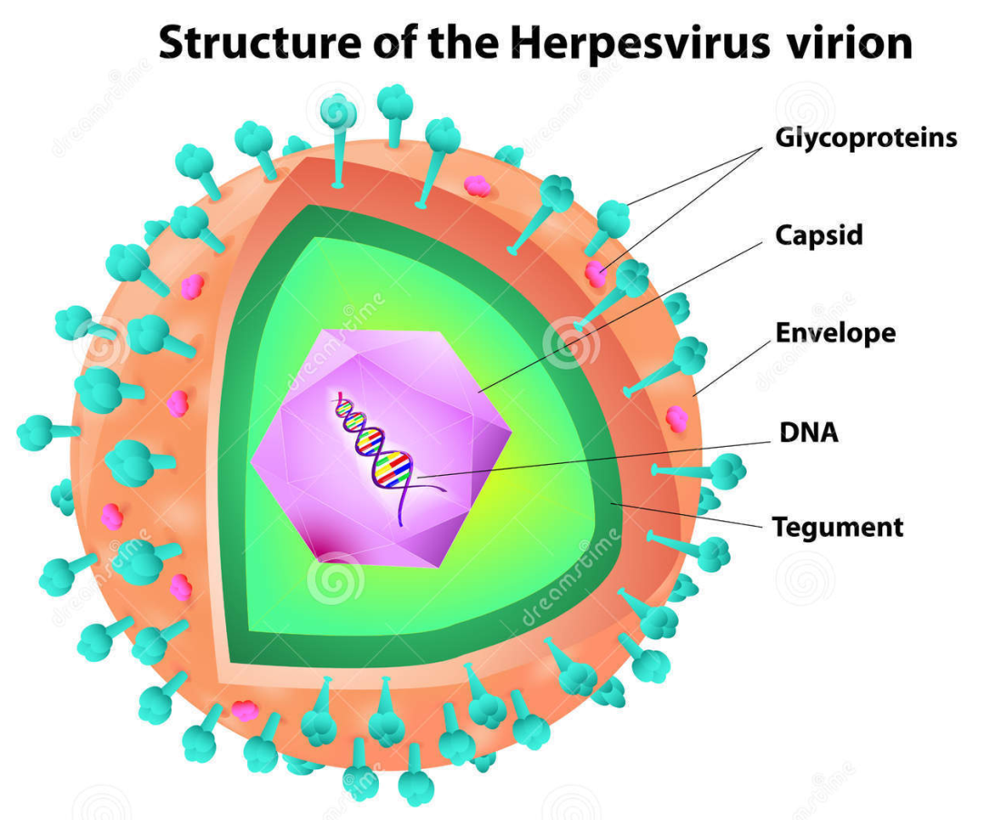
Types Of Viruses…
Adenovirus
Herpes Viruses
Retrovirus
Lentiviruses
Poxviruses
Notes:
Зачем так много вирусов надо проверять. Потомучто существует три главных проблемы efficiency targeting I biosafity

Slide 14
Current Status
FDA hasn’t approved any human gene therapy product for sale
Reasons:
In 1999, 18-year-old Jesse Gelsinger died from multiple organ failure 4 days after treatment for omithine transcarboxylase deficiency.
  Death was triggered by severe immune response to adenovirus carrier Raper SE, Chirmule N, Lee FS, Wivel NA, Bagg A, Gao GP, Wilson JM, Batshaw ML. Fatal systemic inflammatory response syndrome in a ornithine transcarbamylase deficient patient following adenoviral gene transfer. Mol Genet Metab 2003;80:148–158.
January 2003, halt to using retrovirus vectors in blood stem cells because children developed leukemia-like condition after successful treatment for X-linked severe combined immunodeficiency disease
Notes:
Sākiuma entuziāsms tika pārtraukt ar diviem nāves gadījumiem metabolisma traucējumi
По поводу биобезопасности, препараты генной терапии на базе вирусов не были одобрены ни в одной стране мира, кроме Китая, который купил лицензию у ONYX Pharmaceuticals на использование рекомбинантного аденовируса для лечения рака head and neck cancer,
И чтобы не быть голословной приведу два трагических примера провала генной терапии
Конечно при лечении рака действуют другие этические и психологические аспектыю Проще говоря при терапии рака действует принцип, хуже уже не будет и зачастую в клинике тестируются малоперспективные вирусные препараты, в которые просты вложено много труда и средств. Например в аденовирусы.
К сожалению у нас нет времени рассказывать о проблемах и недостатках вирусных систем, я лучше сконцентрируюсь на достоинствах нашей вирусной системы

Slide 15
Viral gene therapy
immunotherapy
oncolytic virotherapy

Slide 16
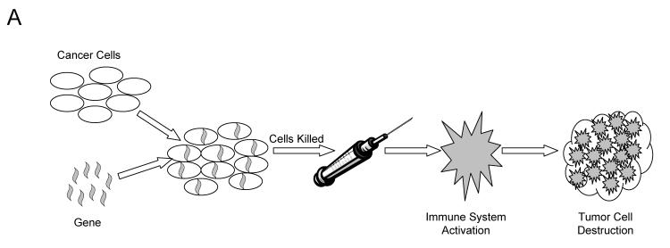
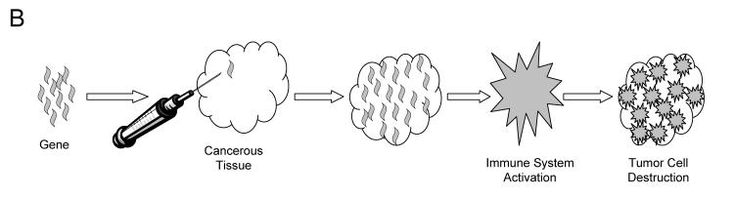
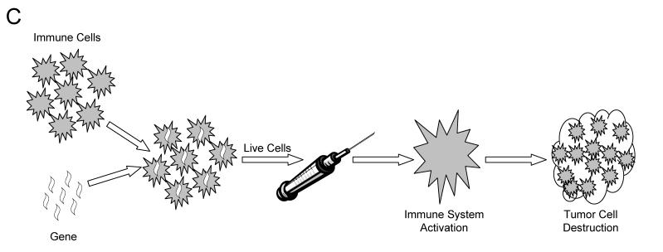
immunotherapy

Slide 17
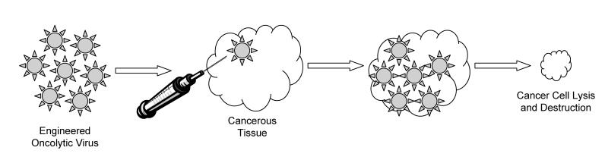
oncolytic virotherapy
incredible power in murine models

Slide 18
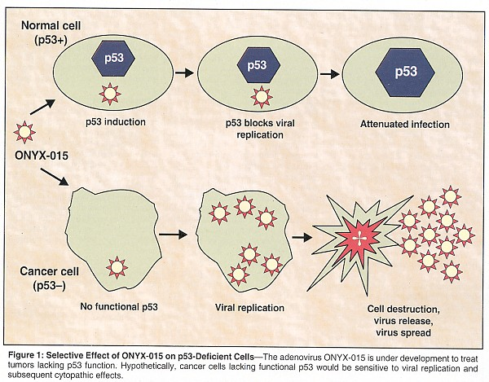
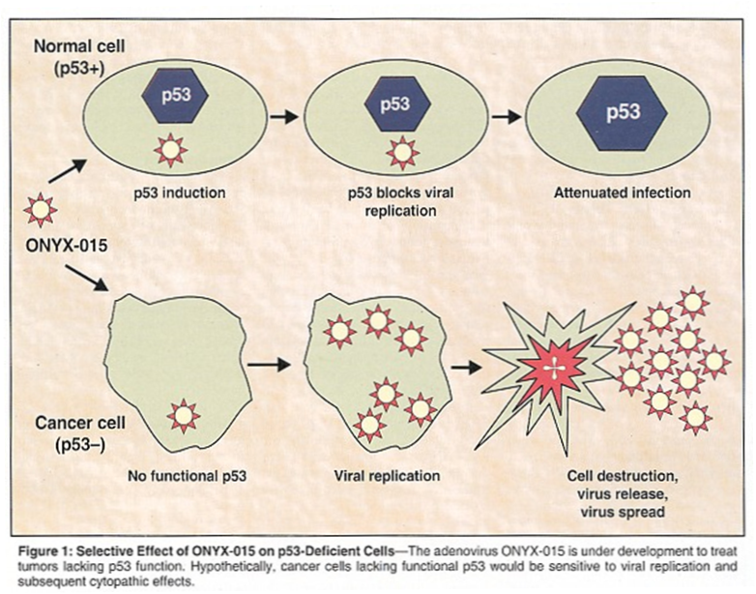
Notes:
ONYX-015 is an adenovirus that has been engineered to lack the viral E1B protein.⁴⁴ Without this protein, the virus is unable to replicate in cells with a normal p53 pathway. In addition, the E1B protein is essential for RNA export during viral replication
In 30 evaluable patients, 19 (63%) showed an objective respons - See more at: http://www.cancernetwork.com/ovarian-cancer/gene-therapy-head-and-neck-cancers/page/0/2#sthash.fBapvbac.dpuf
Common oncogenic mutations in cancer cells

Slide 19
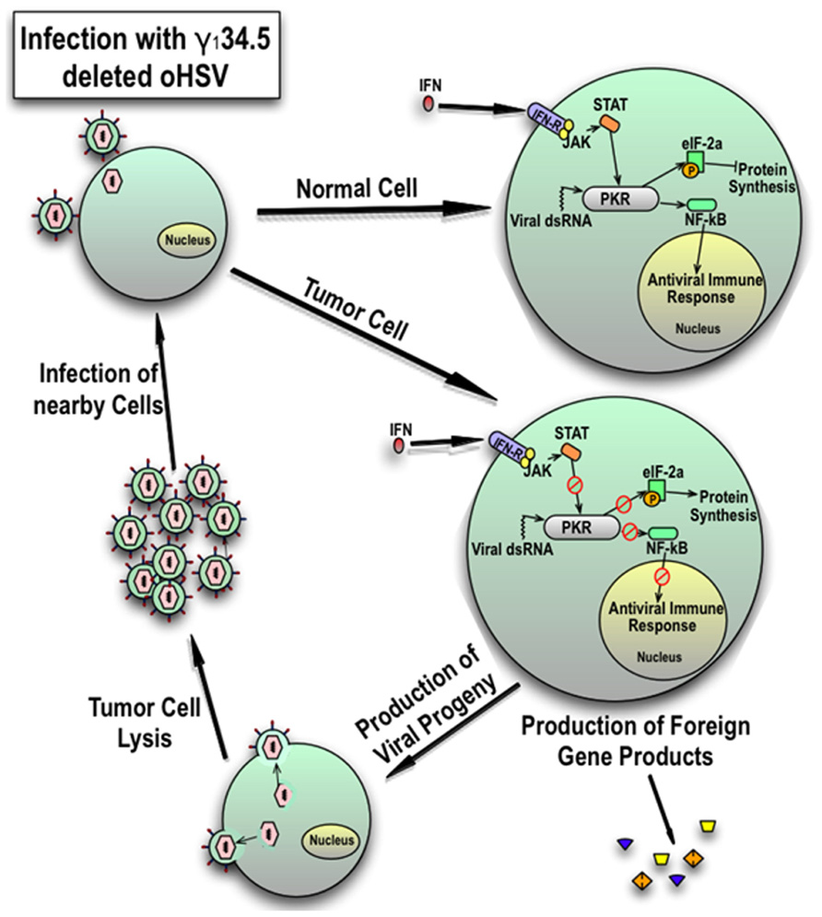
G207 and NV1020
Notes:
Hypoxia promoter

Slide 20
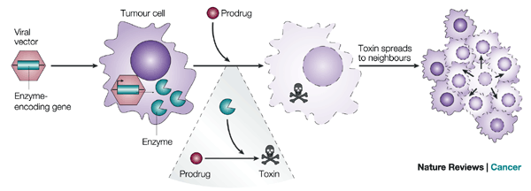
Notes:
Iodoxuridine

Slide 21
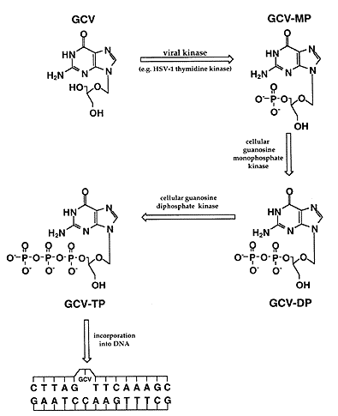

Slide 22
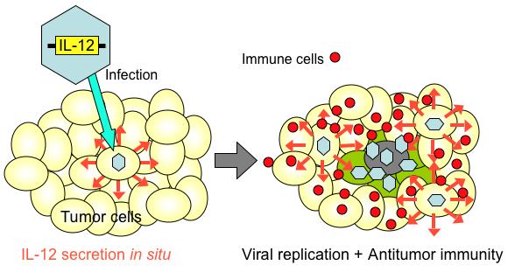

Slide 23
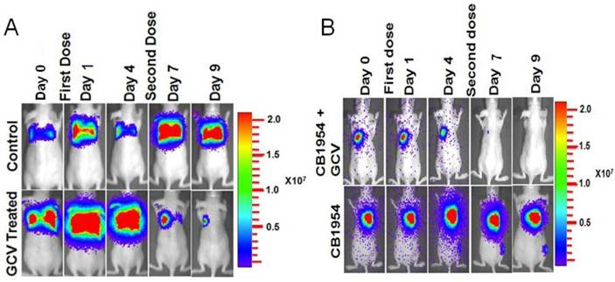
Noninvasive Theranostic Imaging of HSV1-sr39TK-NTR/GCV-CB1954 Dual-Prodrug Therapy in Metastatic Lung Lesions of MDA-MB-231 Triple Negative Breast Cancer in Mice.
Theranostics 2014; 4(5):460-474. doi:10.7150/thno.8077

Slide 24
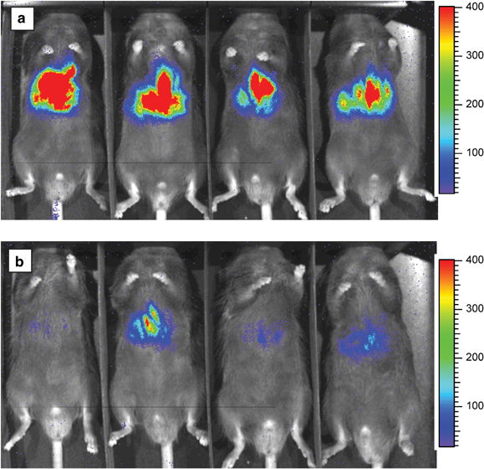
Bioluminescence imaging reveals a significant role for complement in liver transduction following intravenous delivery of adenovirus
Notes:
Bioluminescence imaging of luciferase expression in living mice at 13 days after intravenous injection of 2.3 10⁹ v.p. of Ad5Luc1 in (a) wild-type control mice, and (b) C3^{-/-} mice. The pseudocolor overlay represents the intensity of light emission, and thus the level of luciferase expression. A single lot of E1-deleted recombinant Ad5Luc1 containing the firefly luciferase gene under control of CMV promoter was used;²⁹ all injections of the virus were intravenous. Preliminary studies with a range of Ad5Luc1 doses (2 10⁹–1 10¹⁰ v.p.) showed from 10- to 100-fold less expression of luciferase in C3^{-/-} mice (4 mice) versus matched controls (four mice). Based on these initial studies, three additional experiments each with two groups of mice each (control and C3^{-/-} mice, n=3–4/group) were conducted to evaluate three different Ad5Luc1 doses (2.3 10⁹, 4.0 10⁹, and 1.3 10¹⁰ v.p.). At various times after administration of Ad5Luc1, the mice were imaged using a bioluminescence imaging system (Xenogen, Inc.) to detect luciferase expression. Images were collected on mice oriented in the same position and always 10 min after intraperitoneal injection of 2.5 mg luciferin. The mice were maintained under enflurane anesthesia at 37°C, with their ventral surfaces facing the CCD camera that was part of the imaging system. Imaging was performed several times on each mouse, beginning at 6 h after Ad5Luc1 injection and continuing to day 34. Data acquisition times for imaging ranged from 20 s to 10 min.

Slide 25
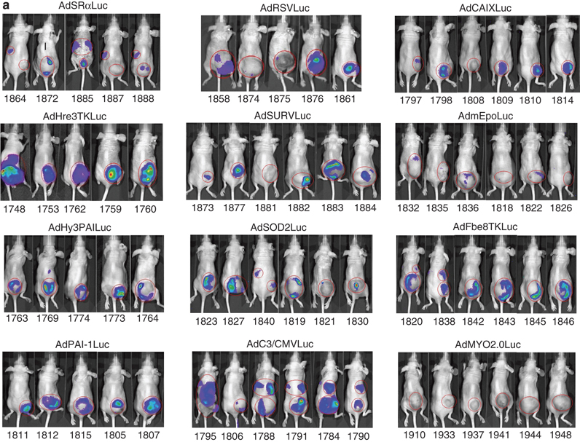
Adenoviral targeting of gene expression to tumors Cancer Gene Therapy 17, 375-386 (June 2010) R T Hogg, J A Garcia and R D Gerard
Notes:
hypoxia-responsive promoters
hypoxia response element-thymidine kinase (Hre3TK)

Slide 26
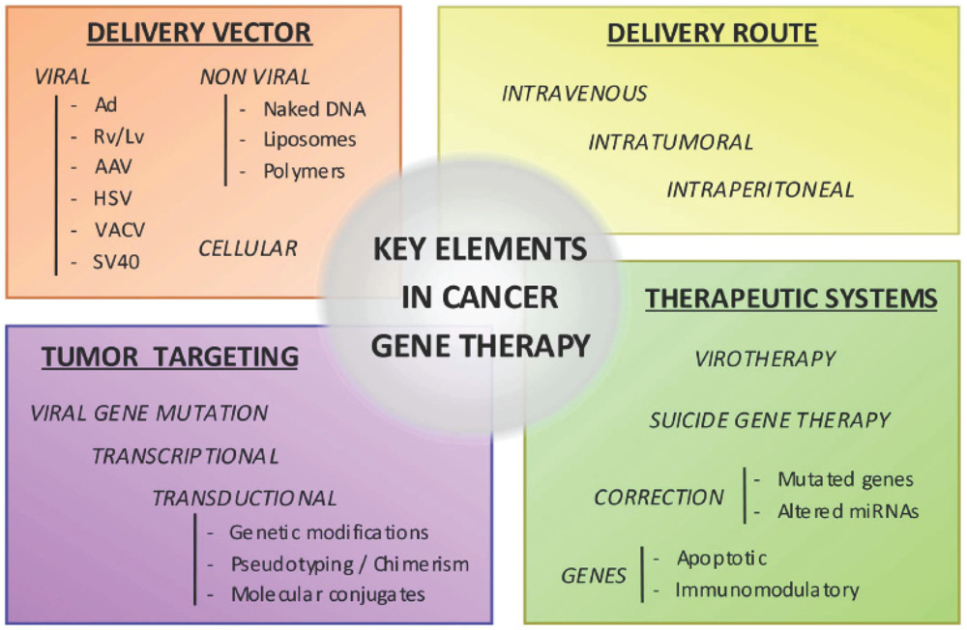

Slide 27
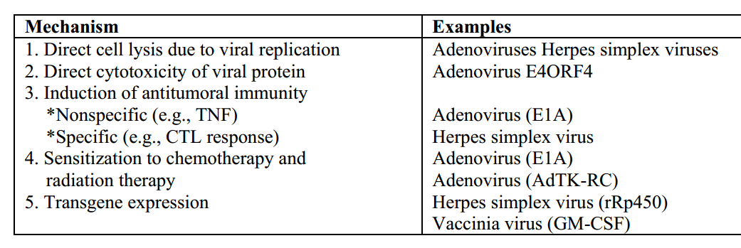
Oncolytic therapy
Notes:
adenoviruses generate the death protein E3 11.6 kD

Slide 28
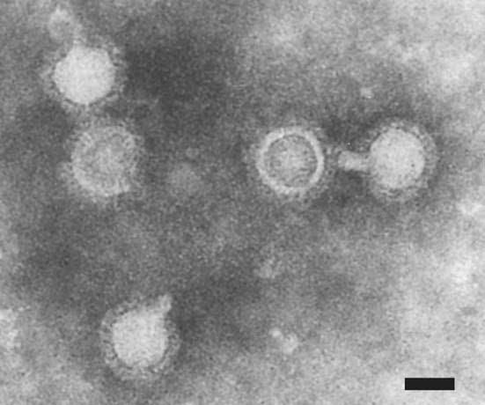
Enveloped virus
Icosahedron : 240 copies of 1 protein
Spherical : 65-70nm
Envelope : 80 trimer spikes
each spike = 3 x E1/E2 heterodimers
Alphaviruses
icosahedron
lipid bilayer
Surface glycoproteins
Electron microscopy of recombinant SFV particles. Negative staining, bar 50 nm.
(Zajakina et al, 2009)

Slide 29
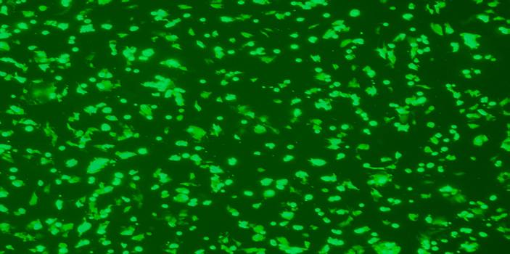
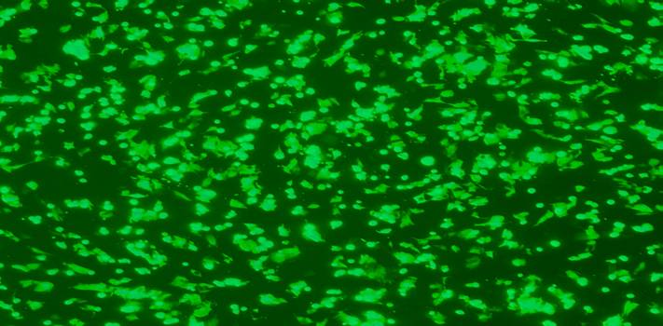
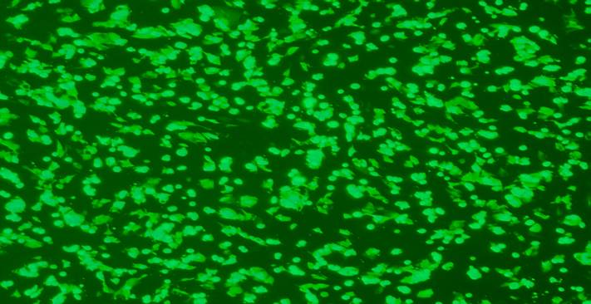
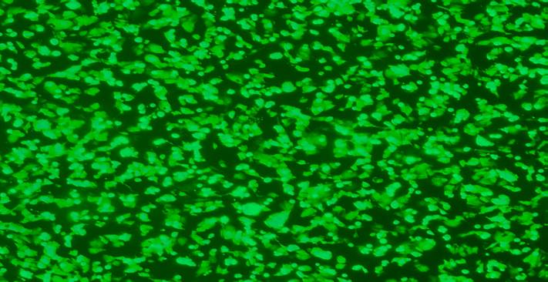
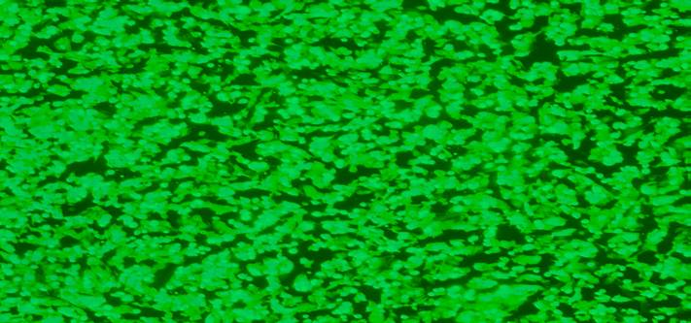
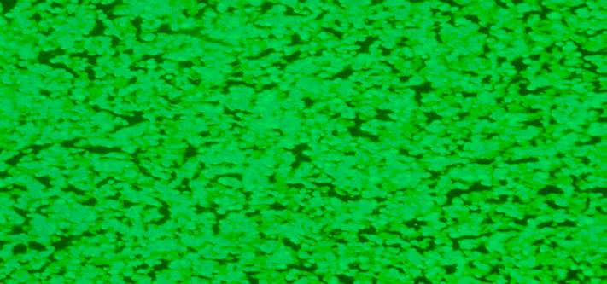
SFV-GFP Infection Kinetics in BHK Cells.
2 min
5 min
15 min
30 min
60 min
120 min

Slide 30
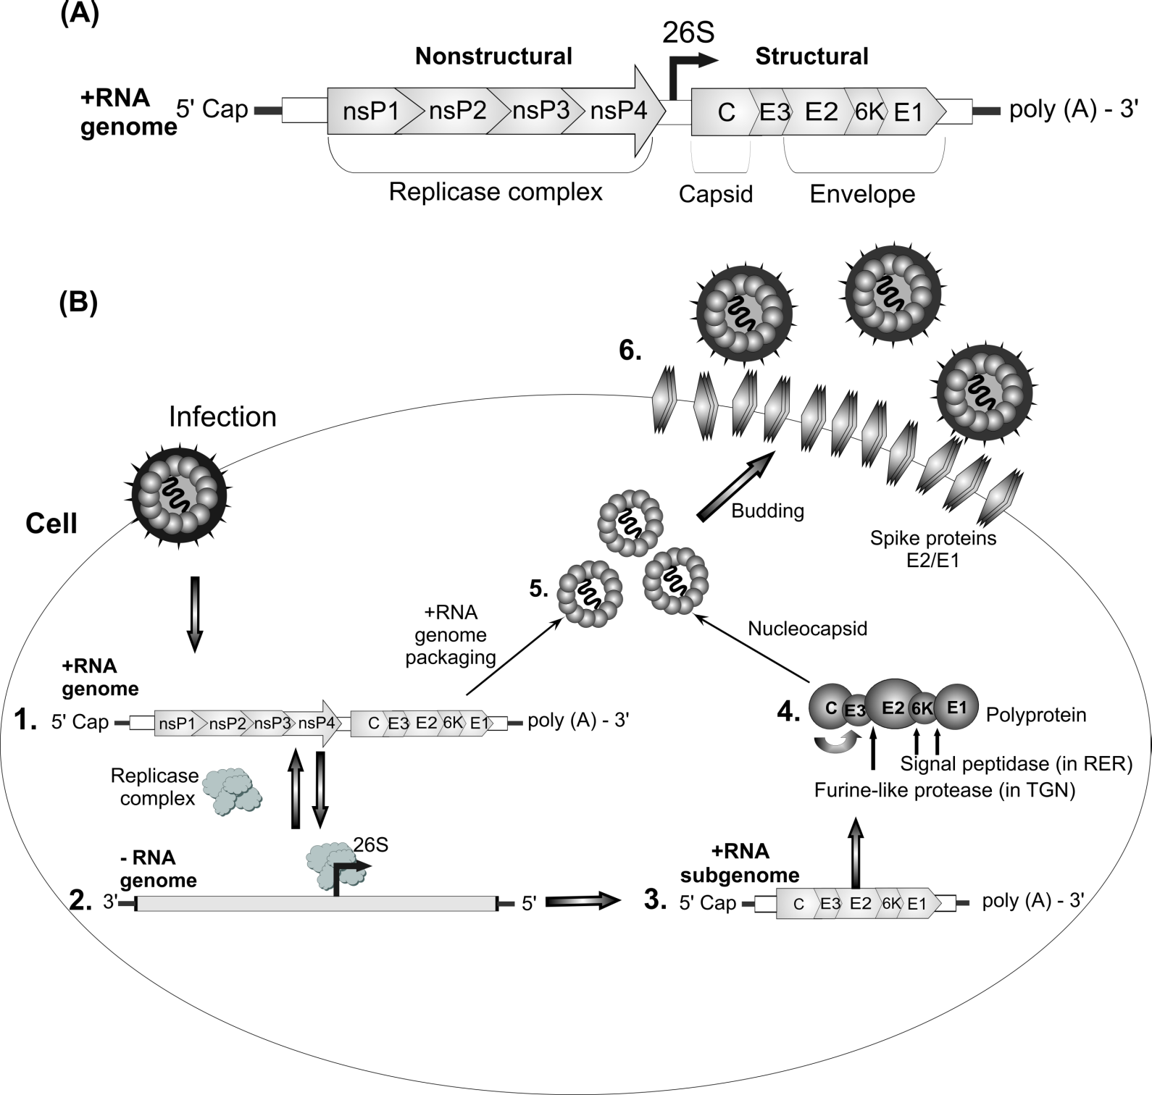
Replication cycle of alphaviruses. (Zajakina et al., Medicinal Protein Engineering, 2014)

Slide 31
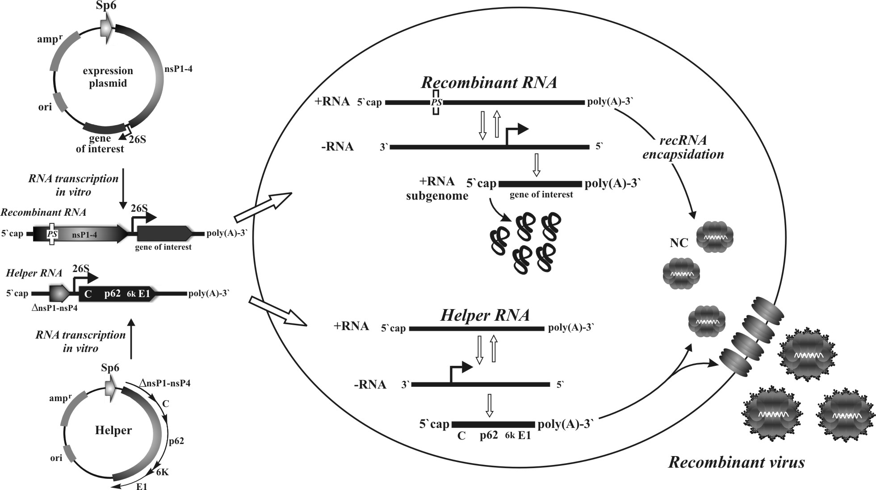
Recombinant alphavirus production.

Slide 32
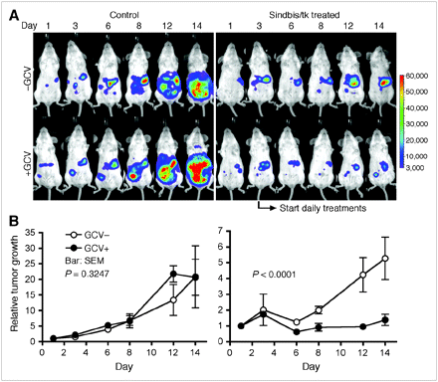
Tumor-Specific In Vivo Transfection with HSV-1 Thymidine Kinase Gene Using a Sindbis Viral Vector as a Basis for Prodrug Ganciclovir Activation and PET
J Nucl Med July 2006 vol. 47no. 7 1136-114

Slide 33
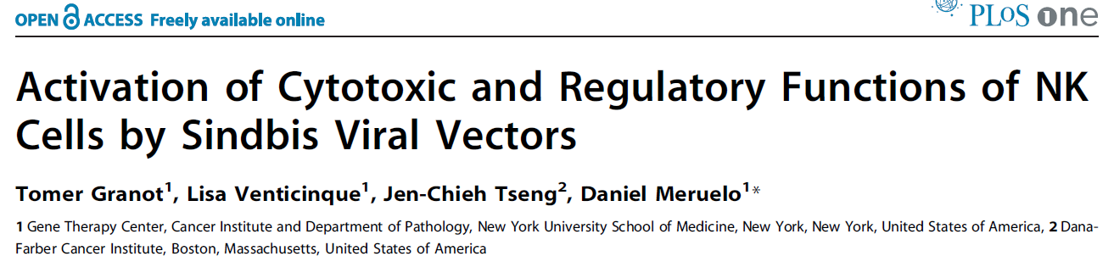
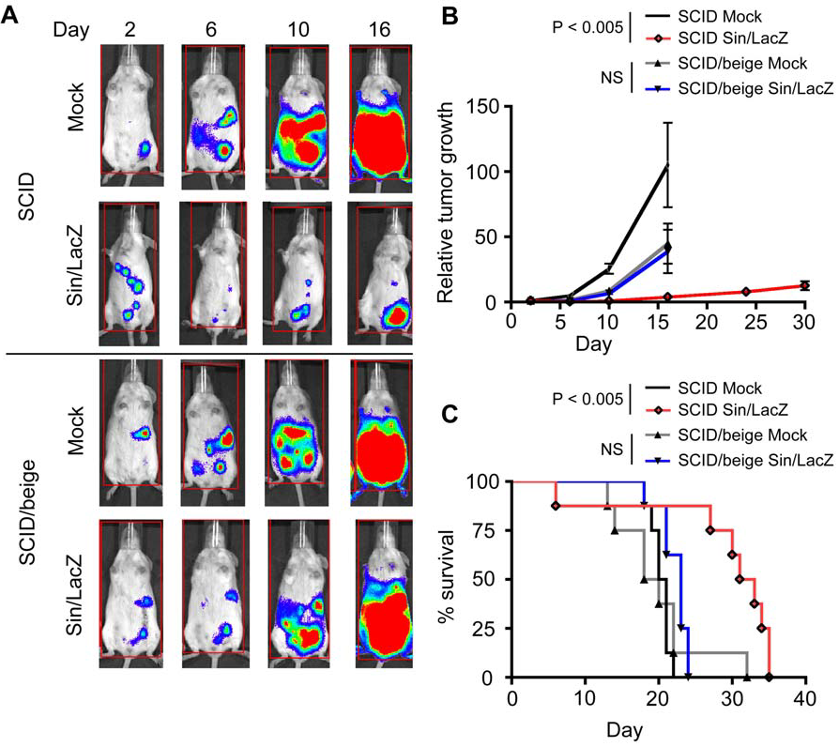
2011

Slide 34
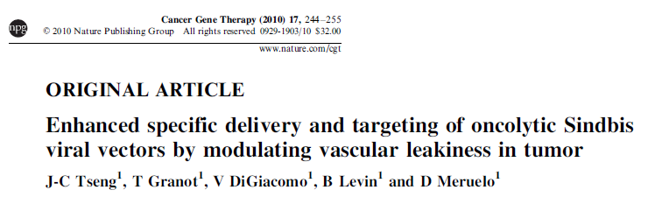

Slide 35
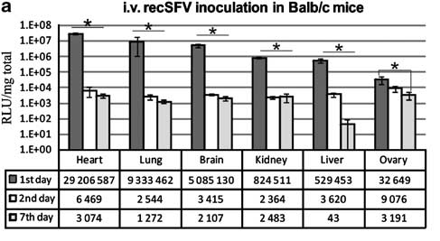
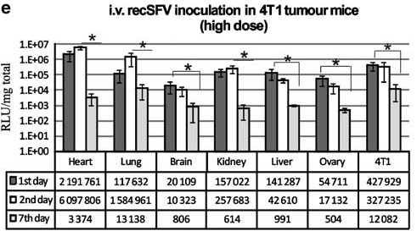
Luc gene expression
in tumor-free Balb/c
and 4T1 tumor-bearing
mice
Zajakina et al,
Cancer Gene Therapy, 2012)

Slide 36
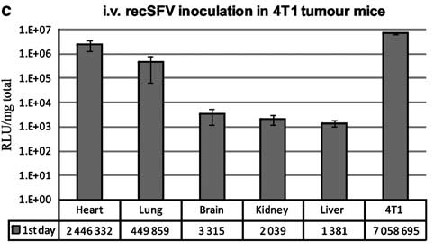
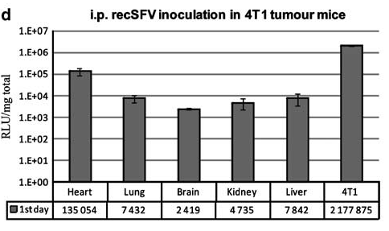
2x10⁸ recSFV
Zajakina et al,
Cancer Gene Therapy, 2012)

Slide 37
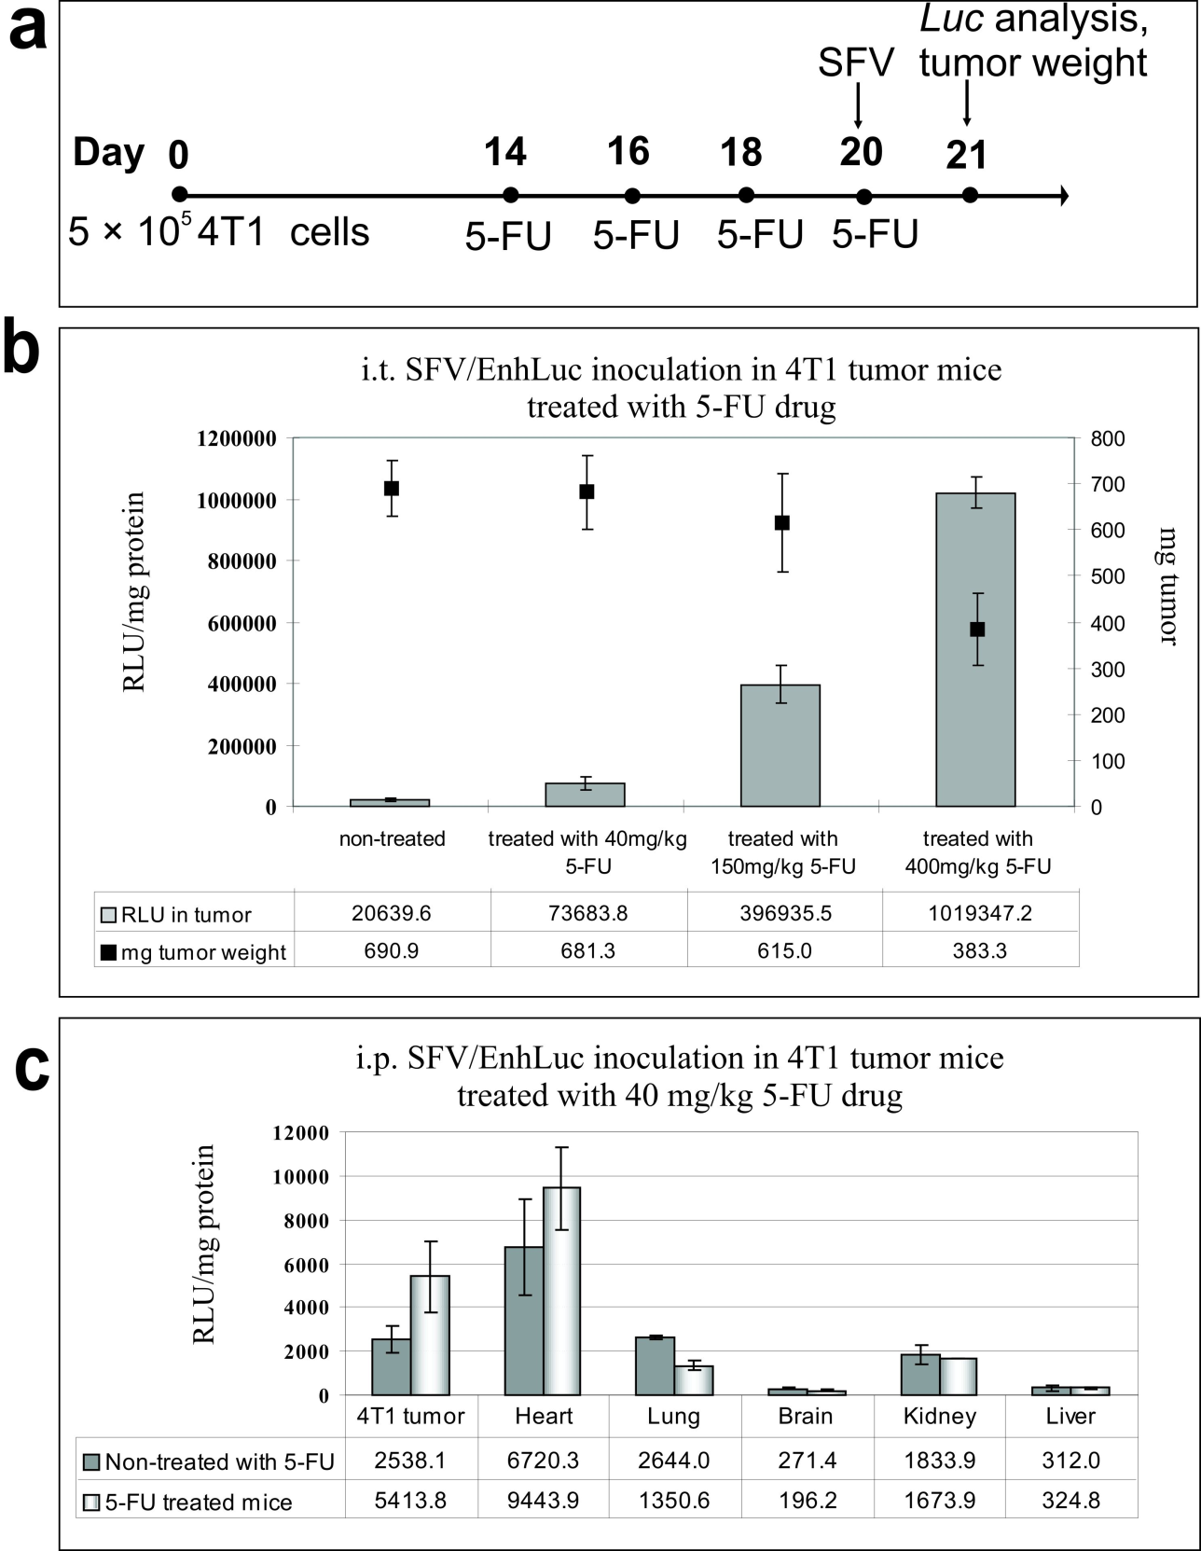
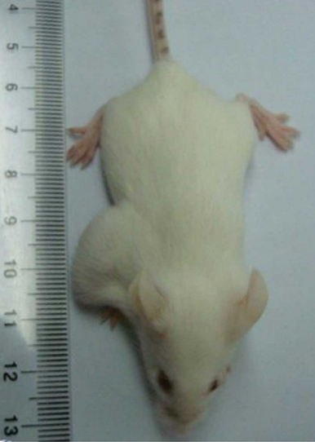
High efficiency of alphaviral gene
transfer in combination with
5-fluorouracil in a mouse
mammary tumor model.
Zajakina et al.,
BMC Cancer, 2014
Notes:
Почему так происходит, первое что я предположила это следующее, 5fUразрушает опухоль и главной мишенью является tumor vasculature, angiogenesis

Slide 38
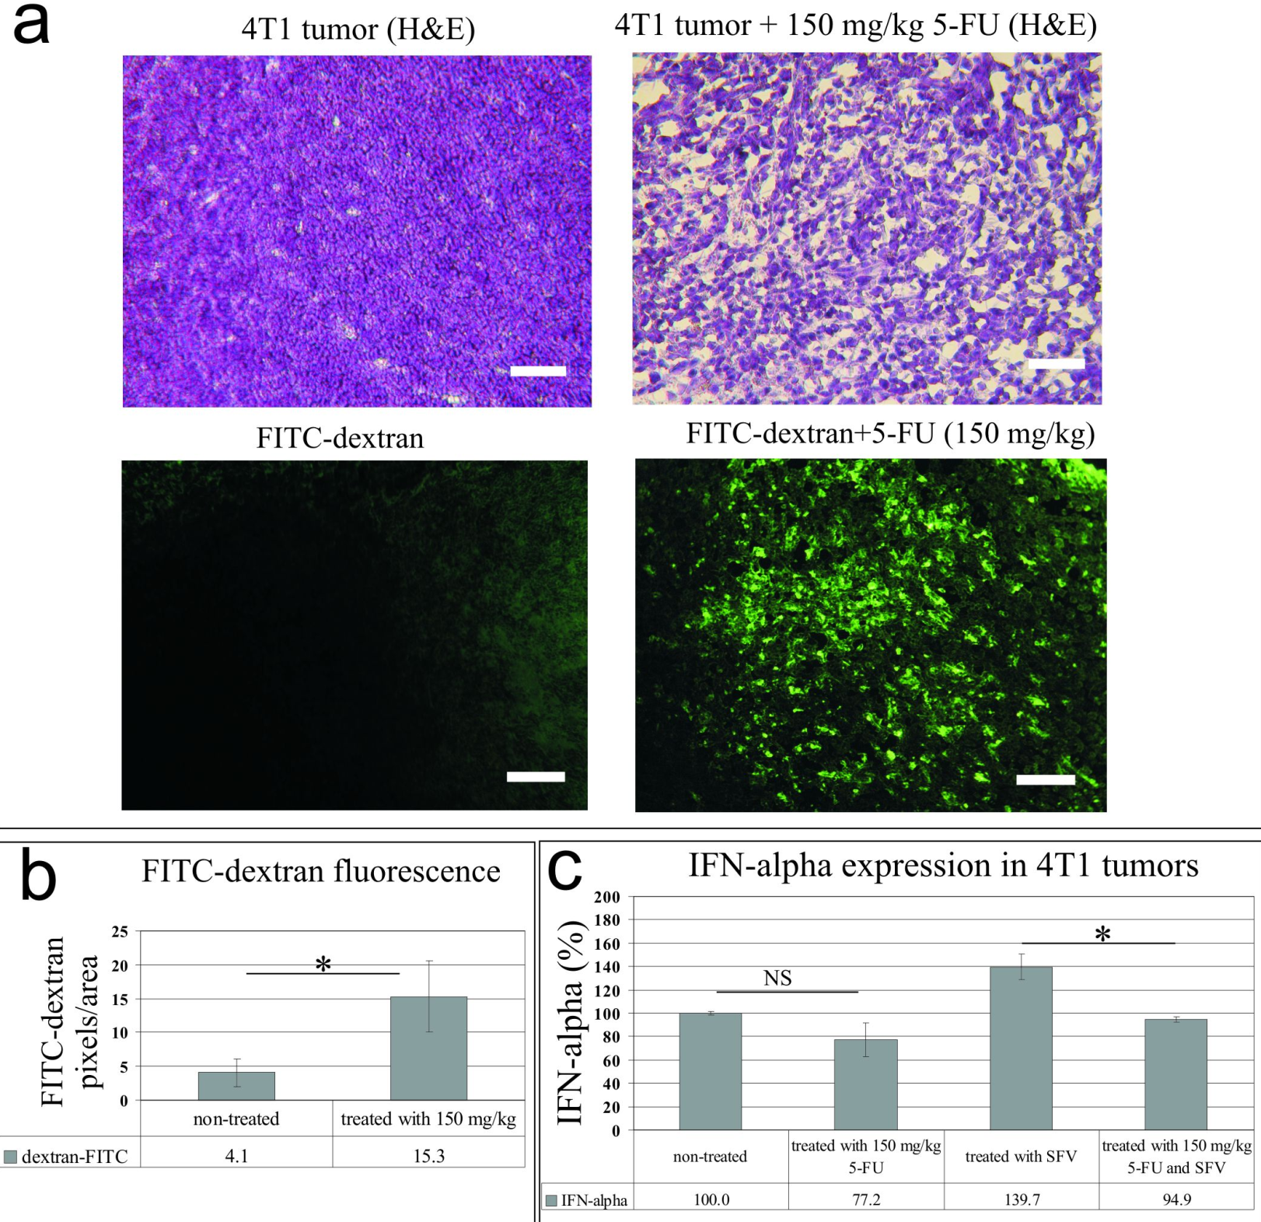

Slide 39
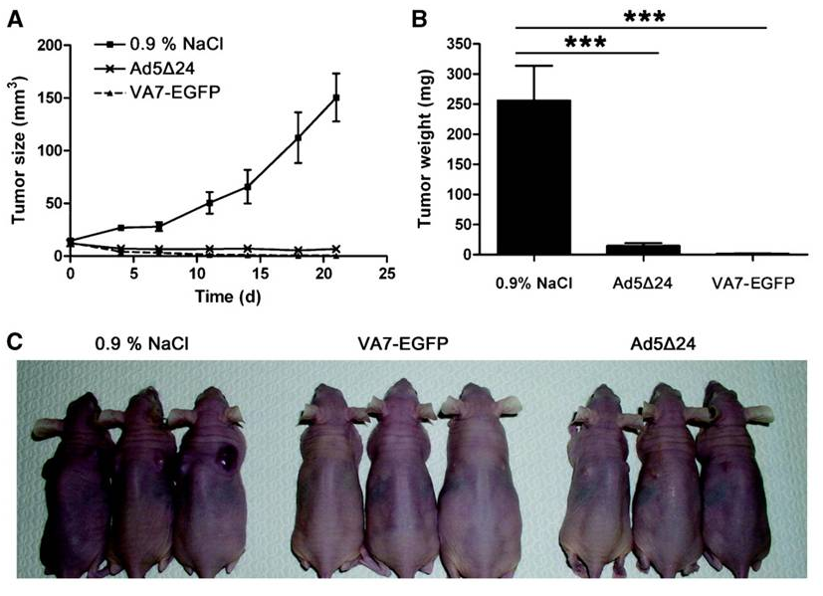
Therapeutic effect of both VA7-EGFP and Ad5Δ24 viruses was tested in subcutaneous Saos2LM7 human osteosarcoma tumors implanted into nude mice.
Ketola A et al. Cancer Res 2008;68:8342-8350

Slide 40
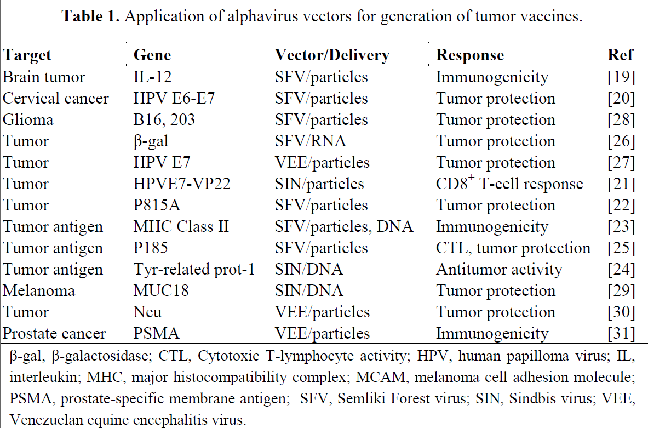
Lundstrom, 2009

Slide 41
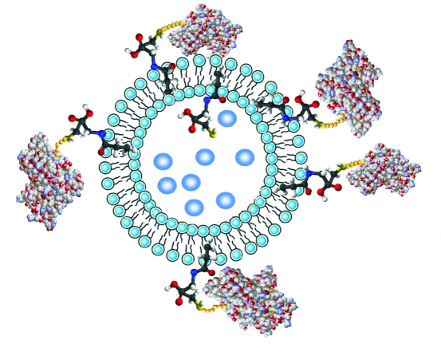
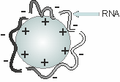

Non-viral delivery of alphaviral RNA

Slide 42

2012. October 25-29: The European Society of Gene and Cell Therapy Congress.
“Intratumoral delivery and biodistribution of oncolytic alphaviral vectors in mouse melanoma model” authors: Jelena Vasilevska, Dace Skrastina, SvetlanaLubina, Tatjana Kozlovska, Anna Zajakina. France, Versailles.

Slide 43




B16 melanoma ex vivo infection

Slide 44


Slide 45


Slide 46
Alphaviruses as genetic vaccines
RNA replication
No risk of integration
Alphaviruses can target lymph nodes
Dendritic cells infection
High virus titers
Safe for human
No vector preimmunity
Transient expression
Oncolytic properties
Production insert titer
Baculovirus | 30 % | 15 kb | 2x10⁸
Adenovirus | 0,5-2 % | 8-30 kb | 10¹⁰-10¹²
Retrovirus | 0,1-0,5 % | 7,5 kb | 10⁵-10⁶
Alphavirus | 0,5-20 % | 6 kb | 10¹⁰
Semliki Forest virus (SFV)
Sindbis virus (SIN)
Venezuelan Equine Encephalitis virus (VEE)
Notes:
SFV has a wide host range and can replicate efficiently; with these characteristics it has been used as a biological vector for genes, encoding vaccines, and cancer agents.

Slide 47

Notes:
Ja nekas nepalīdz

