Slide 4
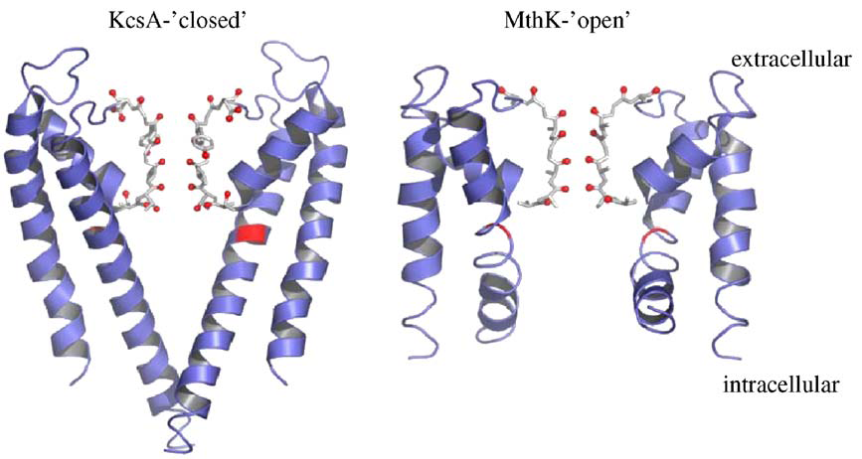
Doyle et al., Science 1998; 280: 69
Jiang et al., Nature 2002 417; 523

Slide 5
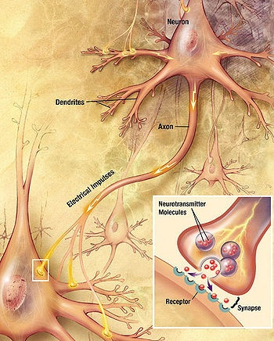

Slide 6
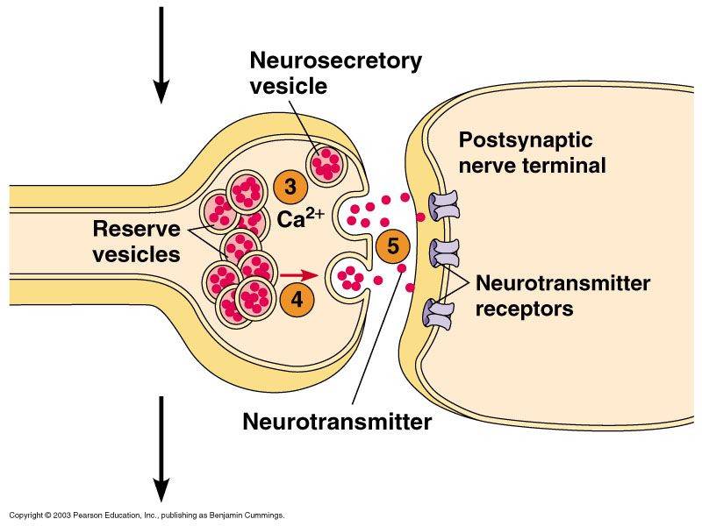

Slide 7
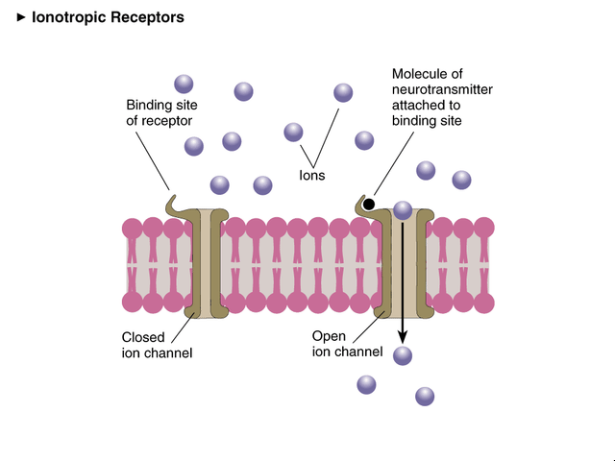

Slide 8
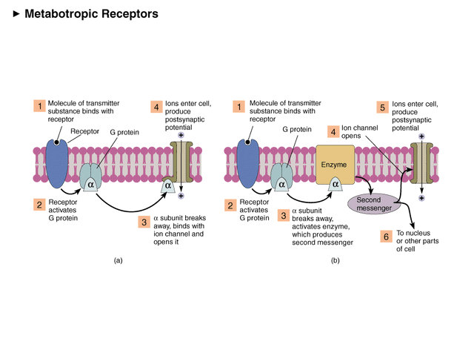

Slide 9
Depending on the type of ion channel which opens, the postsynaptic cell membrane becomes either depolarized or hyperpolarized.
Ions will tend to follow the concentration gradient from high to low concentration, and the electrostatic gradient towards the opposite charge.

Slide 10
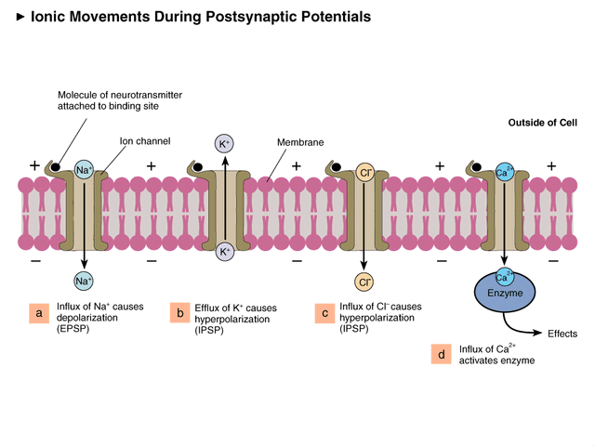

Slide 11
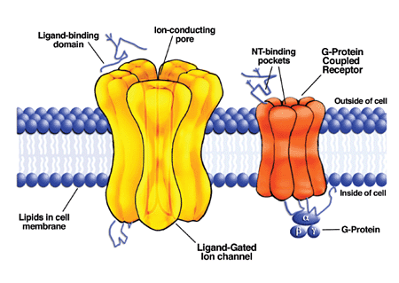

Slide 12
INTEGRATION OF EXCITATORY AND INHIBITORY SYNAPSES
INPUTS
RESPONSE

Slide 13
Excitatory Post Synaptic Potential
Inhibitory Post Synaptic Potential
IPSP
Neuron 2

Slide 14
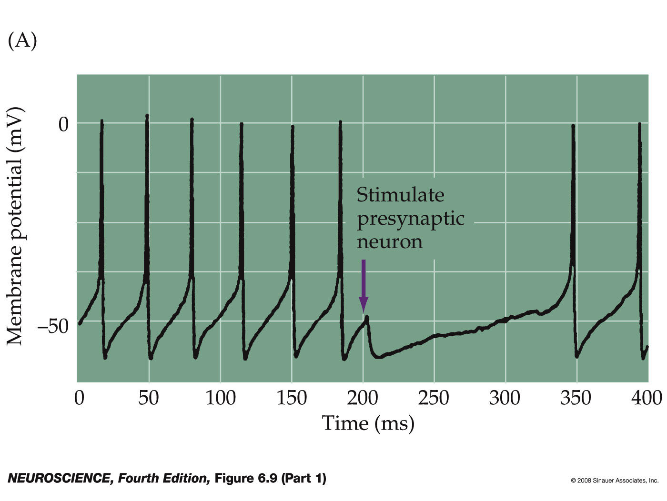
Inhibitory neurotrans-mission prevents excitation of the post-synaptic neuron
Inhibitory GABA presynaptic neuron
excitatory presynaptic neuron
Postsynaptic neuron
inhibitory

Slide 15
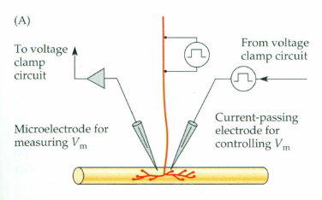
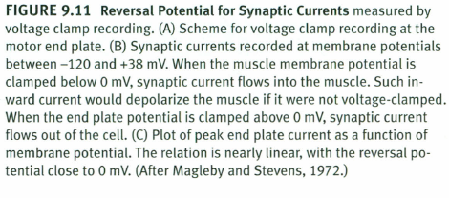
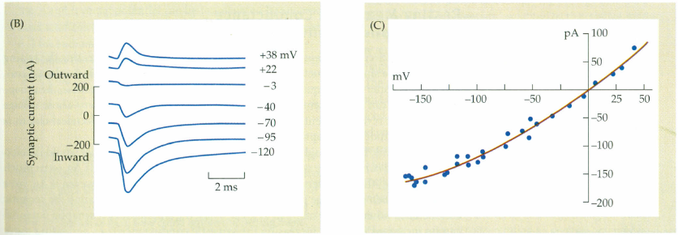
Nicholls: Neuron to Brain

Slide 16
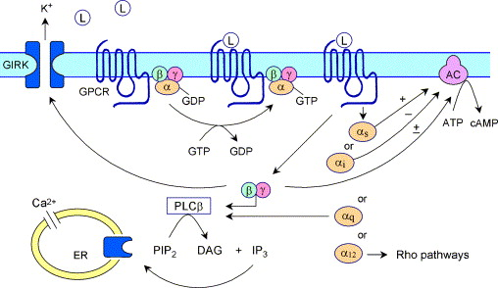
Fig. 5 Signal transduction pathways of G-protein coupled receptors. Upon activation of the G-protein coupled receptor (GPCR) by the binding of an appropriate ligand (L), the associated heterotrimeric G-protein, which contains an α, β and γ subunit, exchang...
Steven J. Husson , Inge Mertens , Tom Janssen , Marleen Lindemans , Liliane Schoofs
Neuropeptidergic signaling in the nematode Caenorhabditis elegans
Progress in Neurobiology Volume 82, Issue 1 2007 33 - 55
http://dx.doi.org/10.1016/j.pneurobio.2007.01.006

Slide 17
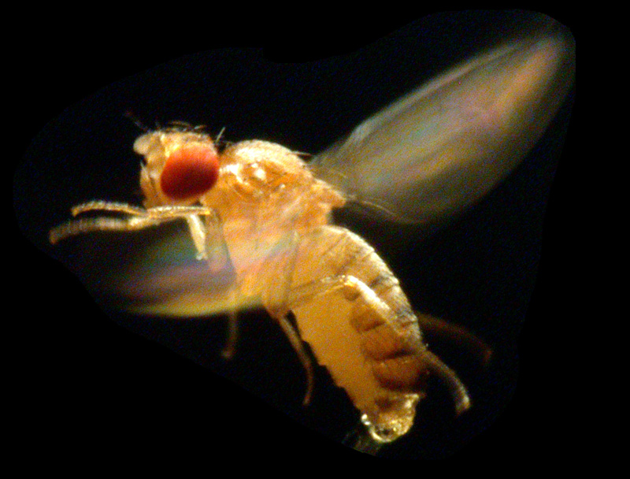
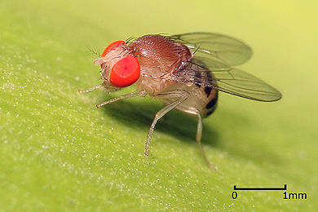
Fig. 5 Signal transduction pathways of G-protein coupled receptors. Upon activation of the G-protein coupled receptor (GPCR) by the binding of an appropriate ligand (L), the associated heterotrimeric G-protein, which contains an α, β and γ subunit, exchang...
Steven J. Husson , Inge Mertens , Tom Janssen , Marleen Lindemans , Liliane Schoofs
Neuropeptidergic signaling in the nematode Caenorhabditis elegans
Progress in Neurobiology Volume 82, Issue 1 2007 33 - 55
http://dx.doi.org/10.1016/j.pneurobio.2007.01.006

Slide 18
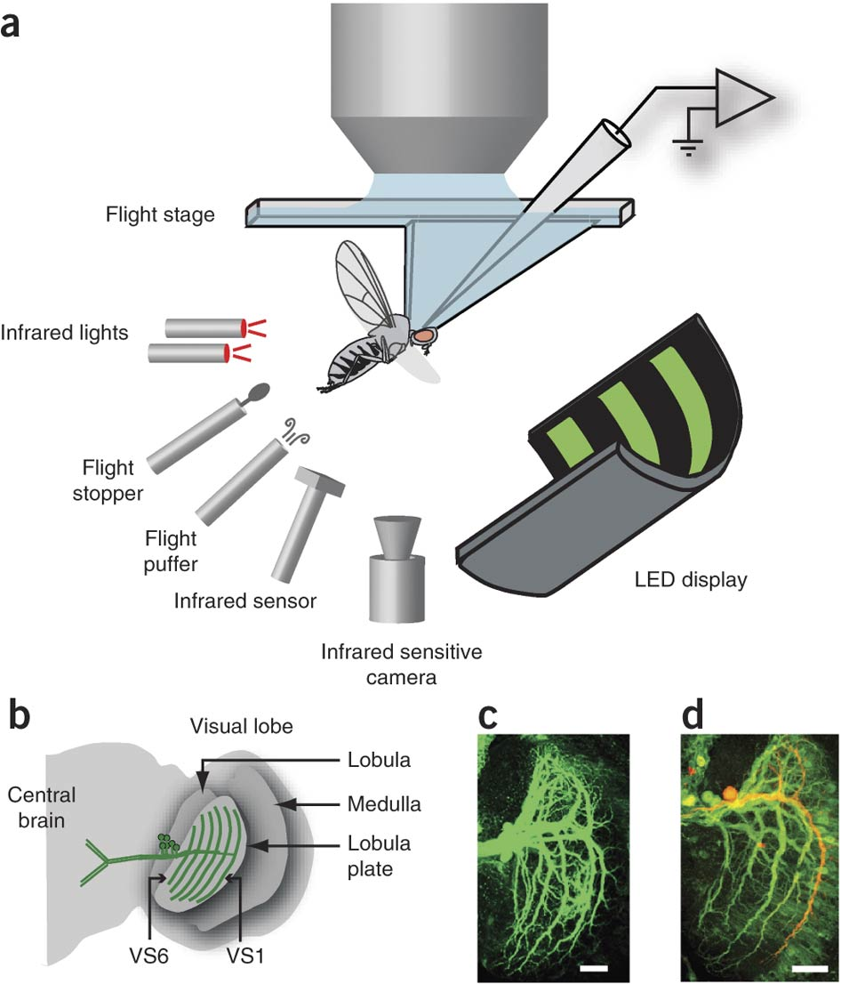

Slide 19
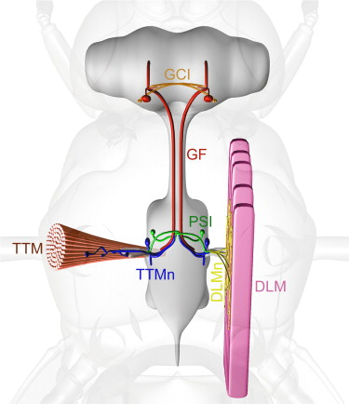
Phelan … Bacon (2008) Current Biol 18, 1955–1960

Slide 22
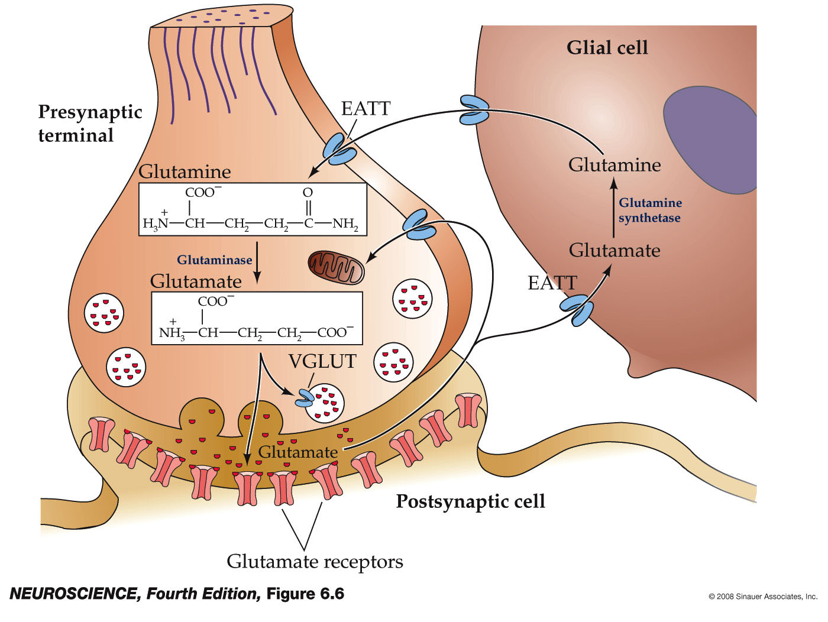
Glutamate fast neurotransmission
Synthesis, packaging, reuptake, degradation
(error - should be EAAT)

Slide 23
Pharmacology
AMPA
agonists: AMPA, glutamate
antagonists: CNQX, NBQX
Kainate
agonists: kainic acid, glutamate
antagonist: CNQX
NMDA
agonists: glutamate, aspartate, NMDA
antagonists: D-APV, D-AP5, MK-801, Ketamine, Phencyclidine, (Mg⁺⁺)

Slide 24
Pharmacology
AMPA
agonists: AMPA, glutamate
antagonists: CNQX, NBQX
Kainate
agonists: kainic acid, glutamate
antagonist: CNQX
NMDA
agonists: glutamate, aspartate, NMDA
antagonists: D-APV, D-AP5, MK-801, Ketamine, Phencyclidine, (Mg⁺⁺)

Slide 25
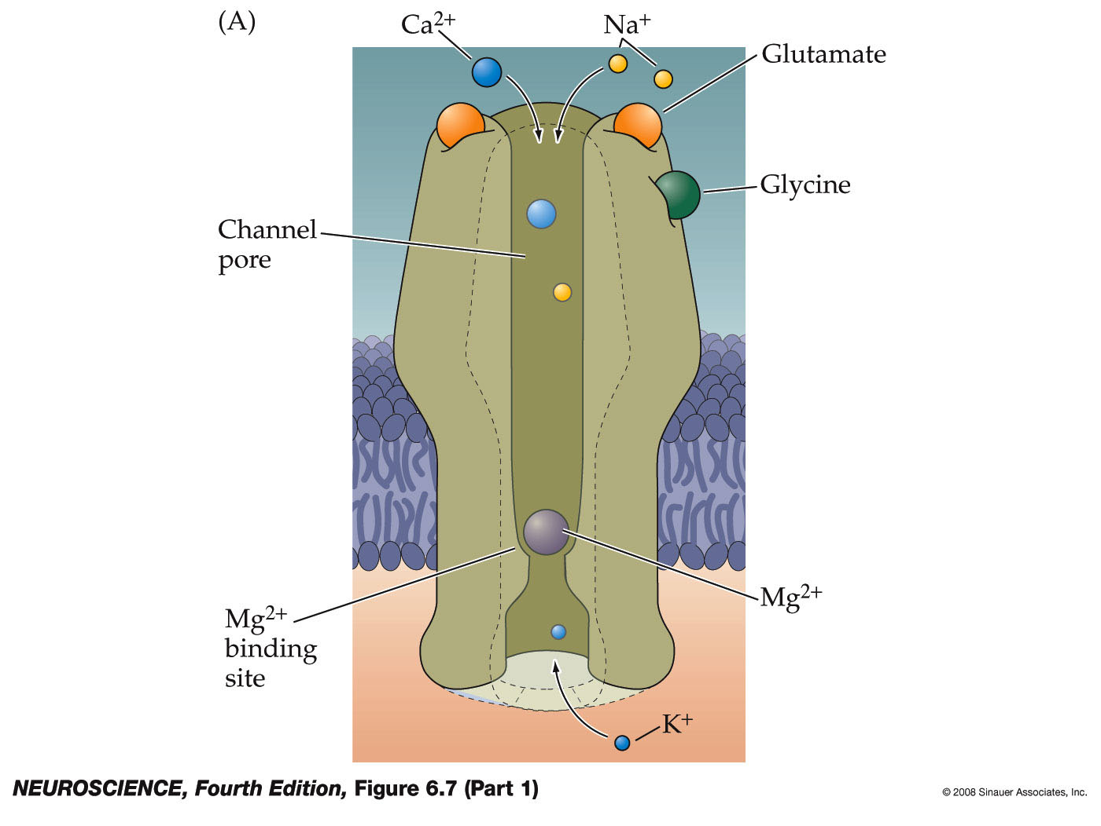
NMDA receptors

Slide 26
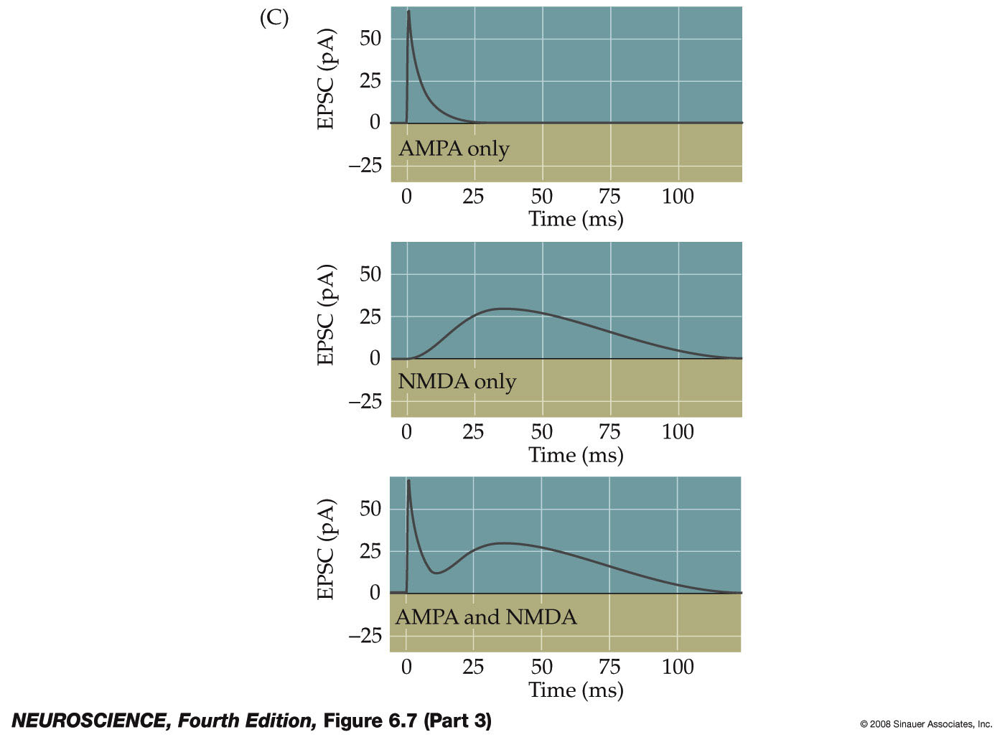
NMDA receptors show slow onset and decay kinetics
Some synapses have both glutamate receptor types, and produce a two-component synaptic current

Slide 27
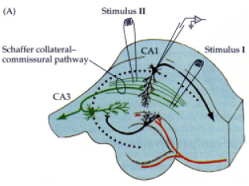
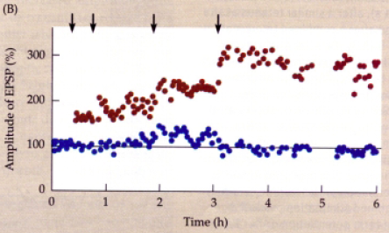

Slide 28
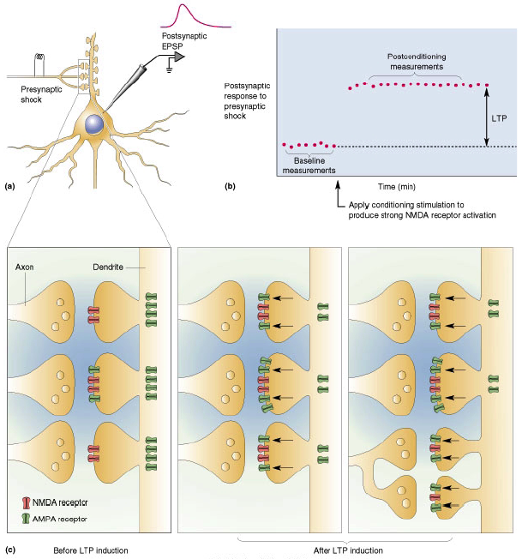

Slide 29
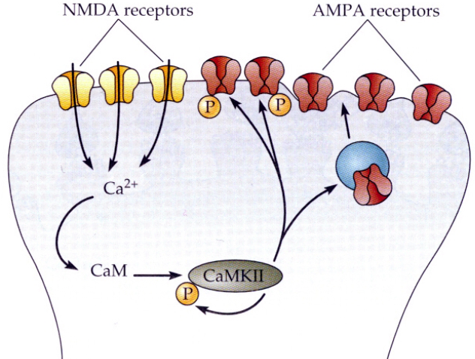

Slide 30
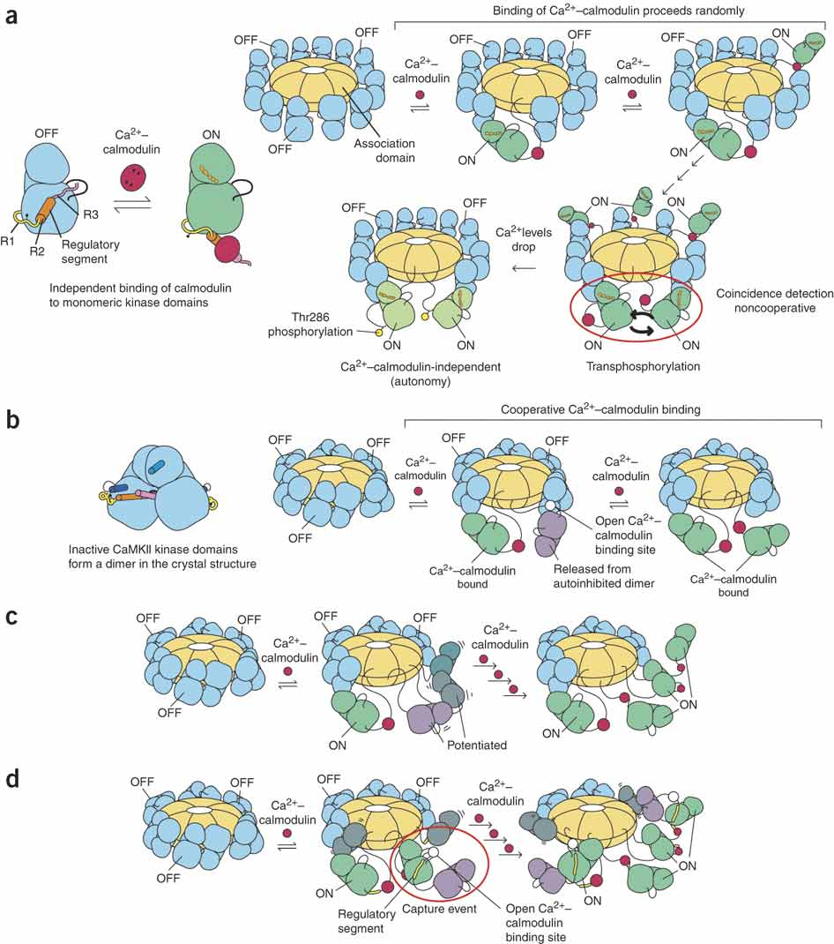

Slide 31
If the time interval between Ca²⁺ spikes is long compared to the dissociation time of Ca²⁺–calmodulin (low frequency), initial binding is presumed to lead to a separation of kinase domains; however, transphosphorylation of Thr286 does not occur before Ca²⁺–calmodulin dissociates. If the interval between Ca²⁺ spikes is short compared to the Ca²⁺–calmodulin dissociation time (high-frequency regime) Ca²⁺–calmodulin remains bound to the first pair of kinase domains long enough for a second, slow step to occur, in which the activated kinase domains capture the regulatory segments of adjacent kinase domains. This potentiates the binding of Ca²⁺–calmodulin to those domains with increased affinity, resulting in the phosphorylation of Thr286 and acquisition of autonomy (Ca²⁺–calmodulin-independent activity).
Caho …. Kuriyan (2010) Nature Structural & Molecular Biology 17, 264–272 (2010)

Slide 32
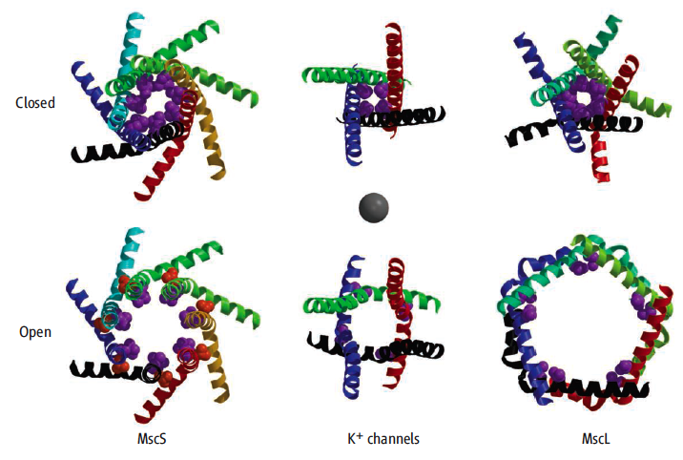
http://proteopedia.org

Slide 33
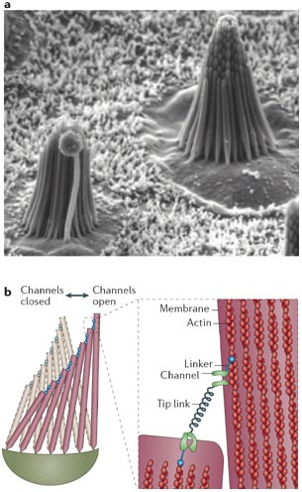

Slide 34
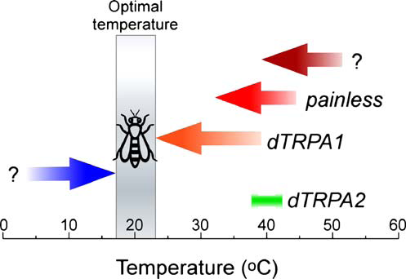
McKemy (2007) Pflugers Arch 454:777–791

Slide 35
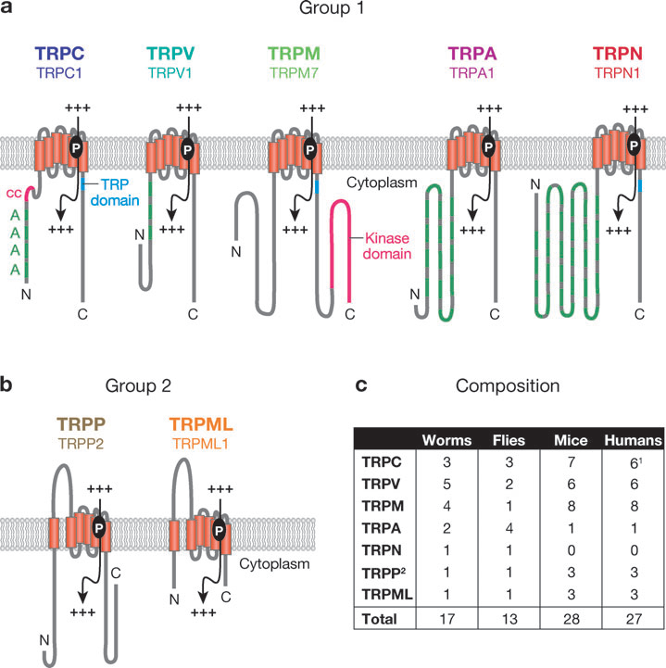
Venkatachalam & Montell (2007) Ann Rev Biochem 76:387–417

Slide 36
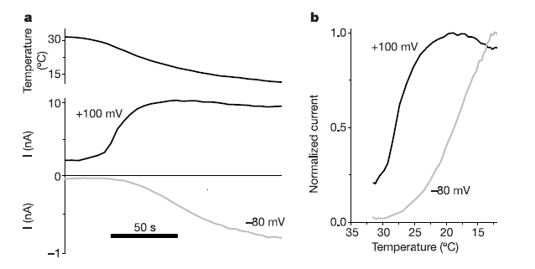
Cooling activates TRPM8 by shifting the voltage dependence of activation.
a, Whole-cell TRPM8 currents at +100 and -80 mV in response to slow cooling of the bath solution.
b, Normalized current responses at +100 and -80 mV in function of temperature.
Voets et al (2004) Nature 430: 748 - 54

Slide 37
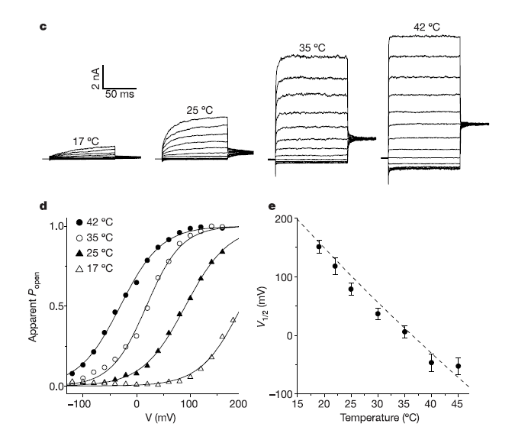
Heating activates TRPV1 by shifting the voltage dependence of activation. c, Current traces at different temperatures in response to voltage steps ranging from 2120 to þ160 mV. d, Steady-state activation curves at different temperatures for the currents shown in c. Lines represent Boltzmann functions fitted to the data. e, V 1/2 as a function of temperature (n values between 4 and 9). Dashed line represents the change in V 1/2 as predicted by the two-state model (see text).
Voets et al (2004) Nature 430: 748 - 54

