Slide 1
Hodgkin & Huxley II. Voltage Clamp
MK Mathew
NCBS, TIFR
UAS – GKVK Campus
Bangalore
IBRO Course in Neuroscience
Center for Cognitive Neuroscience & Semantics, University of Latvia
Riga, Latvia
August 21-August 29, 2013

Slide 2
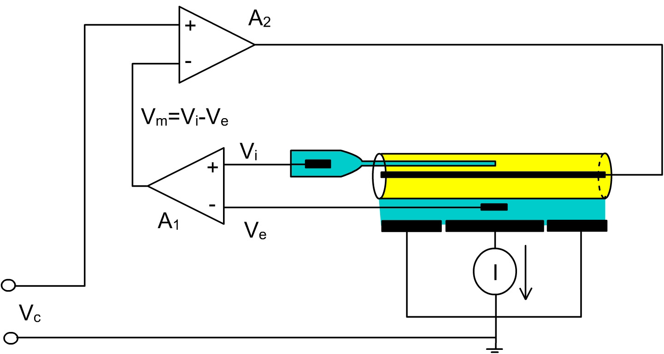
Voltage clamp of the squid axon. Vi is the internal potential measured with a pipette inserted in the axon. Ve is the external potential measured by an external electrode. Vm=Vi-Ve as computed by amplifier A1. A2 compares Vm with Vc (which is the command desired voltage) to inject current I, which maintains Vm at Vc. The current injected by the axial wire crosses the axonal membrane as it is drained by the chamber plates and measured by a current measuring device.
Bezanilla web page

Slide 3
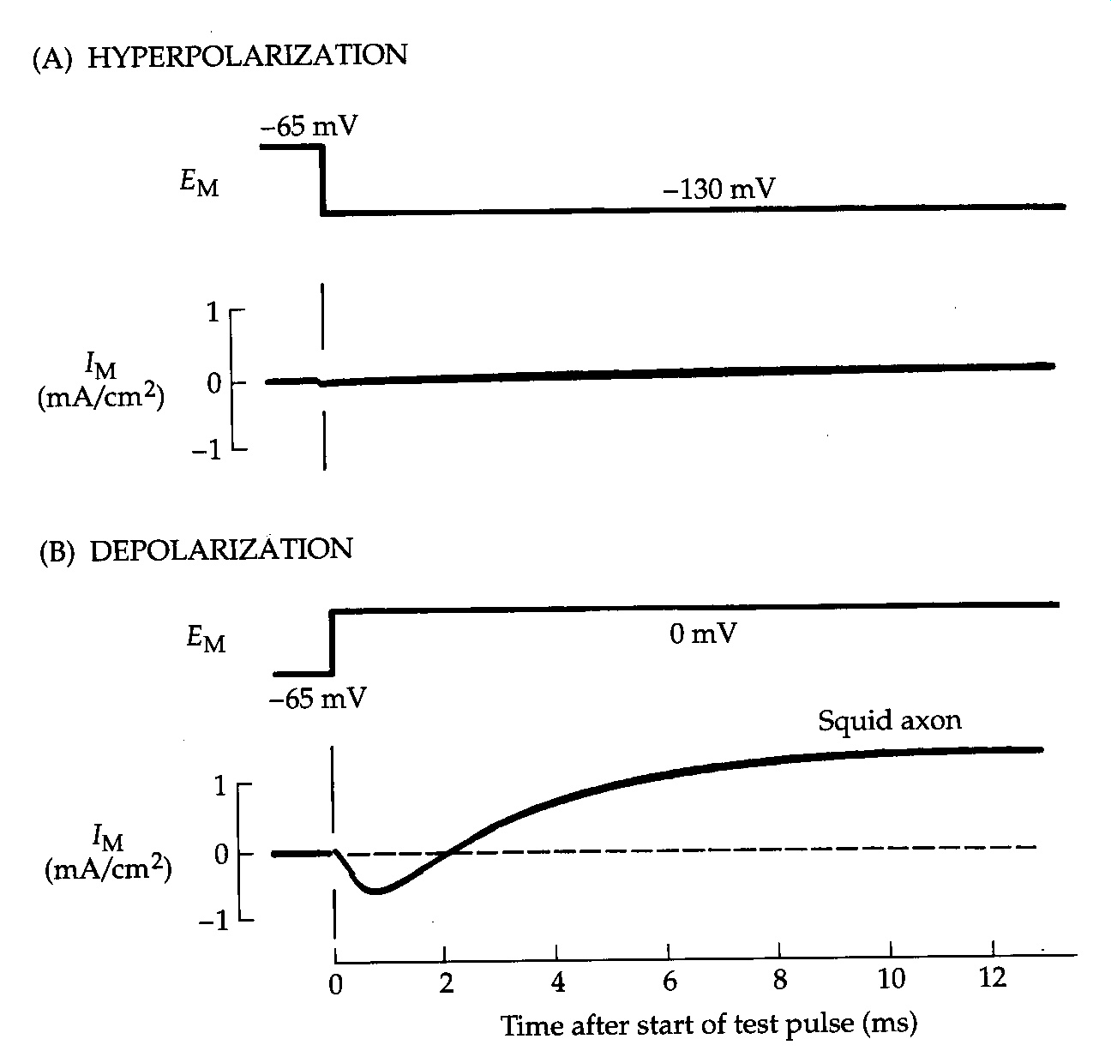
Voltage Clamp currents in a Squid Axon. An axon is bathed in sea water and voltage clamped by the axial wire method. The membrane potential is held at -65 mV and then hyperpolarized in a step to -130 mV or depolarized in a step to 0 mV. Outward ionic current is shown as an upward deflection. The membrane permeability mechanisms are clearly asymmetrical. Hyperpolarization produces only a small inward current, whereas depolarization elicits a larger biphasic current. T = 3.8ºC
Nicholls “From Neuron to Brain”

Slide 4
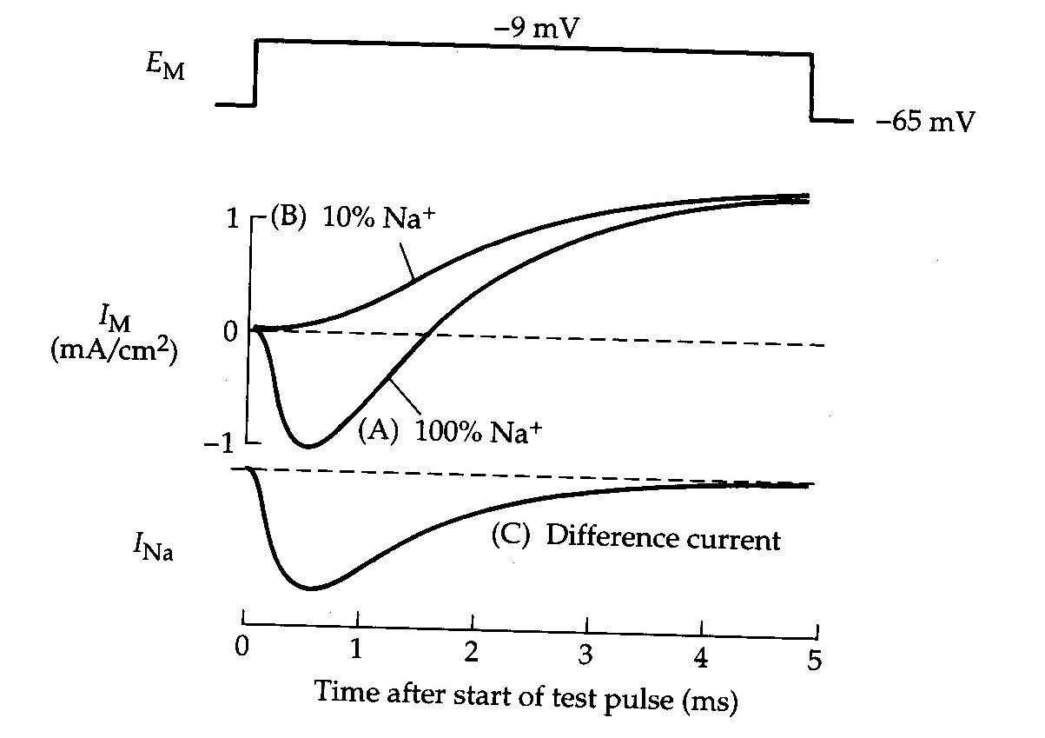
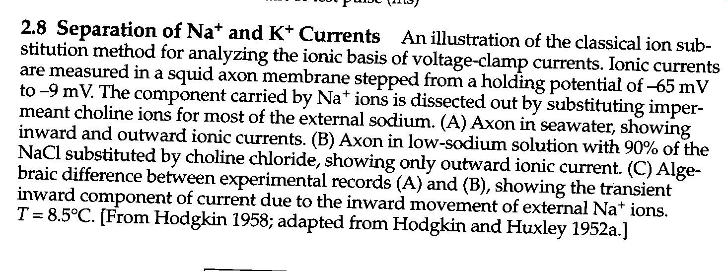
I_{K} = g_{K} (E_{m} – E_{K})
Nicholls “From Neuron to Brain”

Slide 5
I_{K}(t)= g_{K}(t).(E_{m}(t)– E_{K})
Nicholls “From Neuron to Brain”

Slide 6
I_{Na}=g_{Na}(E_{m} – E_{Na})
2 terms: Rising phase and falling phase
Nicholls “From Neuron to Brain”

Slide 7
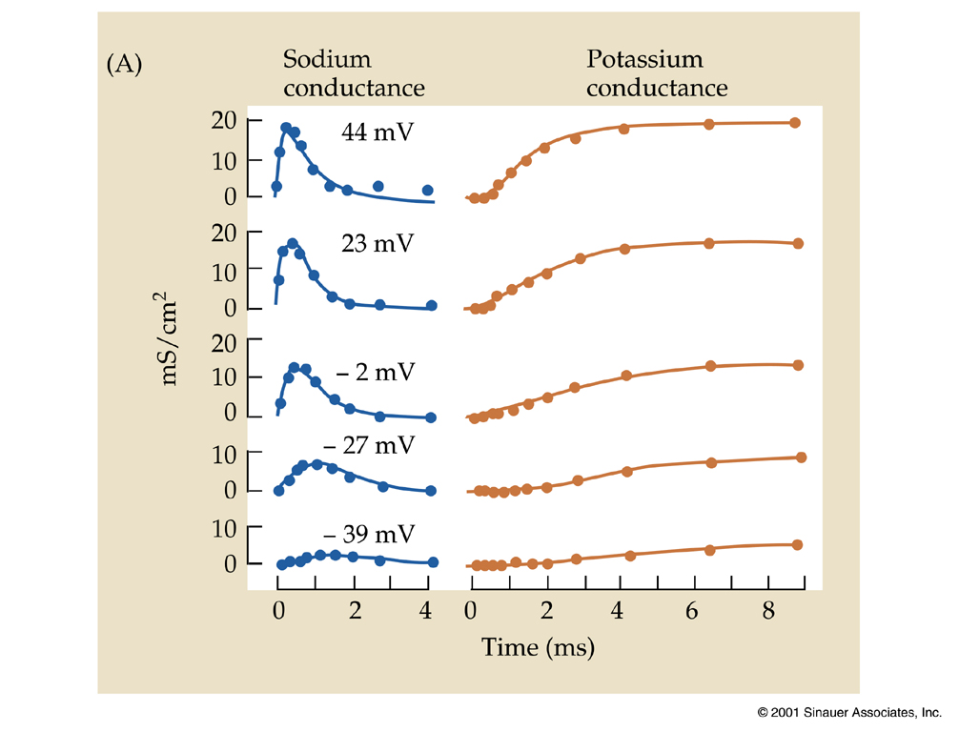

Slide 8
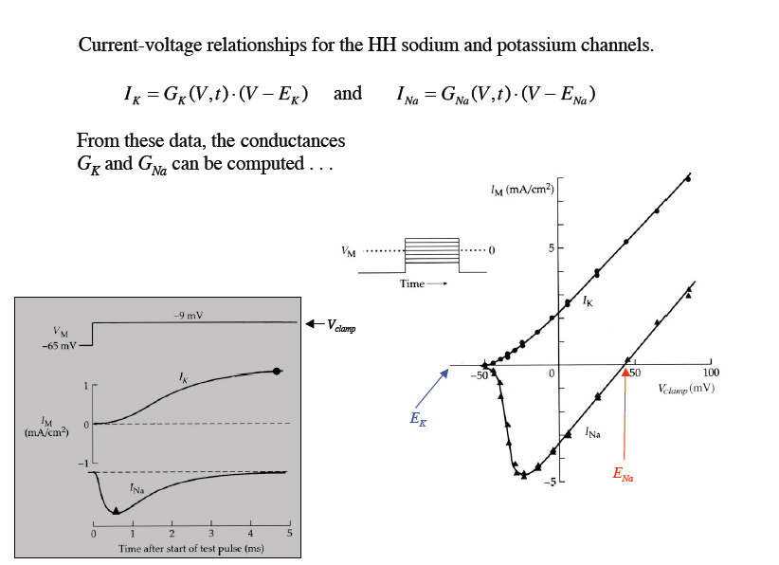
Steady State (Plateau) Value of I_{K}
Peak I_{Na}
Reversal Potential

Slide 9
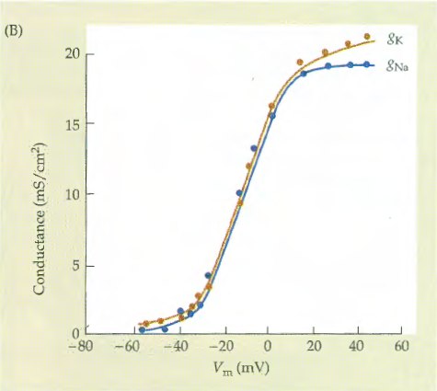
Nicholls: Neuron to Brain

Slide 10
C O
G/G_{max}
V_{1/2}

Slide 11
Fits to n⁴

Slide 12
Limiting value g_{K}
Fits to n⁴

Slide 13
K+ CHANNEL
Putting n⁴ and the voltage dependence together:
Let the probability of a gating particle being ON be n
ON
OFF
Each of 4 gating particles can be either ON or OFF
(Protein 3D Configurations)
Channel is open when all 4 Gating Particles are ON
Probability of the channel being OPEN is then n⁴

Slide 14
The Potassium Channel
The probability of a Gating Particle being ON:
The probability of the channel being open:
The conductance of a patch of membrane to K⁺ when all channels are open: (Constant obtained by experiments)
The conductance of a patch of membrane to K⁺ when the probability of a subunit being open is n:

Slide 15
I_{Na}=g_{Na}(E_{m} – E_{Na})
2 terms: Rising phase and falling phase
Nicholls “From Neuron to Brain”

Slide 16
Na⁺ CHANNEL
Na channel also has 4 sensors or gating particles
3 of these particles are involved in the CLOSED to OPEN transition m
1 of these particles is involved in INACTIVATION h
^{Na}
m
(Protein 3D Configurations)
h
Probability of C O gating particle being ON = m
Probability of Channel being OPEN = m³
Probability of INACTIVATION particle being OFF = h
Probability of Channel being CONDUCTING = m³h

Slide 17
The Sodium Channel (2)
The probability of a fast subunit being open:
The probability of a slow subunit being open:
The probability of the channel being open:
The conductance of a patch of membrane to Na⁺ when all channels are open: (Constant obtained by experiments)
The conductance of a patch of membrane to Na⁺ :

Slide 18
The Full Hodgkin-Huxley Model

Slide 19
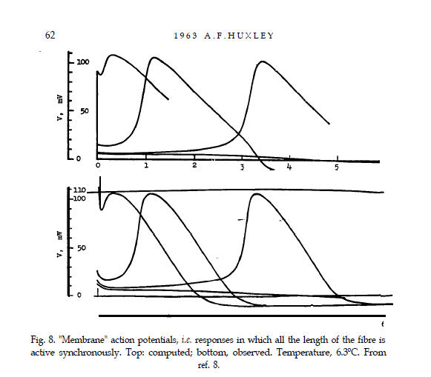

Slide 21
C O
Resting Potential

Slide 22
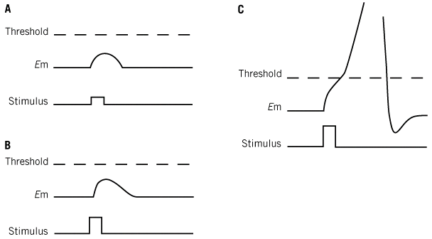
1
.
0
e
c
n
0
.
8
a
t
c
u
0
.
6
d
n
o
C
0
.
4
m
u
D
e
p
o
l
a
r
i
z
e
t
h
e
i
d
0
.
2
o
C
e
l
l
S
0
.
0
-
8
0
-
6
0
P
-
4
0
-
2
0
0
2
0
o
t
e
n
t
i
a
l
(
m
V
)
O
p
e
n
S
o
d
i
u
m
C
h
a
n
n
e
l
s

Slide 23
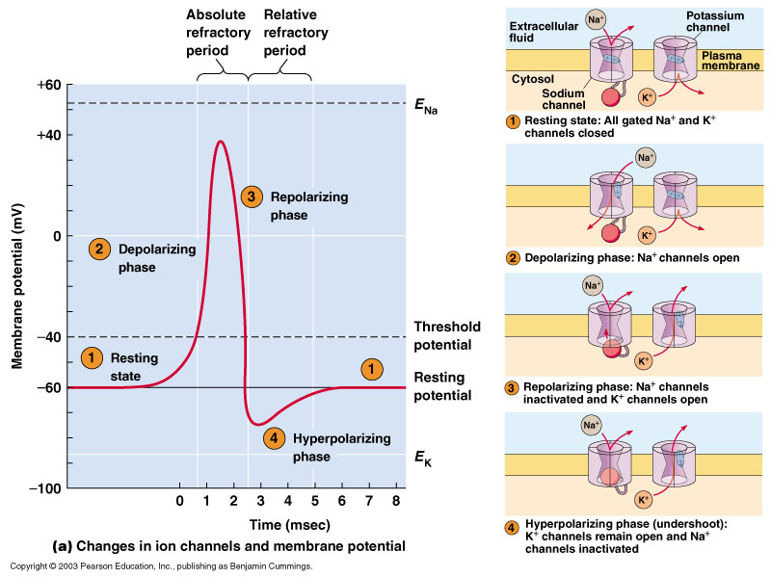

Slide 28
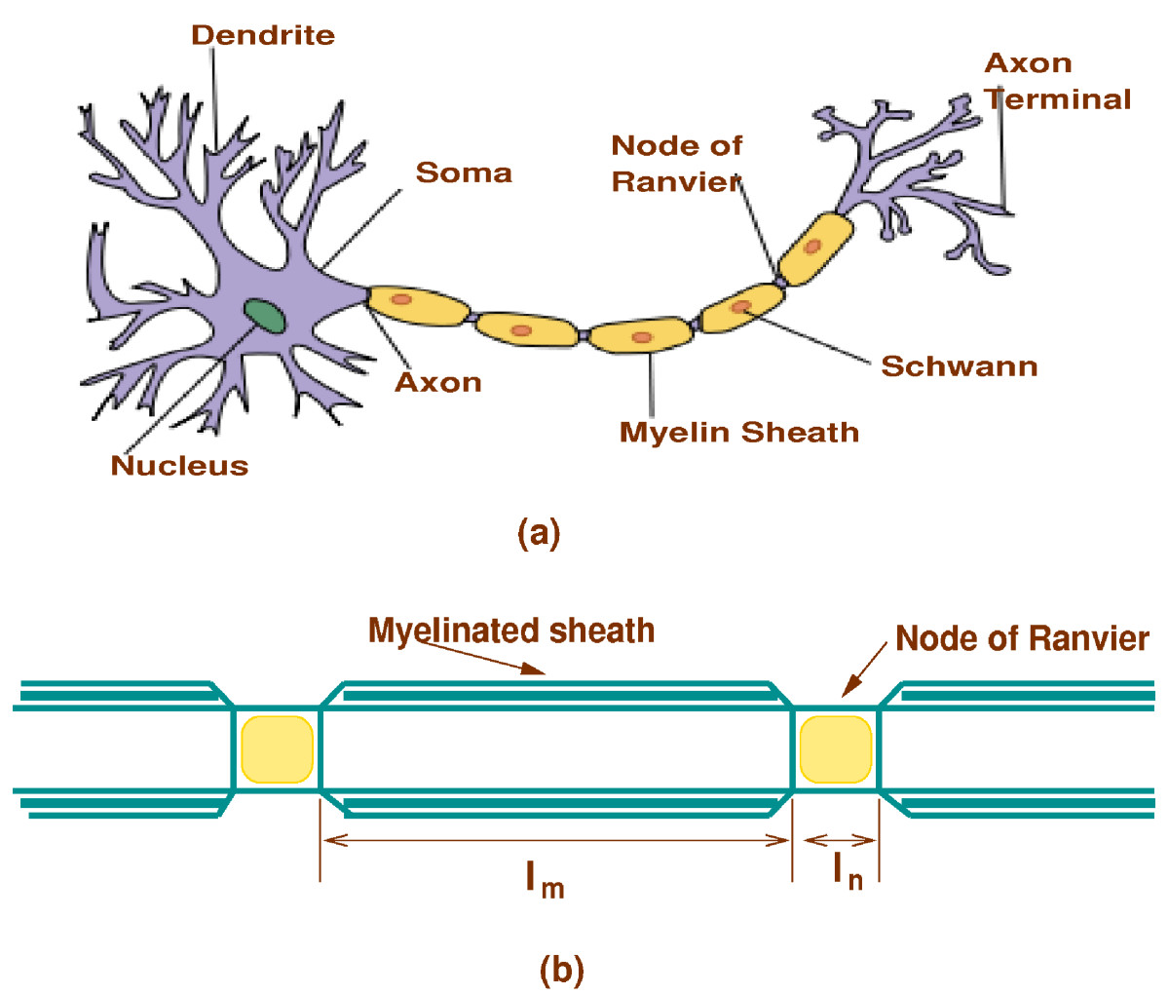

Slide 30
V(x) = V_{o} e^{-x/λ}
λ
$= √$r_{m}/r_{ax}

Slide 31
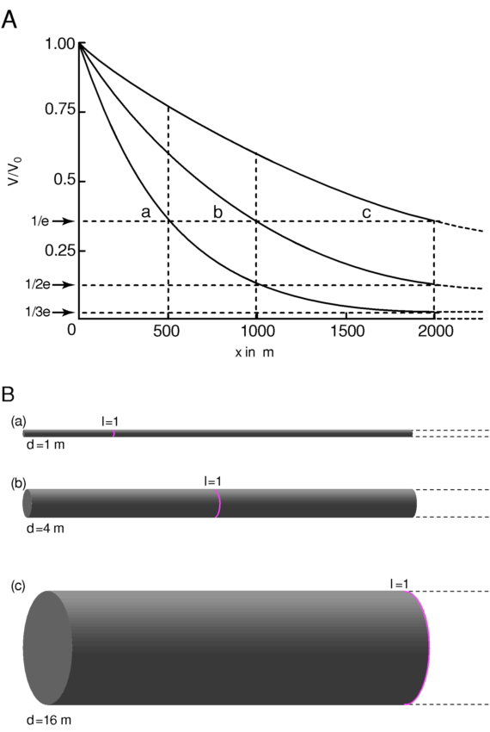
μ
μ

Slide 32
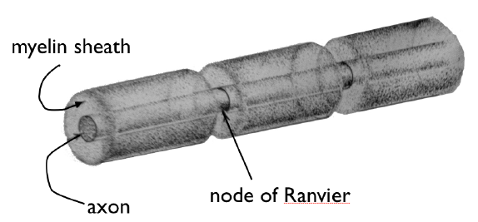
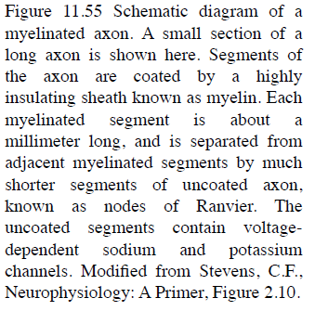
The capacitance of the surface of a myelinated axon is about 1000 times smaller than that of an unmyelinated neuron
the conductance of the membrane to Na⁺ and K⁺ is also decreased, which has the effect of increasing the space constant for passive spread
from Molecules of Life

Slide 33
Myelination
Passive propagation
Ri: Unaffected
Rm: Increased (series resistors)
Transient conductance is better:
Cm: decreased (series capacitors
Metabolism is lower:
No ion channels except at nodes
Amplification
Saltatory conduction

Slide 34
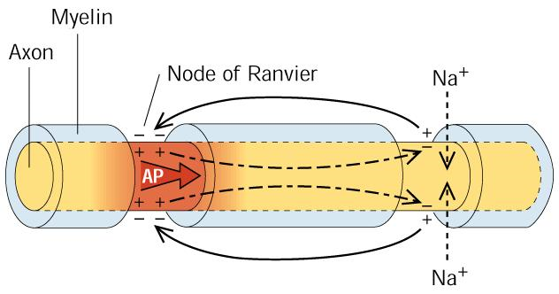

Slide 35
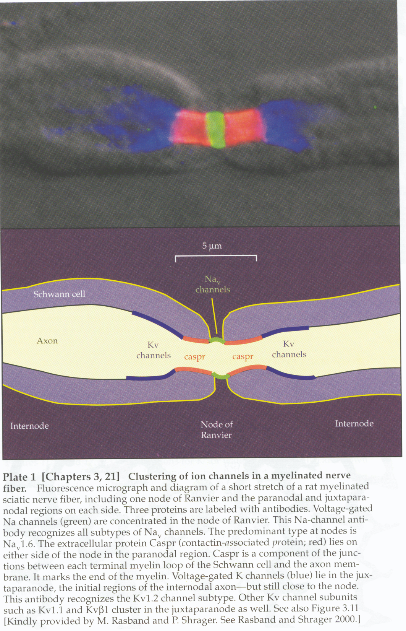
Nicholls “From Neuron to Brain”

